Slide 1
Q4 Data Review

Slide 2
Q4 Data Review
Based the report on the analysis completed by the Ministry which was presented to this group last summer
Ministry Data was compiled using Budget information
This was presented to the group during the last meeting
This

Slide 3
Q4 Data Review
Compare the actual costs to ministry funding provided and identify shortfall/surplus
Tying costs to service intensity which can then be weighted-discussion and ideas
Comparison of individual agency data to overall and list ideas that occur that can be applied to change practice

Slide 4
Q4 Data Review Calculations
Value | Data Used
Cost Per Bed | Financials.YearEndActual / Targets.DSBEDS#
Cost Per Individual | Financials.YearEndActual / Targets.YTDEstimate
Cost Per Day | Financials.YearEndActual / Targets.DSRDPERM# (or DSSDAYS#)
Cost Per Hour | Financials.YearEndActual / StaffingSheet.TotalHours

Slide 5
Q4 Data Review Calculations
Report | Use
Sector Analysis | This report shows the entire province by sector.
Company Based | Has much more detailed information allowing Agencies to better compare themselves.

Slide 6
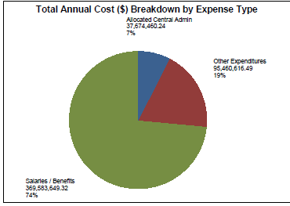
Q4 Data Review
Pie Charts

Slide 7
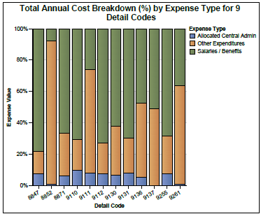
Q4 Data Review
Stacked Bar Charts

Slide 8
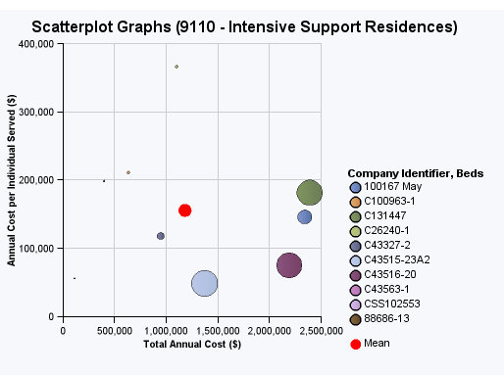
Q4 Data Review
Scatter Plots

Slide 9
Q4 Data Review Idea’s Are Welcome
We are continuing to review the data and clean further
We distributed a new version of the extraction tool in July which will allow agencies to extract data independently
We will continue to automate the process and revise what we measure and report…

Slide 10
Q4 Data Review
What’s Next
Compare the actual costs to ministry funding provided and identify shortfall/surplus
Idea’s for Tying costs to service intensity
Comparison of individual agency data to overall and list ideas that occur that can be applied to change practice

