Slide 1
Corporate Policy, Agency Governance and Open Government Division (CPAGOG)
Focus Group on Budget Flexibility
Transfer Payment Administrative Modernization (TPAM) Project &
Joint Funding Reform Forum
April 16, 2015

Slide 2
Agenda
Introductions
Background on TPAM Project and Open for Business Funding Reform
Budget Flexibility – Context and Progress
Discussion on Potential Opportunities
Next Steps

Slide 3
TPAM Project - Purpose
Transfer Payment Administrative Modernization (TPAM) Project was launched in spring 2013
TPAM is seeking an official mandate while continuing to undertake the foundational work necessary to move forward
Transfer Payment administrative modernization must work for wide variety of programs and recipient organizations
Transfer Payments represent > 80% of OPS spending
Programs deliver human services, business support and other benefits to Ontarians
Lots of complex problems as seen from an enterprise-wide perspective, but they are solvable
Enormous opportunity for positive change

Slide 4
TPAM Project - Principles
Reduce administrative burden
Consider impact of Ontario Public Service requirements on recipients’ ability to deliver services
Collect information once; use it many times
Simplify/clarify
Standardize common data and link information accurately
Leverage technology investments already made and optimize technology footprint
Value for money
Maximize and automate common rules-based business processes
Open, accountable stewardship
Know what you know
Make information easily available to support oversight and evidence-based decision-making

Slide 5
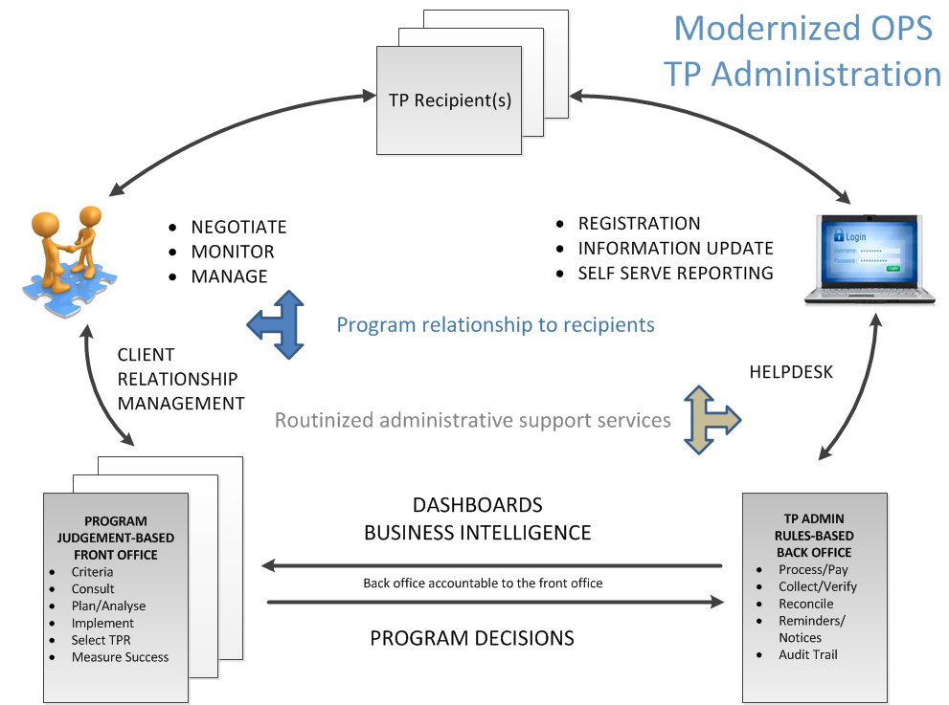

Slide 6
Focus on Administrative Processes
PROGRAMS/ MINISTRIES
Still responsible for:
defining program purpose and funding level
selecting appropriate recipients
managing the relationship with recipients to hold them accountable for delivering on commitments
In scope is “back office” rules-based administrative and business processes that enable transfer payment (TP) management.
Examples:
Transfer payment agreement administration
Funds flow/payments process
Financial reporting/reconciliation
Supporting technology
Out of scope is “front office” judgement-based decisions and relationship management by programs with transfer payment recipients.

Slide 7
Funding Reform - Context
In June 2012, the Ministry of Citizenship, Immigration and International Trade (MCIIT) and the Ontario Nonprofit Network (ONN) agreed to collaborate in seeking solutions to simplify and standardize the TP process (Funding Reform)
Through this Open For Business (OFB) process, both short- and longer-term reforms were identified
In August 2014, the Open for Business (OFB) Non-profit Sector Funding Reform work reached a point of transition. TPAM was identified as the primary vehicle for moving ahead with implementing the identified OFB reforms.
The Ministry of the Attorney General (MAG) Commercial Practices Group worked with TPAM to develop and release a streamlined Transfer Payment Agreement template in December 2014
This improvement aligns with a short-term Open For Business (OFB) Funding Reform priority:
Provide clear notification of changes to transfer payment terms and conditions
The new MAG TP Agreement template is posted internally in English and French
Ministries are encouraged to use it in the 2015/16 funding cycle and provide feedback to TPAM about potential improvements, limitations encountered, etc.

Slide 8
Budget Flexibility - Background
Another key OFB funding reform short-term priority is allowing for operating budget flexibility
Ministries must balance accountability for oversight, budget spending and compliance with regulations and policies while trying to achieve program objectives.
TP recipients have asked for appropriate budget flexibility as they work to achieve Agreement commitments
MCIIT/ONN made a joint presentation to Ontario Public Service (OPS) finance directors on November 14, 2013
The directors noted that, due to little corporate guidance on budget structure, each ministry has evolved practices based on their own programs/context
There may be opportunities for win-win changes

Slide 9
Budget Flexibility – Progress
TPAM interviewed seven ministry program areas and an ONN member in fall 2014, supported by Internal Audit. TPAM compared and assessed ministries’ procedures, tools and practices for overseeing TPR budget management, and gathered feedback on how to support greater budget flexibility within individual TP agreements
Three opportunity areas were identified and presented to the Financial Controllership Committee (FCC) and to the Financial Business Management Council (FBMC):
Budget flexibility should be aligned with risk assessment results
Use thresholds to facilitate flexibility (5% - 15%) within Agreements
Simplify budget templates, use fewer cost categories
FBMC and FCC supported further engagement with ONN regarding these opportunities, with the understanding that they don’t have the mandate to endorse implementation
TPAM updated JFRF at their January 29, 2015 meeting; TPAM and ONN collaborated to organize today’s Focus Group on budget flexibility

Slide 10
Assessed Risk and Flexibility
Opportunity 1: Budget flexibility should be aligned with risk assessment results
There is support for a proportional risk assessment approach, that is, the degree of oversight/control and of flexibility should be based on identified and assessed risks
Types of risks that could affect flexibility include the nature of the program, vulnerability of the end clients, the Agreement value ($), the capacity of the TPR to meet the program requirements, and whether the TPR is new or has worked with the program area/OPS previously
Questions
What objective criteria would need to be met for a recipient to be assessed as ‘low risk’ and eligible for ‘minimum oversight’ ?
What would ‘enhanced oversight’ look like?
What could trigger the need for more oversight?

Slide 11
Flexibility to Move Funds
Opportunity 2: Use thresholds to facilitate flexibility (5% - 15%)
Fixed amount or percentage of total budget: recipients can move funds across cost categories without ministry approval
OPS would need to provide guidance on:
Eligible funds that can be reallocated
Ineligible or restricted funds, for e.g., Operating expenses cannot be reallocated to Capital
Approval process if threshold/ percentage is exceeded
Questions
For the thresholds that allow moving funds within/between cost categories without ministry approval, does the 5%-15% range make sense?
Should a maximum dollar amount be established?
How could this be determined?

Slide 12
Simplifying Budget templates
Opportunity 3: Simplify budget templates, use fewer cost categories
OPS must balance program needs with desire to streamline
Programs need to clarify eligible expenses within budget categories, for e.g.:
Program A uses a 4-category template: Training Incentives; Training Supports; Field Supports; Operating Funds (salaries, rent, marketing, and other direct operating expenditures)
Other programs organize expenses in different categories, for e.g.:
Program B: Salaries & Benefits; Other Operating Expenditures (Rent, Utilities, Office Supplies, Telecommunications, Office Equipment, Advertising, Promotional Goods, Workshops/Meetings/Events, Volunteer Expenses, Client Expenses, Audit, Bookkeeping, Legal, Translation, Insurance, etc.)
Program C: Staffing; Benefits; Project Expenses; Administration/Other Expenses
Program D: Salaries & Benefits; Transportation & Communication; Supplies & Equipment; Services (Rent/Mortgage Interest, Mortgage Principal, Utilities, Staff Training, Advertising, Services related to Repairs and Maintenance, Contracted-out Services, Purchased Client Services, Insurance, Other)
Questions
Are there budget templates you think would work better, and why?
What kinds of cost categories should be included in a standardized budget template?

Slide 13
Overall Budget Flexibility
Summary Questions
What would be the potential impact on your non-profit organization, if any or all of these approaches were implemented?
If one or more of these opportunity approaches are implemented, what are most important points that should be clarified with TP recipients (to manage expectations)?
Are there funding models that work better than others, e.g., cost per unit, claims-based? What are the benefits and challenges of these?
Besides these three opportunities, can you suggest any other approaches or ideas to improve budget flexibility?

Slide 14
Next Steps
Facilitate an additional Focus Group session, if necessary
Report at next JFRF meeting (end of April)
TPAM to present key findings to OPS finance directors spring 2015
TPAM to incorporate key findings into ongoing work on standardizing/ simplifying budget and reporting processes
Questions?
Thank you for your time and expertise

Slide 15
Contact Information
Rose Langhout, Executive Lead, TPAM – rose.langhout@ontario.ca or 416-212-6531
Rebecca McKenzie, Manager, Special Projects, TPAM –
Rebecca.McKenzie@ontario.ca or 416-314-5908

