Slide 1
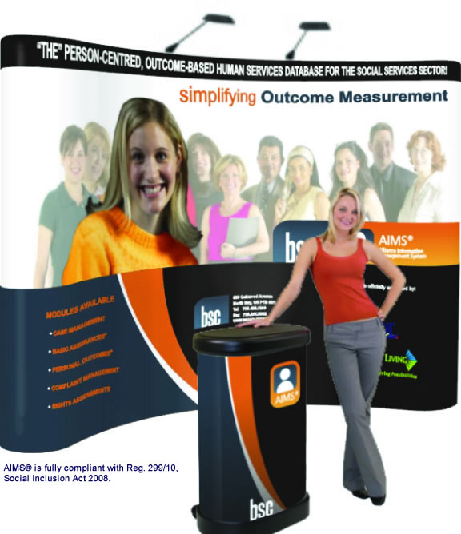
Developmental Services Finance Group
Software Solutions for the Social Services Sector
705-494-7594

Slide 2
How to Benefit the most from this slide show
For an overall understanding of the general content, viewing the slideshow only will be adequate.
To gain more understanding of each slide, please refer to the slide show notes attached to each slide in this presentation. These are not visible in slide show mode.
The “Important Links” page in the back of this presentation will allow you to open up pdf’s for modules that are referenced in this slideshow. Clicking on them will open them up outside of PowerPoint to view.

Slide 3
Financial Reporting Using a Software Approach
Financial reporting is critical as a basis for financial analysis and budgeting.
CFOs must make fast and accurate reporting a priority
Why is automating the process beneficial.
Notes:
Financial reporting is critical as a basis for financial analysis and budgeting. Externally, it's essential to remain in compliance with provincial reporting requirements.
With these considerations in mind, it behooves CFOs to make fast and accurate reporting a priority, and many look to financial reporting software to help achieve these goals.
The purpose of this presentation is to learn the basics of financial reporting and find out why automating the process could be beneficial.

Slide 4
Benefits of automating the financial reporting process
Software that automates financial and data reporting can simplify financial and data analytics.
Increases regulatory compliance and reduce the amount of labor.
Latest person centred systems are now being designed for nontechnical business users.
Notes:
Software that automates financial and data reporting can enable users to perform in-depth what-if analyses, speed up the process and simplify financial and data analytics.
It can also increase regulatory compliance and reduce the amount of labor involved in generating reports.
While financial reporting and analysis software of the past often required heavy IT support, some of the latest person centred systems are now being designed for nontechnical business users.
This is achieved through legacy based systems or cloud based solutions such as AIMS.

Slide 5
Benefits of automating the financial reporting process
Enterprise Resource Planning (ERP) system or with the help of specialized tools.
More specialized products such as what will demonstrated today can often offer deeper and more customized functionality than reporting modules within an ERP.
Notes:
Automated data reporting can be achieved either through an Enterprise Resource Planning (ERP) system or with the help of specialized tools.
Although niche software requires implementation time and may not integrate well with other systems, more specialized products such as what will demonstrated today can often offer deeper and more customized functionality than reporting modules within an ERP.

Slide 6
Pros and cons of using Excel for Data reporting
Current reliance on Excel.
It is often found arduous and can lead to poor financial visibility.
Is considered outdated or cumbersome technology.
Notes:
As with other financial management functions, a large percentage of organizations rely on Excel for data reporting -- up to 72%, according to a study conducted by Dynamic Research.
While it's possible to create reports using Excel and export critical data to other systems, users often say using Microsoft Excel for financial reporting is arduous and can lead to poor financial visibility. Some organizations have even reported missing statutory filing deadlines due to outdated or cumbersome technology.

Slide 7
Pros and cons of using Excel for Data reporting
Financial reporting software can help to streamline the reporting process and reduce errors.
Some financial reporting systems are too complex for an organization's needs with users often returning to more traditional methods of data collection and aggregation.
Notes:
Experts say implementing financial reporting software can help to streamline the reporting process and reduce errors. Many offerings feature integration with Excel, which is a selling point for businesses that don't want to abandon spreadsheets entirely.
On the other hand, some financial reporting systems are too complex for an organization's needs with users often returning to more traditional methods of data collection and aggregation because the new software solution chosen was too difficult for the average business user.

Slide 8
Pros and cons of using an ERP for Data Reporting
Try to avoid the implementation and integration hurdles that could arise from adopting specialized software
Should I stay or should I go now.
Perform needs analysis to take into account a system's ability to adapt to changing regulatory requirements.
Notes:
Organizations that choose to perform financial reporting within an ERP or financial management system often do so to avoid the implementation and integration hurdles that could arise from adopting specialized software
One important decision facing CFOs is whether to stick with on-premises ERP or implement new software specifically designed to aggregate organizational data. Through highly customized interfaces, this software can be customized to cater to a company's unique accounting needs.
Before making a choice, it is wise for CFOs to perform a needs analysis and take into account a system's ability to adapt to changing regulatory requirements.

Slide 9
Some Motivating Factors for Change
QAM
New TP (TP) Agencies Reporting Standards.
Accreditation (CARF, CQL, FOCUS)
Organizational Accountability
Notes:
Quality Assurance Measures regarding Ontario Regulation 299/10 made under the Service and Supports to Promote the Social Inclusion of Persons with a Developmental Disability Act, 2008
The new regulation talks about the rules that agencies and Developmental Services Ontario (called Application Entities in the Act) must follow. Quality assurance measures are rules that help agencies and Developmental Services Ontario provide high quality services and supports and meet set standards.
New TP (TP) Agencies Reporting Standards.
The new regulation talks about the rules that agencies and Developmental Services Ontario (called Application Entities in the Act) must follow. Quality assurance measures are rules that help agencies and Developmental Services Ontario provide high quality services and supports and meet set standards.
Accreditation (CARF, CQL, FOCUS)
Fiscal savings: Financial institutions, including rating agencies, investment bankers, and insurance carriers, look for accreditation as a sign of financial stability.
A marketing advantage: Accreditation gives organizations a competitive edge in the eyes of prospective residents, families, caregivers, and others.
Risk management: Accreditation can help to reduce an organization's exposure to risk in areas such as human resources, healthcare, governance, and finance.
Access to an international network: Accreditation gives an organization the opportunity to collaborate, form partnerships, and share ideas with an international network of other providers that have earned accreditation.
Organizational Accountability
Wish to be accountable for intrinsic reasons to the people they support, parents, stakeholders, Ministry and Board.
Require a system that allows them to compare and contrast the actual quality and quantity of services and supports provided to the perceived quality and quantity of services and supports received.

Slide 10
Translating Efforts to Outcomes & Improvements
Data overflow issues
Numbers without meaning.
Data remains relevant
Notes:
Often a shortage of data isn’t the problem, it’s often an overflow of information that can’t clearly reflect the results your program has produced.
You’re tracking your numbers, but they cease to have meaning when they aren’t tied to the outcomes your efforts are producing.
It is especially important that the data you collect stays relevant over a long period of time, as continuous improvements are always part of a non profits goal.

Slide 11
How can AIMS help?
Was designed for agencies seeking accreditation or simply looking for internal accountability
Fully QAMS compliant
Person centred and outcome based system

Slide 12
How can AIMS help?
Has strong partnerships with agencies to continually improve products and services
Integrated tools to assist with new TP agencies reporting requirements
Features and Benefits

Slide 13
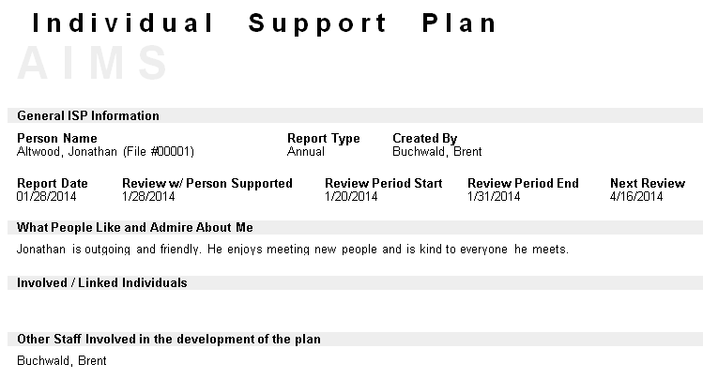
Individual Support Plan
Notes:
Agencies must have a support plan for every person who uses their services and supports.
Must be made with the person who has a developmental disability or someone acting on their behalf.
Must be checked and updated each year.
This tool assists agencies who wish to focus on individualized budgets rather than block funding.
This provides the ability to know what services and resources the agency has committed to each individual and then the ability to track and compare what was provided.

Slide 14
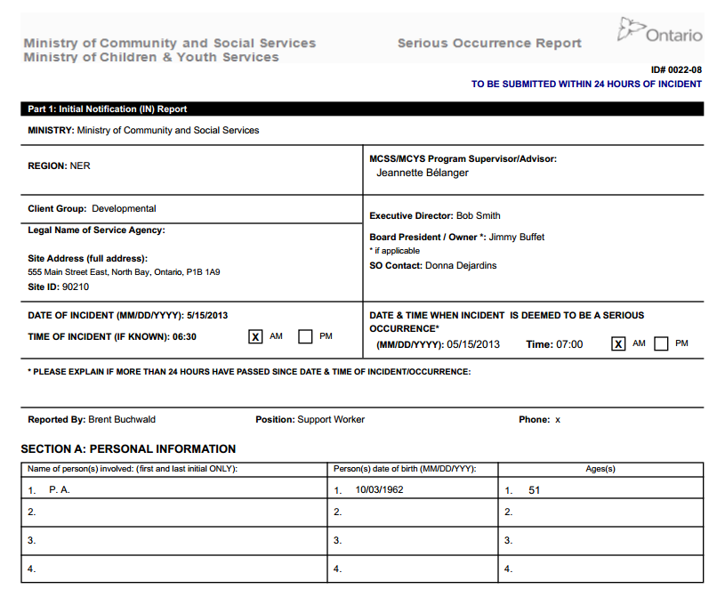
Serious Occurrences
Notes:
Serious/enhanced serious occurrence reporting (SOR/ESOR) is one of many tools providing the ministries and the service provider with an effective means of monitoring the appropriateness and quality of service delivery.
Monitoring includes an ongoing review of service provider practices, procedures, and training needs.

Slide 15
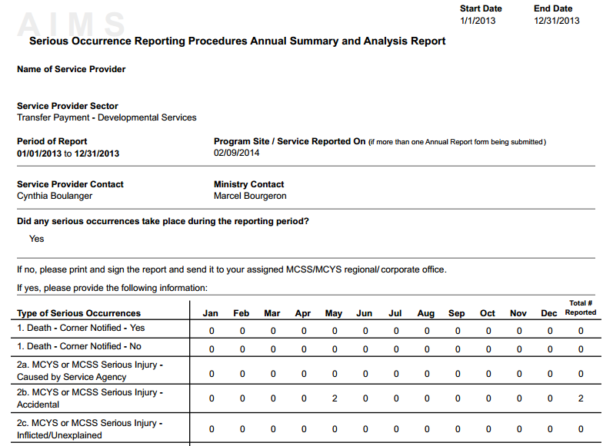
Serious Occurrences Annual Summary and Analysis Report
Notes:
Information about serious occurrences is available to regional program supervisors, program advisers, licensing and compliance staff and corporate offices of the Ministry of Community and Social Services (MCSS) and the Ministry of Children and Youth Services (MCSS).

Slide 16
Preventing and reporting abuse
Policies and procedures that keep everyone safe.
Complaints/Allegations
Incident Reporting
Rights Assessment
Advanced Record Search
Notes:
Agencies need to have policies and procedures that keep everyone safe. These rules explain that no type of abuse or neglect is allowed.

Slide 17
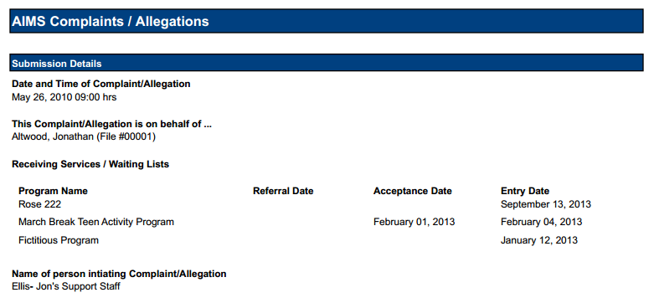
Complaints/Allegations

Slide 18
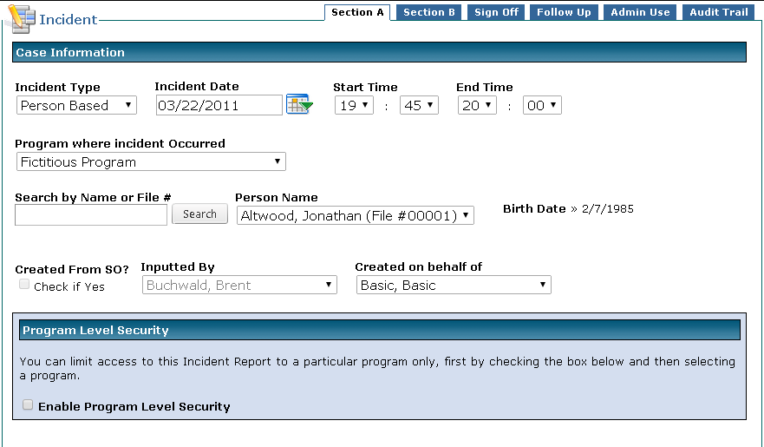
Incident Reporting

Slide 19
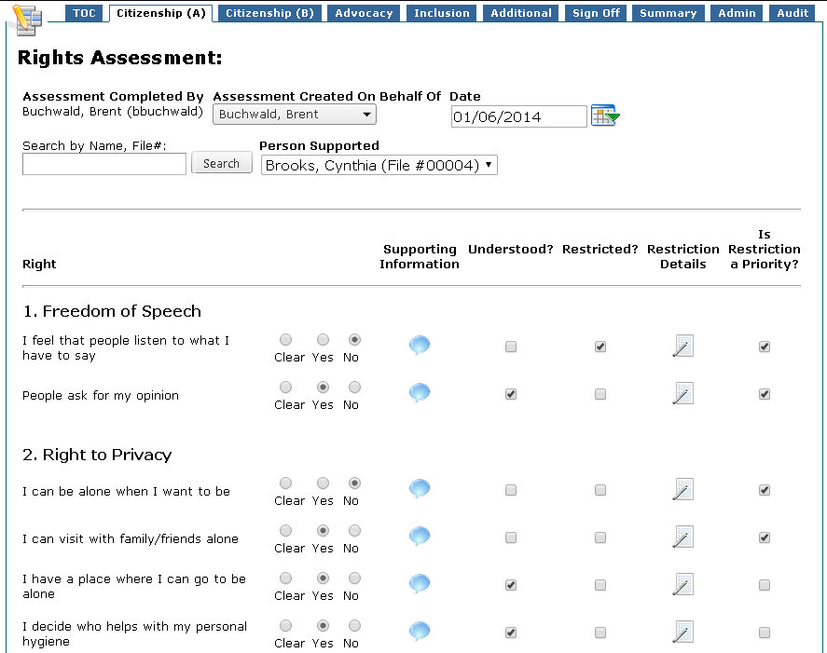
Rights Assessment

Slide 20
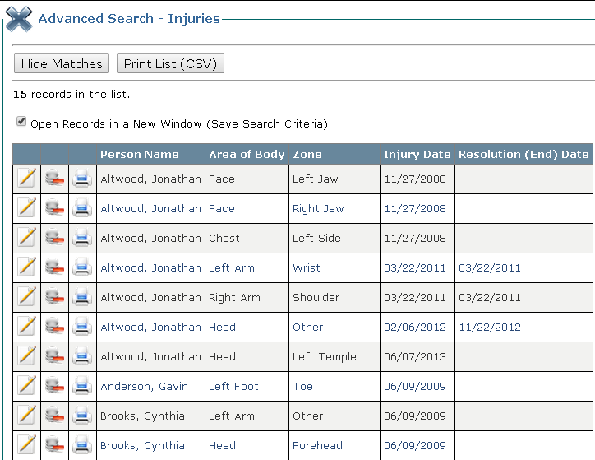
AIMS Advanced Record Search

Slide 21
Confidentiality and privacy
Rules about confidentiality.
Must follow Ontario’s privacy laws.
Consents Module
My File Access
Rights Assessment
Advanced Record Search
Notes:
Agencies must have rules about confidentiality and privacy that protect the personal information of people they support.
Must follow Ontario’s privacy laws and any agreement the agency has with the government.

Slide 22
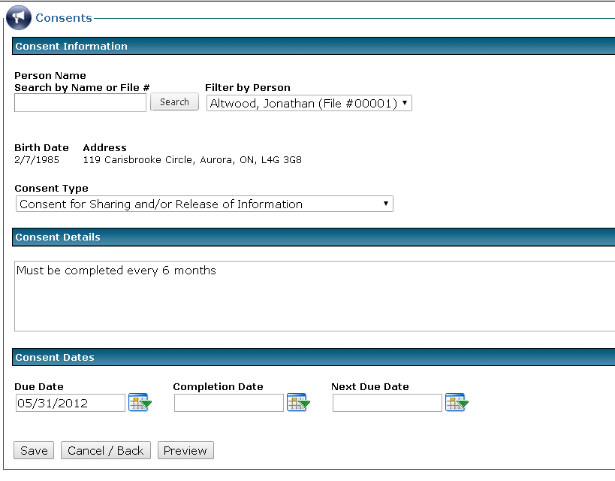
AIMS Consents

Slide 23
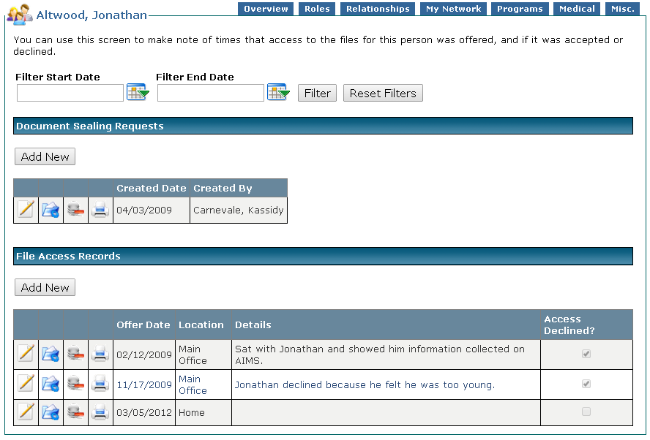
AIMS File Access

Slide 24
Health promotion, medical services and medication
Monitoring the health concerns of people
Must keep records of medical services provided
Clinical Visit Documentation
Medication Management
Notes:
Agencies need to have rules about monitoring the health concerns of people they support that are included in their support plans.
Must keep records of medical services provided to the people they support and rules about how they handle, store and use medication.

Slide 25
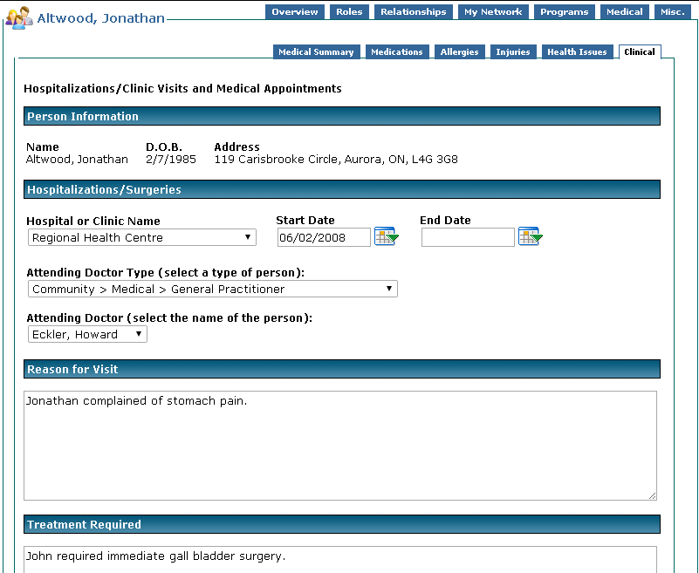
AIMS Clinical Visit

Slide 26
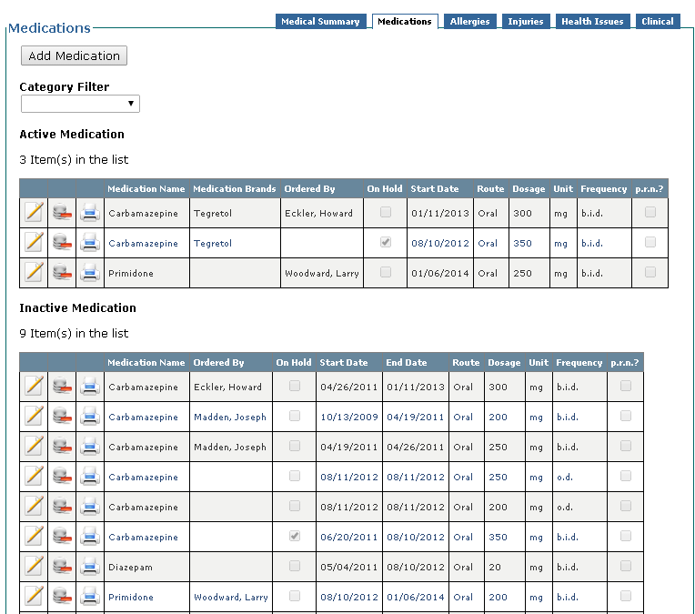
AIMS Medication Management

Slide 27
Health promotion, medical services and medication
Staff and volunteers must be trained on first aid and CPR.
HR / Staff Training
Notes:
Staff and volunteers working directly with people who have a developmental disability must be trained on first aid and CPR.

Slide 28
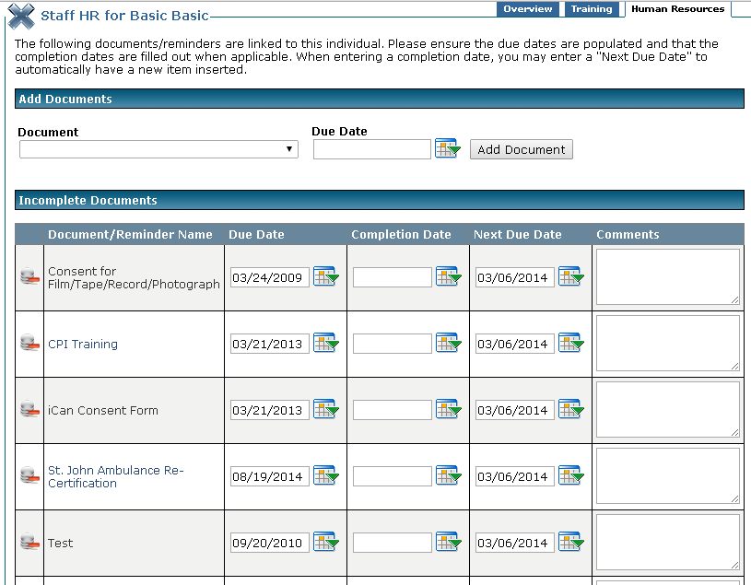
AIMS Staff Training

Slide 29
Safety in agency owned or operated places
Agencies have to keep equipment in good working order.
Agency Documentation
Notes:
Agencies have to keep equipment in good working order. In order to show compliance, there must be systems in place to track when checks are being made and equipment is being serviced.

Slide 30
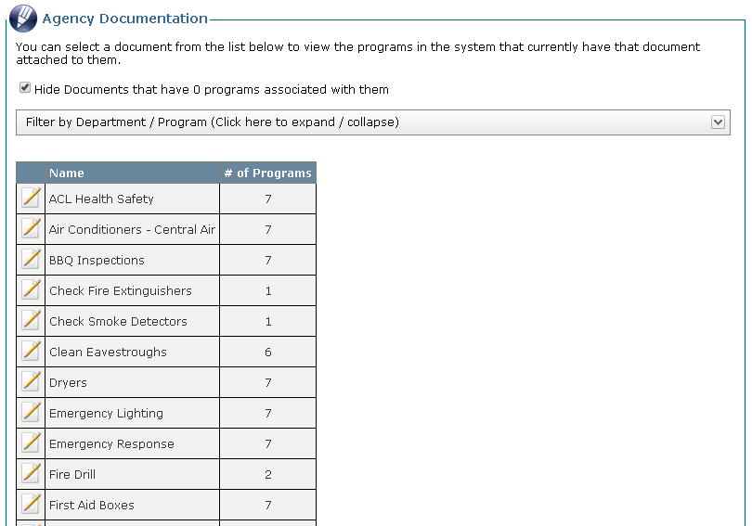
AIMS Agency Documentation

Slide 31
Helping with day-to-day finances
Assistance with money
Decision Making
Personal Finance
Notes:
Sometimes a person with a developmental disability needs help to manage money. Agencies must have rules to explain how they can help a person to manage money, if the person needs or asks for help. There must also be systems to track how this money is being spent and a clear and distinct audit trail listing who is responsible for administering monies on behalf of a person.

Slide 32
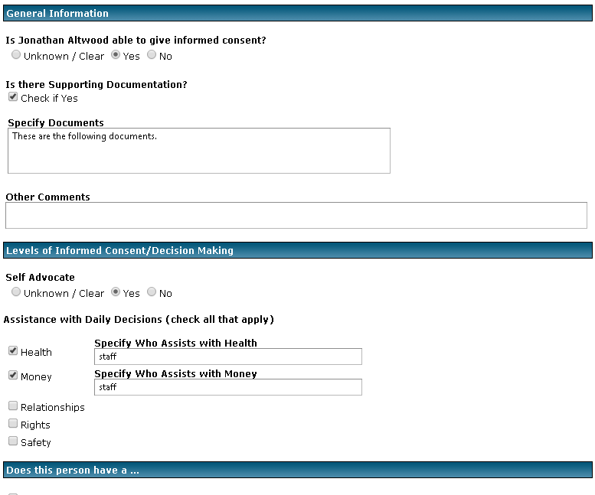
AIMS Decision Making
AIMS Decision Making

Slide 33
Helping with day-to-day finances
Agencies have to keep a separate record for each person who gets help.
Personal Financial
Program Financial
Personal Inventory
Program Inventory
Notes:
Agencies have to keep a separate record for each person who gets help. That record also has to be checked each year by a third party. A third party is someone other than the person at the agency who helps with finances.

Slide 34
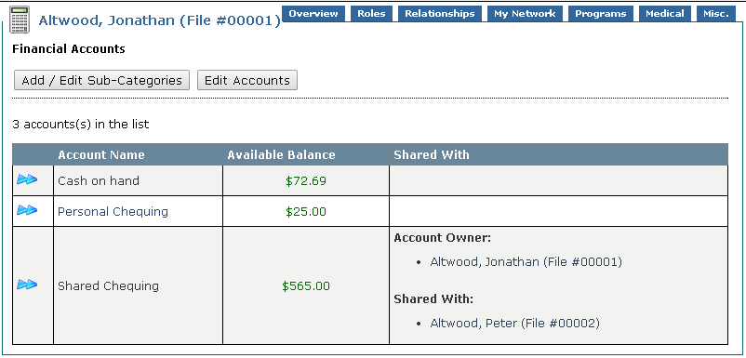
AIMS Personal Financial

Slide 35
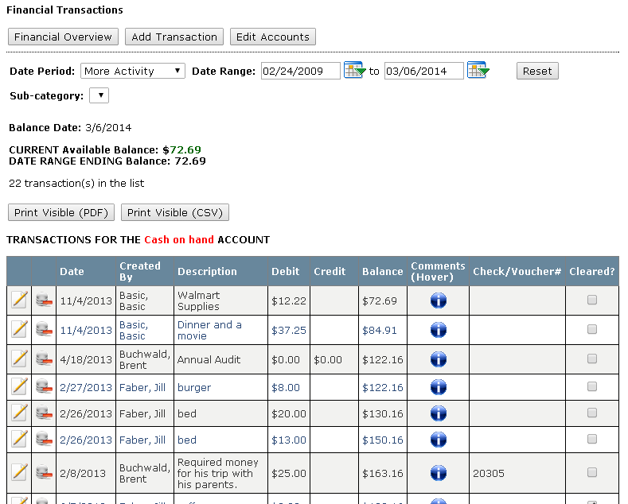
AIMS Personal Financial

Slide 36
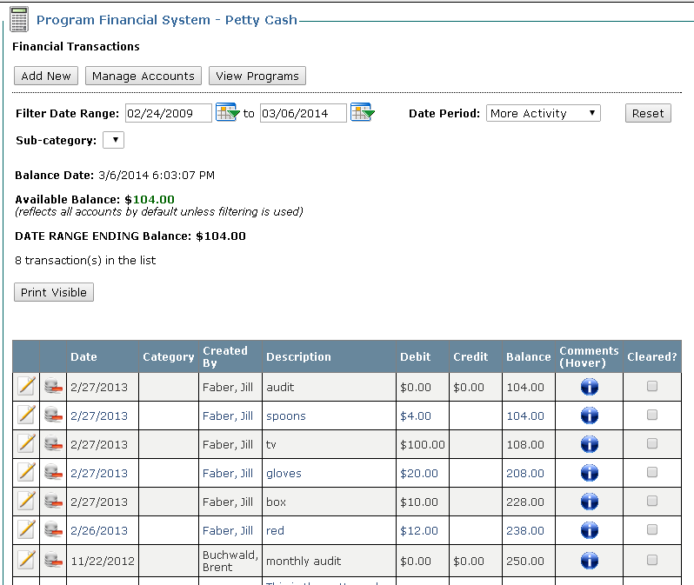
AIMS Program Financial

Slide 37
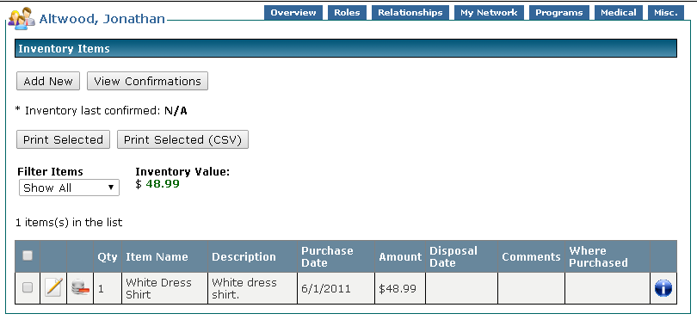
AIMS Personal Inventory

Slide 38
Service records
Agencies must keep records on file for all people receiving services
Destroy Dates
Notes:
Agencies must keep records on file for all people receiving services and supports for seven years after the person stops receiving services and supports from the agency. Agencies must also have rules about keeping and storing all records or files.

Slide 39
Data Elements & TLS (Typical Level of Service)
Data elements are integral part of the Transfer Payment Budget Package.
Ministry sets and approves the expected financial and service levels through negotiations with service providers.
Notes:
Data elements are an integral part of the Transfer Payment Budget Package as they define the results to be achieved by each service provider.
As part of the service contract/approval process, the ministry sets and approves the expected financial and service levels through negotiations with service providers. Service providers report the actual results of each data element quarterly and/or at year-end. Ministry staff monitor and evaluate the results to assess whether transfer payments are supporting the objective(s) of the program(s).

Slide 40
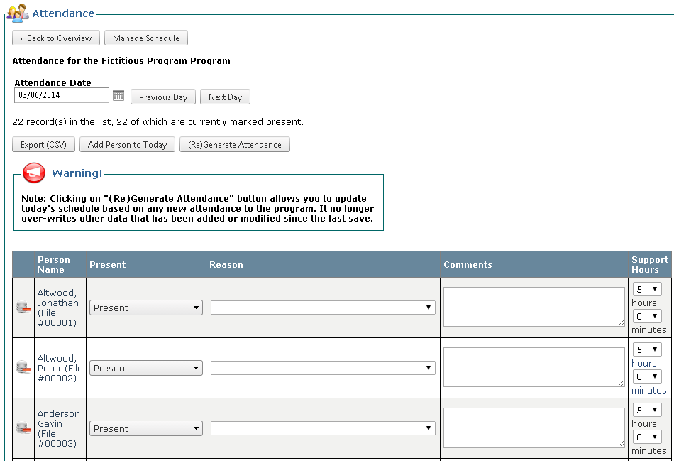
Attendance
The Attendance module in AIMS is used to create a record of support days/hours for reporting purposes.
Notes:
The Attendance module in AIMS is used to create a record of support days/hours for reporting purposes. When an Individual is accepted into a Program, a Schedule is created based on the days the Individual will typically receive support (If used by the program, if schedule manager is not used, then only enter the TLS to have a suggested support level recorded). When an Individual’s support needs change, their Schedule can be modified

Slide 41
Attendance – Why Helpful
Assists with the disconnect that can occur sometimes between those who input data and those who collect data.
Now have ability to get a better understanding of how their resources are being impacted.
Notes:
Assists with the disconnect that can occur sometimes between support staff who input the data and finance team who are ultimately responsible for interpreting the data but are not always involved in its collection or verification that it is done accurately.
By having a tool that reports services committed versus actual services received, agencies have the ability to get a better understanding of how their resources are being impacted. For instance, if a person receives more services than were scheduled to be committed, this affects overall agency resources.

Slide 42
Attendance – Why Helpful
How do you know what is driving a budget surplus or deficit?
Notes:
Helps in determining what is driving a surplus or deficit by getting a better understanding of the levels of service provided.

Slide 43
Types of Attendance Reports
TLS overview
TLS Person by Program
TLS Program by Person
TLS Roll up
Notes:
TLS overview
Identifies by program(s) chosen, number of individuals in each TLS category. Individuals that do not clearly fit into a category are included in TLS category Z. Note duplication may result if multiple programs are chosen and individuals are supported in more than one program.
TLS Person by Program
Identifies each individual in the program(s) chosen; the program the individual is in; the support days for the individual for the period chosen, calculated from the attendance module; the TLS category that the individual is in, calculated based on the attendance module, for the period of time chosen and the TLS category that was expected based on the attendance program scheduler. Note duplication may result if multiple programs are chosen and individuals are supported in more than one program.
TLS Program by Person
identifies the same information as TLS Person by Program but sorted by program rather than by person.
TLS Roll up:
Identifies number of individuals in each TLS category by combining the attendance of programs chosen in order to report individuals only once.

Slide 44
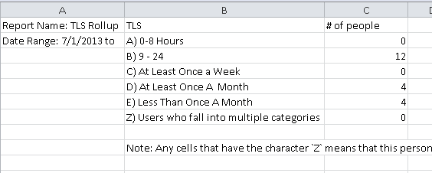
Data Elements by Report
Data Elements #1 – (individuals served) – TLS Rollup
Year to date – cumulative
Notes:
Data Elements #1 – (individuals served) – TLS Rollup
Year to date – cumulative

Slide 45
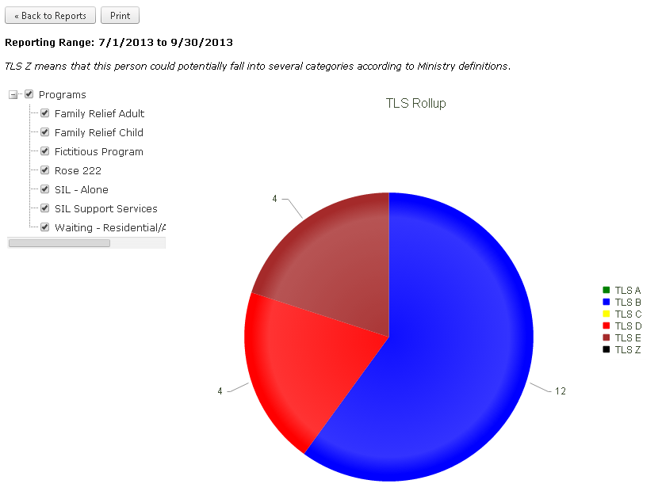
Data Elements by Report
Data Elements #1 – (individuals served) – TLS Rollup
Year to date – cumulative
Notes:
Data Elements #1 – (individuals served) – TLS Rollup
Year to date – cumulative

Slide 46
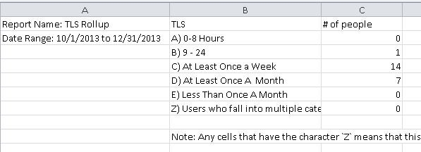
Data Elements by Report
Data Elements #3 – (individuals served by level of support) – TLS Rollup
Snapshot – point in time
Notes:
Data Elements #3 – (individuals served by level of support) – TLS Rollup
Snapshot – point in time

Slide 47
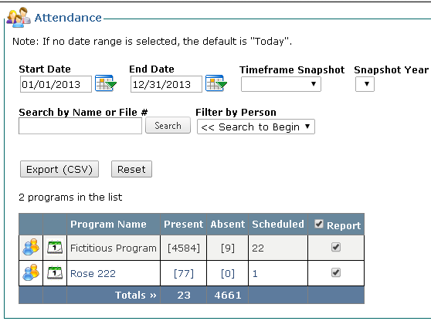
Data Elements by Report
Data Elements #4 – (support days) – Attendance Overview - People
Year to date
Notes:
Data Elements #4 – (support days) – Attendance Overview - People
Year to date

Slide 48
Data Elements by Report
Data Elements #6 (Resident Days) - Attendance Overview - Dates
Year to date – cumulative
a) Permanent Resident DSRDPERM#
Notes:
Data Elements #6 (Resident Days) - Attendance Overview - Dates
Year to date – cumulative
a) Permanent Resident DSRDPERM#
This total box will give the totals for each group living program resident days. There is also a variance report to show the number of days the person was away from their residence.

Slide 49
Data Elements by Report
Data Elements #6 (Resident Days) - Attendance Overview - Dates
Year to date – cumulative
b) Days on hold DSRDHOLD# - Reports - Leaves
Notes:
Data Elements #6 (Resident Days) - Attendance Overview - Dates
Year to date – cumulative
b) Days on hold DSRDHOLD# - Reports - Leaves
The leaves file will show the dates and times of leaves for people in group living. In this report it can be determined if the times were over a four day period and if to report on.

Slide 50
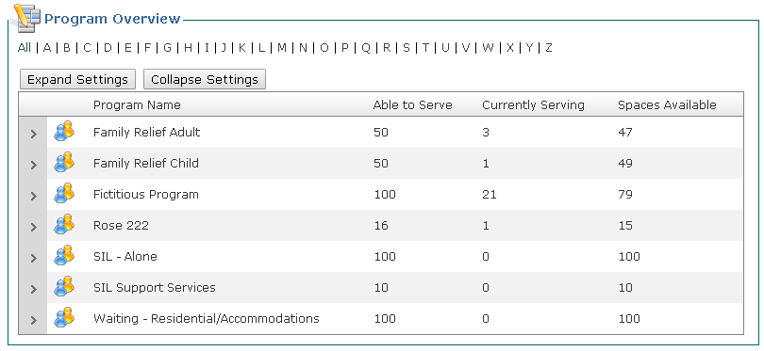
Data Elements by Report
Data Elements #7 (Beds) – Program Overview
Notes:
Data Elements #7 (Beds) – Program Overview
Allows you to view all programs across organizations specifically detailing how many people you are able to support in each program, how many people are currently receiving services and how many spaces are available to service new intakes.
Can be used to track internal waiting lists as well such as residential services or summer programs, etc.

Slide 51
Data Elements by Report
Data Elements #8 (Bed Days Available) – Attendance Overview
Notes:
Data Elements #8 (Bed Days Available) – Attendance Overview
Export to csv this will show the total bed days with absentees as well. Can calculate a total from this document for YTD bed days available for group living.

Slide 52
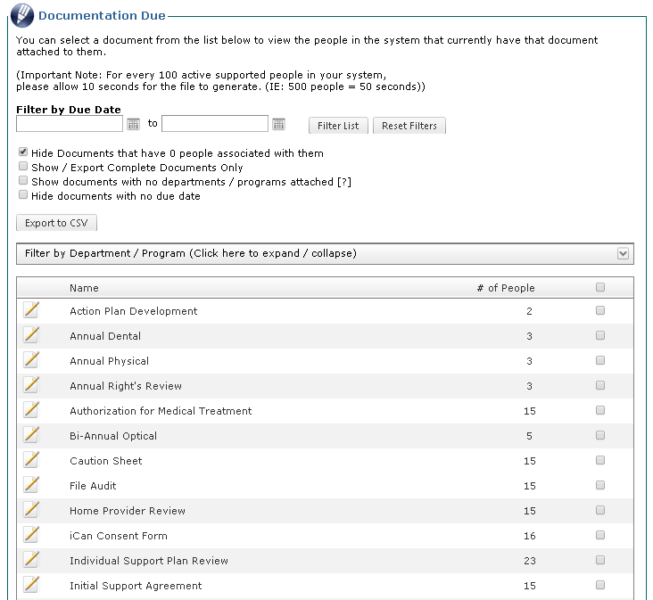
Data Elements by Report
Data Elements #20 (ISP) – Documentation Due
Notes:
Data Elements #20 (ISP) – Documentation Due
The Documentation Due module will allow you to track every important date in a person’s life such as when is an item due, when it was completed and what its next due date is.
Quickly run reports to show all completed items for each program or for each person, list items that are pending completion or more importantly, which items that over due, not in compliance, and need your immediate attention.

Slide 53
Summarizing Software Benefits
Assists you to meet Ministry compliance requirements
Helps monitor program and service effectiveness
Create in-depth reports
Understand surplus/deficits
Notes:
Having substantial reporting tools assists in meeting current compliance requirements. AIMS is fully QAMS Compliant.
The reporting components of AIMS provides you the tools be accountable to your shareholders be they people you support, family members, community partners, board members or ministry funders.
The extensive reporting section coupled with ad-hoc reporting allows for complex aggregation of data.
Meet accounting goals and gather relevant data to reach out to funders

Slide 54
Important Links from Presentation
Clicking these links will open reports on your desktop outside of this slideshow.
ISP
Serious Occurrence
Serious Occurrence Annual Report
Complaints/Allegations
Incident Reports
Right’s Assessment
Consents
File Access
Clinical Visit
Documentation Due
Medication Management
Decision Making
Personal Financial
Personal Inventory
Destroy Dates

Slide 55
Developmental Services Finance Group
If you have any questions or would like an online demo, please contact me at:
705-494-7594

