Slide 1
With only the job-to-job method, some female job classes could not achieve pay equity
Point Value of Job | Gender of Job | Male Comparator
800 Points |  | M
700 Points |  | M
600 Points | F | M
500 Points | F | M
400 Points | F
300 Points |  | M
200 Points | F

Slide 2
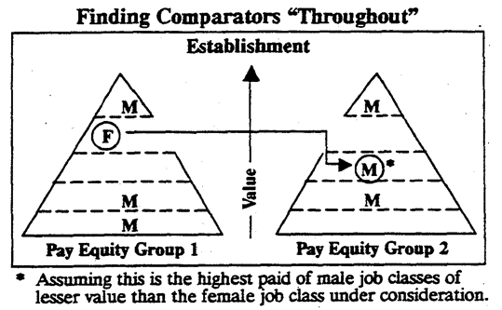
Search Sequence for Male Comparators
The Act required Employers to look for male comparators using the job-to-job method first inside a pay equity plan, and then throughout the establishment.
If there were no male comparators using job-to-job, proportional value was required after the amendments were passed.
The search sequence would then apply again for male comparators inside the plan and then throughout the establishment.

Slide 3
Proportional Value
Proportional value applies to public and private sector employers. This method is used where the job-to-job cannot be used to compare all the female job classes because there is no male job class that is equal value to the work performed by the female job class. This allows an indirect comparison between female and male job classes.

Slide 4
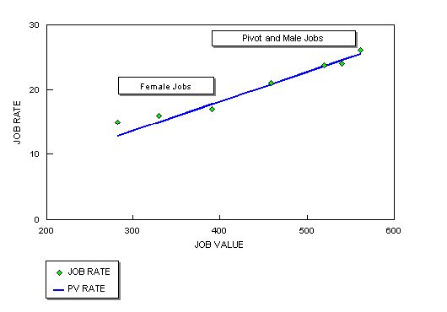
Proportional Value
The Proportional Value Method of comparison requires comparing female job classes to a representative range of male job classes.
This could be achieved by regression analysis calculations or drawing of a male job rate line from the representative male job classes and then comparing the female job classes to the male job rate line.

Slide 5
Proxy
The proxy method was only for public sector organizations if they could not achieve pay equity using either the job-to-job or proportional value methods because no male comparator job classes could be found for all the female job classes.
The proxy method involved comparing the “seeking employer’s” female job classes to female job classes from another public sector organization who becomes their “proxy employer,” and using them as if they were male job classes.

