Slide 1
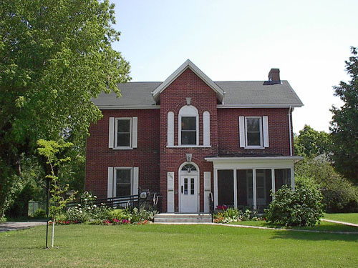
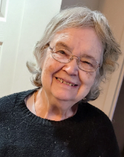
Great St. James Street

Slide 2
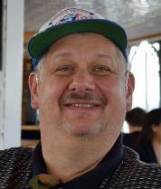
2.8+ million-dollar MCCSS budget
68 SIL contracts
7 Intensive SIL contracts
15 Passport Only Contracts
1 Fee for Service
No congregate settings-Everyone lives in their own apartment or with a roommate of choice
1 vehicle
1 Victoria Century Home-10 offices-boardroom-kitchen-lounge

Slide 3
Notes:
7-20s
8-30s
15-40s
19-50s
16-60s
10-70s
PPRTs-9-under 25, 3 in 50s, 5 in 40s

Slide 4
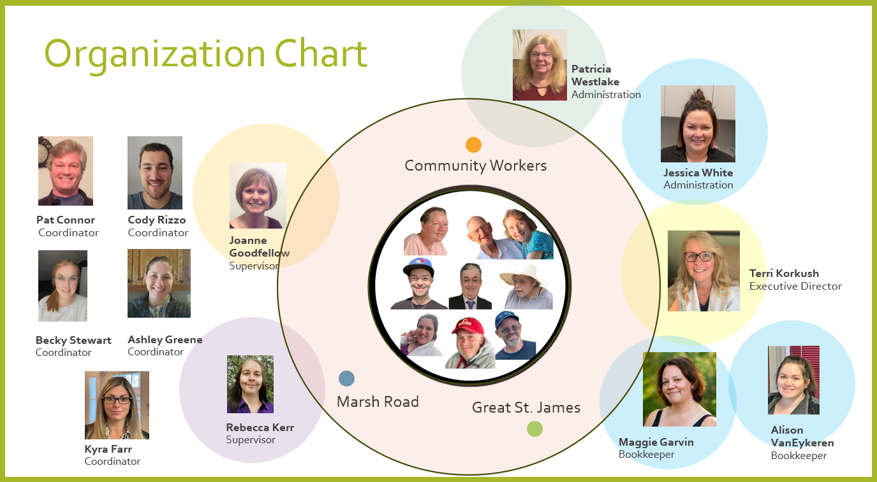

Slide 5
CVNQuinte Service Model
5 Support Coordinators meet with people to determine their goals and support needs
Liaison with families, landlords, courts, doctors, teachers, etc.
Regular communication with recipients of service
Crisis Response
55 Community Support Workers apply for assignments to ensure specific supports are implemented
Choice of assignments-permanent, temporary, one-time
Communicate regularly with other team members and Coordinators
Never get pulled for other crisis from assignments but can pick up more up to 88 in a two-week period if they have Passport assignments
95+ Recipients of Service choose CSWs and determine if they are satisfied with the service
Choice to interview or accept recommended applicant
Can change or end assignment-when, where, and how
Can change workers at any time. (Mediation if mandatory first step)
2 Supervisors provide guidance to Support Coordinators and Community Support Workers

Slide 6
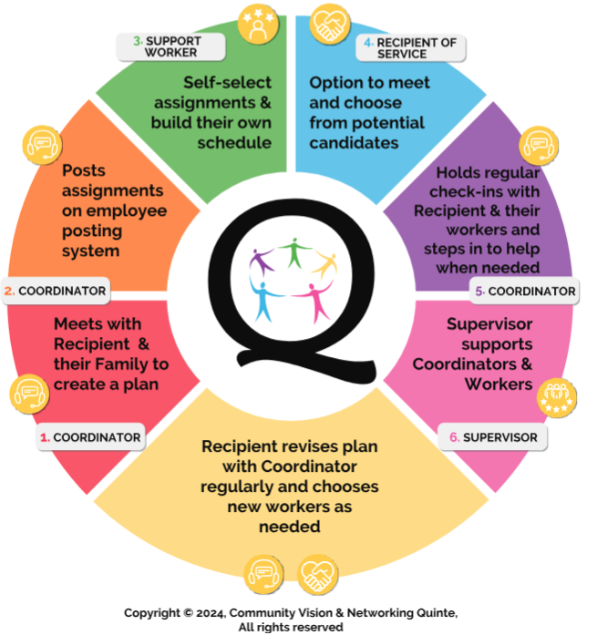

Slide 7
Previous Experience

Slide 8
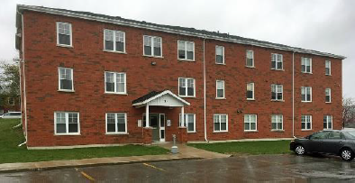
Housing Partnerships
Starling
Sydney Street
Sidney x 2
Notes:
7 people at 24 Starling Street in Belleville, is another successful project. It is an 18-unit affordable housing building created through the Affordable Housing Initiative in agreement with Hastings County in 2009. The owner of Springale, Mr Phil Spry, is the President of MAPS Development Corporation responsible for the development of 52 units of affordable housing at 450 Sidney Street, Belleville (2 at A 4 at B). Starling Street will be brought under the umbrella of the Partnership in 2023.
Good housing relationships
Respond to crisis immediately
The Quinte Community & Housing First Partnership-CLBA, HARS, Enrichment Centre for Mental Health, ACTT, Altogether Housing, Springdale, MAPS. 51% Non-Profit and 49% Profit partnership

Slide 9
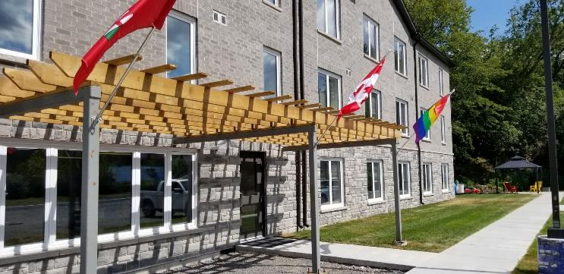
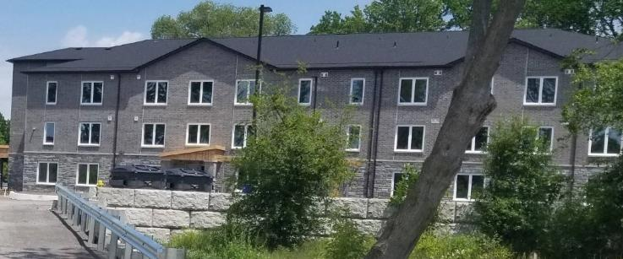
Housing Partnerships
Great St. James
Great St. James Street
Sydney Street
Notes:
All-Together Affordable Housing Corporation and Springale Development have formed a Joint Venture Agreement for the purpose of creating more affordable housing projects in Belleville, Quinte West and Hastings County. Our current Joint Venture housing projects include: 111 Great St. James (GSJ), at the end of Great Saint James Street A multi-residential dwelling GSJ is a mix of affordable and market rent units, including 3, 2. and 1 bedroom units. The 3 bedroom units are leased by the Enrichment Centre as a new home for its Murney Street transitional home. The building features a Community Hub, office space and a huddle room for meetings and video conferencing. The completed project, in May 2022 is another part of the Quinte Community and Housing First Partnership (QCHP).
5 people-4 units. Not B3 regulated. All can evacuate independently,

Slide 10
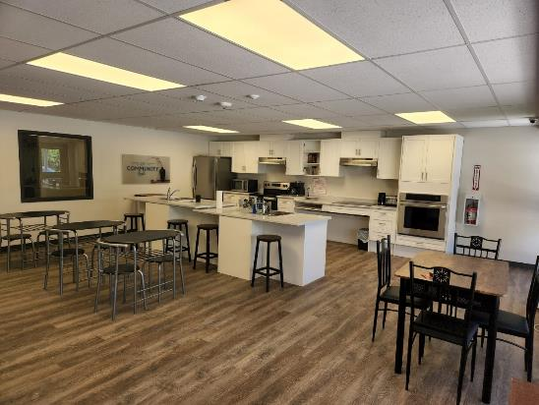
Housing Partnerships

Slide 11
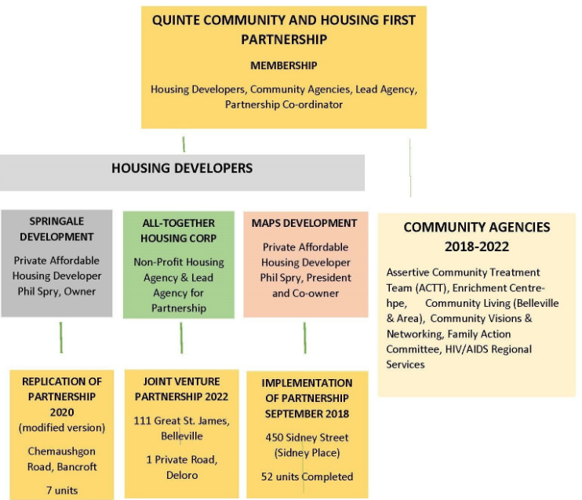
Sydney Street

Slide 12
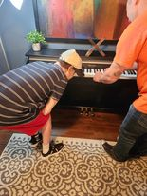
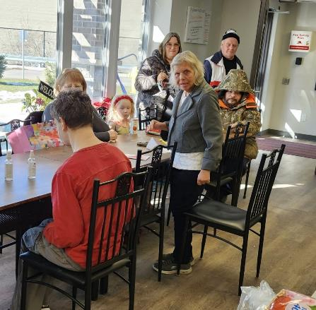
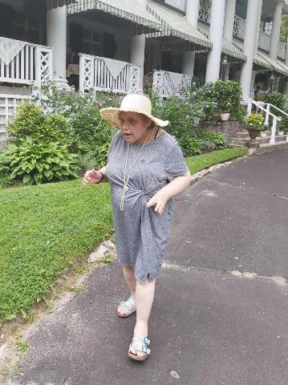
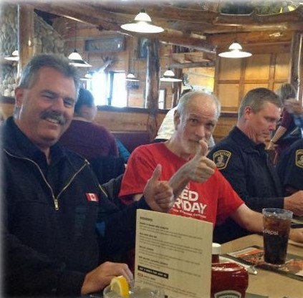
Bridging to Community

Slide 13
Pros
People have their own autonomy
décor,
privacy,
space to entertain
Agency has less upkeep costs
Repairs and maintenance
Utility costs
Snow removal
Citizenship
Community hubs/gazebos/smoking areas
Opportunity for friendships
Employees present for the greater security

Slide 14
Cons
Agency has greater rent costs
Offset by less of other costs
Difficult to support multiple people
Arrange for close proximity
Cameras/technology
People can have difficulty with environment and need to move
Co-lease helps if you need to move someone
Arrange for units that are less intrusive for neighbours
Storage
Utilize small spaces-drop down desks, shared storage spaces
Security
Some complexes have unhealthy neighbours
Create protocols for reporting and avoiding difficult encounters
Parking lot security
Buddy systems, radios/phone system, cameras

Slide 15
Thanks for coming!

