Slide 1
“Lessons from Nova Scotia’s Human Rights Remedy and other key reforms – how leadership can mobilise and sustain whole system reforms”
Eddie Bartnik, Tamar Consultancy
OASIS Conference, Ontario
1st May 2025

Slide 2
Overview
Reflections on broad universal issues impacting disability service systems
Some key ideas about Systems change and innovation (Rockwool Foundation, Etmanski)
Some promising, deep examples of sustained system reform at different levels of scope
Nova Scotia Human Rights Remedy – learning from what has worked and doesn’t
Some fundamentals of leading and mobilising system reforms: person by person,
program level and system level
Moving forward in Ontario

Slide 3
Reflections on broad universal issues impacting disability service systems
Human service systems internationally face similar challenges
Focus on self direction, personalisation and co-production
Upstream investments in prevention and early intervention
Place based approaches and the importance of connection to community and tackling loneliness
Value for money, sustainability and evidence, lifetime approach
Safeguarding vulnerable people – eg Royal Commissions and Inquiries
Cultural competence, reducing inequalities and intersectionality
Human rights and conventions
Sustaining community based alternatives to institutions

Slide 4
Some key ideas about Systems change and innovation
Rockwool Foundation
In Building Better Systems Winhall and Leadbetter 2022 introduced a new working framework:
System innovation involves work across three levels, the macro, meso and micro;
Change is unlocked using the four keys: purpose, power, resources and relationships;
System innovation involves people playing twelve roles, with different vantage points, knowledge and contributions.
Al Etmanski – in his 2015 Book Impact: Six Patterns to Spread Your Social Innovation - Plan Institute describes a helpful view of key roles:
Three types of innovators are required to achieve long term impact: disruptive, bridging and receptive innovators

Slide 5
Some promising and noteworthy deep examples of sustained system reform at different levels of scope – State or provincial level
West Australian Disability Services Commission 1992
Sustained visionary and values based leadership to take intellectual disability out of the Health system into a separate statutory authority (AIH) and then a separate focussed Disability Services Commission, bringing together all areas of disability
A separate Minister for Disability and new Disability Services Act, establishing purpose and safeguards (following extensive community consultation)
A Community Board with a new Strategic Plan and Business Plan, unifying the disability sector with a focus on individual need rather than diagnosis, individualised funding and a balanced range of local and statewide service strategies plus a whole of government approach through legislation.
Very much a “connected” system and best value for money of any disability system in Australia (based on Productivity Commission national data).
A coherent strategy leading to multiple 5 year Business Plans and strong community support

Slide 6
Some promising and noteworthy deep examples of sustained system reform at different levels of scope – State or provincial level
West Australian Disability Services Commission 1992
A partnership approach with providers (versus “market”)
Some highly innovative programs: Local Area Coordination, Post School Options, Community Living Plan which were the first of their kind. Systematic scaling over several years/ evaluations
Local Area Coordination became the front door and gateway to community, not just the disability services system. Local offices across the entire state of 2.5M Km2 .
The LAC charter is :To develop partnerships with individuals with disabilities and their families/support networks as they build and pursue their goals and dreams for a good life and with local communities to strengthen their capacity to welcome, include and support all people as valued, contributing citizens
Post School Options was a “line in the sand” strategy meaning that no school leaver would end school without a year of planning and a funding package for integrated work or community access (not sheltered workshops)

Slide 7
LAC: A personal, local, human approach
Defined geographical area – Located in/connected with community. Place based
Easy to access – no eligibility, local, mobile
Think natural first – build on assets and contribution of people and community
Whole person, whole family, whole community
Voluntary relationship
Not time limited, but avoids dependency
Intentional partnership working with local people, communities, organisations, services

Slide 8
Building blocks and support
(Source: WA Disability Services Commission)

Slide 9
Models of community living
(Source: WA DSC)

Slide 10
National level example: Australia’s National Disability Insurance Scheme (NDIS) since 2013

Slide 11
National level example: background to the NDIS
2008: Commonwealth 2020 Summit proposes a national disability scheme (The Idea)
2009: “Shut Out” report (The Need)
2010: Productivity Commission conducts enquiry into long term disability care (The Evidence)
Every Australian Counts campaign 2011-13 (Collective Leadership)
July 2011: Productivity Commission submits report to government (the Business case)
Oct 2011: COAG agrees to need for reform – taskforce develops scheme design (Government leadership)
Dec 2012: COAG sign agreement to trial the Scheme (Trial)
2013: NDIS Act 2013 establishing the NDIS and NDIA passed
and Bilateral agreements signed
2013: Trial sites 2015: Transition stage and 2018: Full scheme coverage
2023: Independent Review of the NDIS – progress also change needed.
Notes:
A brief overview of the journey to where the NDIS is today:
In 2008 the Australian Government’s 2020 summit proposed a national disability scheme
The Australian Government directed the Productivity Commission to conduct an enquiry into long term disability care and support in 2010. There were over 1000 submissions.
The Productivity Commission report submitted to government in July 2011.
An intergovernmental agreement was signed in December 2012 to proceed with a Scheme trial.
The NDIS Act 2013 establishing the NDIS and NDIA was passed in March 2013.
The NDIS started in July 2013. For the first three years, it is being introduced at trial sites at selected locations because it’s a big change, and we want to get it right and make it sustainable.
On 1 July 2013, the NDIS began in Tasmania for young people aged 15-24, in South Australia for children aged six and under (on 1 July 2014), and in the Barwon area of Victoria and the Hunter area in New South Wales for people up to age 65.
On 1 July 2014 the NDIS commenced across the ACT, Barkly region of Northern Territory, and in the Perth Hills area of Western Australia.
In the Nepean Blue Mountains area of NSW, an NDIA office opened on 1 July 2015 and participant planning began on 1 September 2015 (for children under 17 years of age).
From April 2016 early transition sites in Townsville, Charters Towers and Palm Island will begin
Roll-out of the full scheme in New South Wales, Victoria, South Australia, ACT and Tasmania will commence progressively from July 2016.
Work continues with governments in other states to progress the roll out of the Scheme

Slide 12
Nova Scotia Human Rights Remedy
There is systemic discrimination in Nova Scotia against persons with disabilities in the provision of social assistance. (NS Court of Appeal Decision on October 6, 2021 )
The finding of systemic discrimination applies to the Provincial government of NS as a whole.
Department of Community Services and Disability Rights Coalition worked together to create a human rights remedy. Appointed independent reviewers Eddie Bartnik and Dr Tim Stainton. Remedy to be compliant with UNCRPD.
The Remedy has been agreed by all parties and will address how people with disabilities access social assistance and supports and services to live in the community.

Slide 13
Finding of discrimination in 4 areas:
Unnecessary Institutionalization
(Purpose-built institutions for persons with disabilities and other institutional settings such as psychiatric hospitals);
Right to assistance when in need denied to eligible persons with disabilities;
Community of choice: people often ‘placed’ in settings distant from their families/friends;
Frequent, indefinite, extended delays in the provision of assistance (waitlists) for qualified, eligible applicants and recipients despite statutory entitlement.

Slide 14
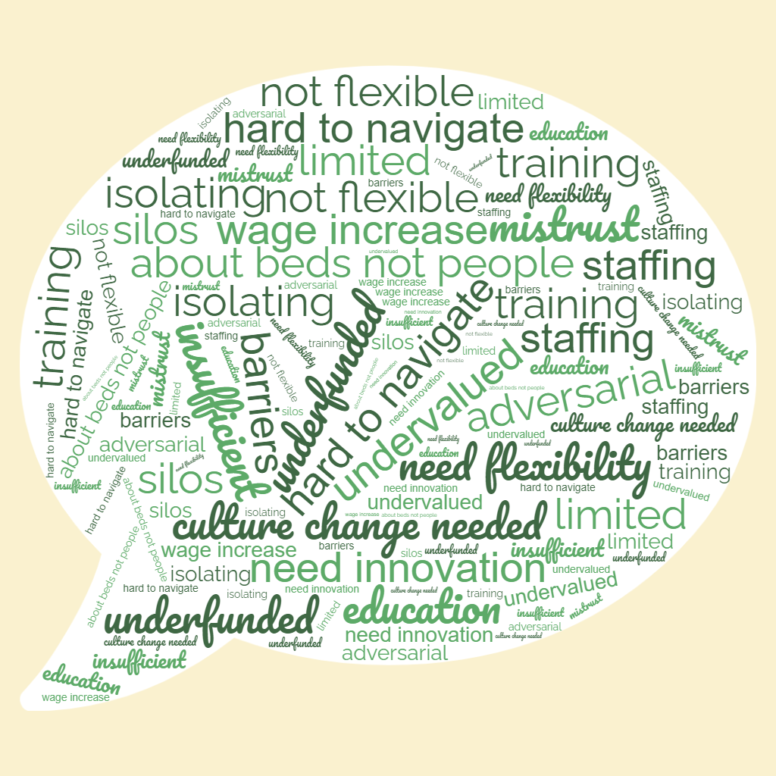
Consultations and Inputs
Virtual and in-person meetings (Oct – Nov, 2022)
met with over 140 individuals in Nova Scotia, including Minister McFarlane, the Minister of Community Services and Tracey Taweel, the Deputy Minister of Community Services.
On line meetings and site visits
Document review
6 online workshops/data workshops/ Government Roundtable
Technical experts engaged
In-person meetings in January 2023 (Halifax)
Report to DRC/DSP then Board of Inquiry approval
ALL key meetings with DRC and workshops had representation from people with disabilities.

Slide 15
Remedy has 6 Key Directions
Key Direction 1: More intensive planning and coordination strategy.
Community based Local Area Coordinators (LAC ratio of 1:50) for individualized planning, coordination and Intensive Planning and Support Coordination (IPSC ratio of 1:20) deinstitutionalization teams. Eligibility, assessment and funding function for restructured Care Coordination
Technical and peer support person centred planning external capability.
Key Direction 2: Close institutions across the province within 3-5 years.
Dedicated closure teams in each region. Including IPSC (ratio 1:15-20) and Community capacity developer (1 per team)

Slide 16
Remedy Key Directions
Key Direction 3: New community services
5 new community service strategies that enhance individual funding, choice and control, create new local community pathways, drive bespoke solutions.
Key Direction 4 : Province wide allied health/ clinical services with Regional hubs
Progressively bring clinical resources in DSP institutions into a shared regional multidisciplinary community outreach team for the benefit of the broader sector, evidence based design and connected to new Regional Hubs
Expand province wide mental health programs for those with intellectual and mental health disabilities.

Slide 17
Remedy Key Directions
Key Direction 5: Move to Individualized Funding (IF) and portability.
IF infrastructure and “backbone” support system
Supported Decision Making legislation/practice,
Key Direction 6: System Capacity and Enablers
Stronger governance structure and Plan for Regional Hub infrastructure.
Monitoring and evaluation of the Remedy/Court process
Leadership and capability panel/plan for cultural change, Disability workforce plan
Intergovernmental leadership and structures, Legislation and policy to support HR
Investment in housing beyond the Small Option Home Model
Strategies to support innovation, partnerships and transition
Build a projection model and financial requirements based on the HR Remedy

Slide 18
Remedy Reflections on key elements that support systems change
Sustained skilled advocacy from the Disability Rights Coalition (across various areas of disability)
Government leadership to commit to a Court resolution, followed by an apology from the Premier and Cabinet agreement to fund the Remedy
External Review uses a collective and inclusive leadership approach to all work, moving on from the court adversarial approach. Final report agreed by all parties and Court.
Whole population approach and Remedy to be resolved in 5 years
Across government approach through new Government Roundtable
Annual reporting, Court Monitor, targets and indicators

Slide 19
Remedy Reflections on key elements that support sustained systems change
Key Directions adopt human rights approach and use best evidence about successful innovations and failed implementation from a wide range of jurisdictions
Strong commitments to program fidelity and evaluation and attention to technical support for implementation of new programs
Strong investments in training and cultural change
Entering year 3, sustained leadership from both Government and DRC to establish sound foundations and a new personalised approach grounded in local communities.
Leadership to keep government engaged and strongly committed despite several changes in Minister
A considered approach to service provider sustainability and transition to Individualised funding and new personalised and local service models

Slide 20
Some fundamentals of leading and mobilising system reforms: Individual person by person and program level
Get to know people well over time, person by person
Connections to the local community
Positive values and assumptions about individuals, families and communities, with safeguards as needed
Building capacity and self sufficiency versus “providing services”
Ask the right starting question: “What’s a good life” versus “What services do people need” (Scarcity versus abundance approach)
Can be augmented by graduated system of pooled individualised funding
Importance of fidelity of design/implementation and evidence

Slide 21
Some fundamentals of leading and mobilising system reforms: Systems level
Rockwool’s 4 keys: purpose, power, resources and relationships;
Purpose – whole disability population versus diagnostic groups, focus on disability
Power – people with disabilities/families on Boards, Minister for Disability, legislation
Resources – whole system view, formal, mainstream and informal, Individualised funding
Relationships –greater lens on co design/co production, trust & partnerships/alliances
Etmanski’s 3 key Innovator roles:
disruptive – on the ground, community up eg Community campaigns, families
bridging – convenors that can connect and provide a neutral ground eg Reviewers
receptive innovators – people in government and politics eg department heads, Ministers

Slide 22
Some possible leadership opportunities in Ontario
Naming the issue as a whole population disability view and sustainable strategy (eg Every Canadian Counts campaign)
Identifying and valuing receptive leaders in government and politics
Building alliances across disability groups and sectors to strengthen collaboration and advocacy
Convening neutral spaces for big ideas and examples of system innovations from other jurisdictions
Global Leadership Exchange international event to be held in Ontario June 2026
Data to support a whole disability population view, link to UNCRPD population, identify all resources in the system not just government. Identify a solution with tangible benefits – a new narrative .
Starting whole population demonstrations at a small scale such as Local Area Coordination, Post School Options with a strong local community focus.

