Slide 1
Towards a National Caregiving Strategy
James Janeiro, Director of Policy
and Government Relations

Slide 2
About the Canadian Centre for Caregiving Excellence

Slide 3
Canada leading the way in quality care, where caregiving is valued, caregivers are supported, and people accessing care are central to policies and practices.
Our Vision

Slide 4
The Canadian Centre for Caregiving Excellence supports and empowers caregivers and care providers, advances the knowledge and capacity of the caregiving field, and advocates for effective and visionary social policy, with a disability-informed approach.
Our Mission

Slide 5
Our Areas of Focus
Support Networks and Knowledge Sharing
Education and Leadership Development
Advocacy and Policy Development
Inclusion and Underserved Communities

Slide 6
Why a National Caregiving Strategy?

Slide 7
Caregivers and care providers are the backbone of Canadian society.
One in four Canadians is a caregiver today. Half of all Canadians will be a caregiver at some point in their lives.
Insufficient support is hurting us all:
Mental, physical, and financial health of caregivers is suffering
3 hours of care are provided by caregivers
for every 1 hour provided by the healthcare system
$1.3B in lost productivity
per year – the equivalent of 500,000 workers lost to the workforce
Care provider workforce is experiencing dire staffing shortages.

Slide 8
Why a national strategy?
The Canada we need and deserve is not possible without caregivers and care providers - and right now, they are not okay.
Federal government action is urgently needed to shore-up caregivers and care providers so they can keep doing their critical work.

Slide 9
Budget 2024

Slide 10
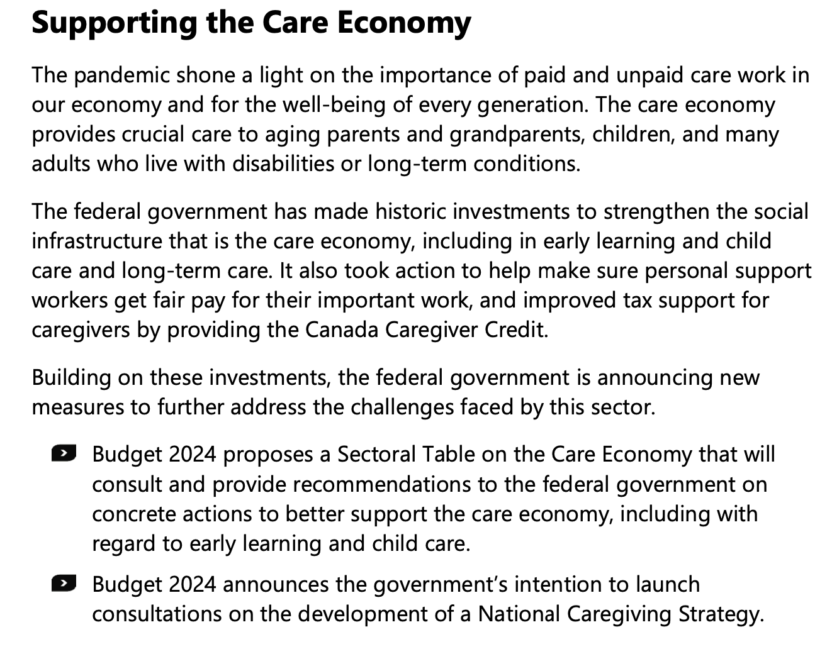
Budget 2024

Slide 11
Developing a National Caregiving Strategy

Slide 12
Our Development Process
Work with caregivers, experts, organizations, and leaders to determine what a National Caregiving Strategy should include.
Produce a practical and workable document of policy recommendations that can be used to move the policy agenda forward.

Slide 13
Our Consultation Process
Convene a Care Champions Table
Consultations at conferences, gatherings, and other convenings
Virtual consultations with key groups across Canada
Virtual consultations with focused themes during Caregiver Aware Month (May)
Regional discussions through provincial organizations
Online form for written feedback submissions
Consult with CCCE’s Canadian Caregivers Advisory Network and other working groups

Slide 14
Priorities for a National Caregiving Strategy

Slide 15
Priority areas
Government and leadership recognition
Optimizing supports, programs and services for caregivers
Improving supports for care recipients
Supporting caregivers in education and the workforce
Developing a thriving care provider workforce

Slide 16
Healthcare
Adoption of federal legislation that creates a National Caregiving Strategy, recognizes the critical role that caregivers and care providers play in our healthcare systems, and creates a National Caregiving Advisory Council.
Make caregiving a priority in future federal healthcare funding agreements with provinces.
Access to training for clinical caregiving tasks (like administering medication and mobility assistance).
Increase the share of medical and care expenses that can be claimed on taxes by caregivers.
Dedicated access to appropriate mental health support for caregivers and care providers to decrease burnout and support caregiver wellness.

Slide 17
Social and Community Care
Financial supports for caregivers, including a refundable Canada Caregiver Credit that returns money to caregivers through their tax return.
A new monthly Caregiver Benefit to fill the gap of lost income or cost of caregiving responsibilities (including out-of-pocket medical expenses).
Targeted support programs to help address isolation and loneliness among caregivers, care providers, and care recipients.
Access to community-based programming to help veteran caregivers, military family caregivers and Canadian Forces caregiver.

Slide 18
Work and Education
Introduce caregiver-friendly workplace policies in federal workplaces and mandate such policies in federally-regulated industries (i.e., banking, telecom, broadcasting).
Easy-to-access caregiver leave policies in all employment sectors through the Employment Insurance system.
Update existing leave policies and benefits to reflect the unpredictable nature of caregiving.
Adjust the rules governing Canada Pension Plan benefit calculations to stop punishing caregivers for stepping out of the workforce due to care responsibilities.

Slide 19
Care Workforce
Implement the federal government commitment of a $25 minimum wage for personal support workers and extend this commitment to other care providers, such as direct support professionals.
Make it easier for care providers from around the world to stay in Canada when their employment status changes by reforming federal immigrant sponsorship programs.
Reform the immigration to make it easier for newcomers to come to Canada specifically to work in the care provider workforce.

Slide 20
What have we missed?

Slide 21
Thank you!
James Janeiro
Director, Policy and Government Relations
416-671-3581
james@canadiancaregiving.org

