Slide 1
Strategies for Success through Stakeholder Engagement

Slide 2
Today's Discussion
Journey to Belonging
Surveying within DS Sector
Considerations for:
Survey Development
Implementation
Sharing Results
Working Together

Slide 4
What is happening currently?
Most agencies are conducting some type of survey or engagement process for a variety of purposes
No province-wide, co-ordinated approach
Most surveys are developed in-house
Range of formats and approaches
Response rates are around 20% or less
Desire to gain more data-driven understanding of customer needs and what is important
Appetite to use research-based or validated questions/surveys

Slide 5
Survey Development
What is the main purpose? What do you want to know?
Who will you survey? And what are the considerations for this?
Do you have a set a questions in mind? How will questions be developed?
Will you develop the survey in-house? Use existing DS or other agency surveys? Engage a researcher?
How will you know you are asking what is most relevant? Will you pre-test questions with target audiences?
Will questions be generic and relevant to all Programs? Or specific to one Program?
Will questions be linked to the themes of the strategic plan? Or Accreditation?
Will questions be closed or open-ended? Rating scale?
How will the survey be implemented? Online, phone, paper, multi-language?
How long will it take to complete the survey?
Will you analyze the results in house?

Slide 6
Implementation
What is the communication strategy?
How will respondents be aware of the survey
How will they access the survey?
How will you reach out and how often? Reminders
How will you address considerations for accessibility, ease of use, language, deaf/blind, ability to start and stop the survey?
How will you address questions related anonymity and confidentiality?
What will you put in place to get a "good response rate"?

Slide 7
Results
How will results be shared with various audiences, internal to your agency and external?
How will you let families / people supported know how information has been used?
How will you encourage families to participate in surveys in future years?
How will results be used internally?
Are you tracking results over time or comparing with other surveys? (e.g. staff survey)
Are you willing to share results with other agencies? And for what purpose?

Slide 9
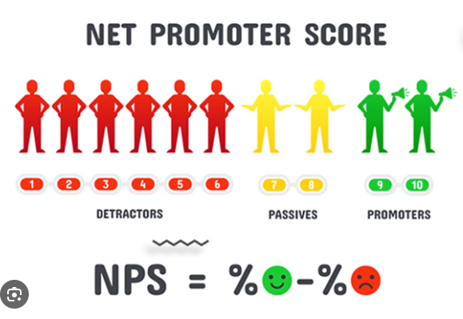
Parent Satisfaction Survey
Several years of not conducting survey
Part of Reena’s strategic plan – a “Client Experience” workgroup
General survey (8 questions)
Leading with “Net Promoter Score”

Slide 10
Developed In house
Online Access
Parent Community (over 400 families)
22% response rate
Repeated SAME survey following year - consistent responses
Deeper dive for 2024/25

Slide 12
Survey: Why, Development and Implementation
Why:
As part of Accreditation and the agency’s quality improvement initiatives.
Development:
Research on approaches by other developmental service agencies utilizing Focus Accreditation’s Quality Enhancement Network and additional online research.
Implementation:
Surveys conducted since 2017 (7 years). Since 2020, disturbed via postcard mailed and emailed with access options of QR Code, website, phone or paper copy. People supported needed to complete survey without their staff support.

Slide 13
Survey Learnings/Changes and Results:
Learnings and Changes:
Report style changed from lengthy full report to concise postcard report.
In 2020, survey for people supported had audio and video component added.
Changed from one survey sent to all service users to surveys based on service provided.
For 2024, agency’s Evaluation Committee to review/revise survey questions and answers and options to include Likert scale and net promote score questions.
Structured action plan developed in 2022.
Results:
Sent to targeted emails, agency website, social media channels and agency’s Possibilities Newsletter.
Presented on postcard since 2019 and 2022 and on a two-page letter format in 2023.
Results report presents: Top Areas or Key Highlights, Areas of Improvement and Action Plans/Moving Forward.
Notes:
Structured action plan developed in 2022. Tasks assigned and progress monitored. Tasks integrated into agency’s strategic action plan.
Discuss Evaluation Committee

Slide 14
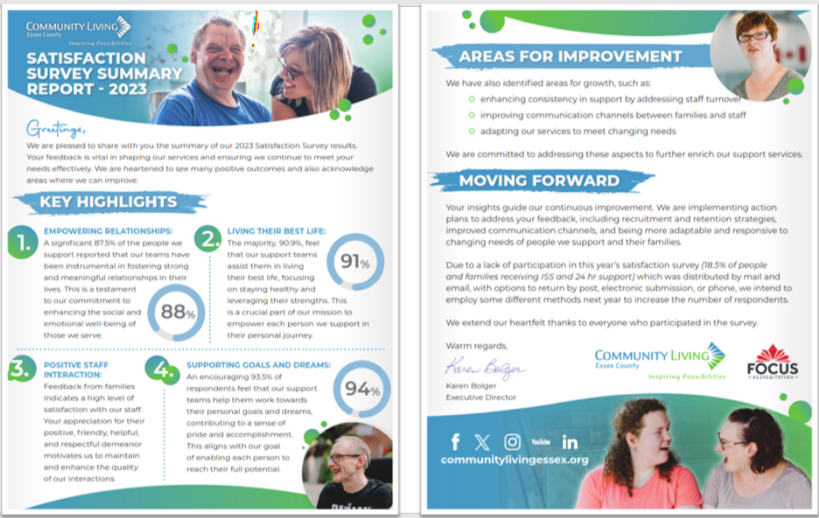

Slide 15
Family Experience Survey
A research on families’ experiences on Community Living Toronto’s programs and services

Slide 16
Measuring Service Excellence
“The ability of service providers to consistently meet or exceed customers’ expectations”
What is important to families?
What are families expecting from CLTO?
Based on your experience, to what extent is CLTO meeting expectations and where is their opportunity for improvement?
Based on your experience, how much do you agree or disagree with the following statements:
(Strongly Agree, Somewhat agree, Neither agree nor disagree, Somewhat disagree, Strongly disagree, N/A)
Overall, does CLTO meet your expectations as an agency to support people with intellectual disabilities?
Overall, how satisfied are you with services provided by CLTO?
How likely are you to recommend CLTO to a friend or colleague? (Rating of 1 to 10)

Slide 17
Communication and ease of access are essential!
Advance notice to families (email, webinars, newsletters)
Opportunity to remove name from survey list
Request different language or specific type survey
Survey was promoted on our website
Survey emailed with a person-specific link
Option to respond by or
Results shared with all program staff, Leadership, Service Excellence Committee, Board & families

Slide 18
Net Promoter Score (NPS)
The NPS assesses the willingness of respondents to promote an organization’s Programs and Services.
NPS is measured by asking respondents to rate their likelihood of recommending “agency name” to family or friends on a scale from 1 to 10. Based on their rating, respondents are classified as Promoters, Passives, or Detractors. The NPS is calculated by subtracting the Detractors from the Promoters, which provides a net score for the proportion of respondents promoting or recommending the agency.
Detractors 1-6
Passives 7-8
Promoters 9-10
For example, a NPS of 43 indicates that more families (63%) will highly promote/recommend “the agency” versus those who are least likely (20%) to promote “the agency”.

Slide 19
Next Steps – Working Together
Is there an interest in creating a community of practice?
Are agencies interested in using a few common questions so we can begin to compare with other agencies, for purpose of sharing best practice etc.
Are agencies interested in sharing methods for follow-up i.e. how results are used

Slide 20
Questions
Heather Dawson
Director, Quality & Risk, Community Living Toronto
heather.dawson@cltoronto.ca
Sharon Magor, Manager, Marketing and Communications, Reena smagor@reena.org
Patty Neufeld
Manager, Quality Assurance, Community Living Essex
patty@communitylivingessex.org

