Slide 1
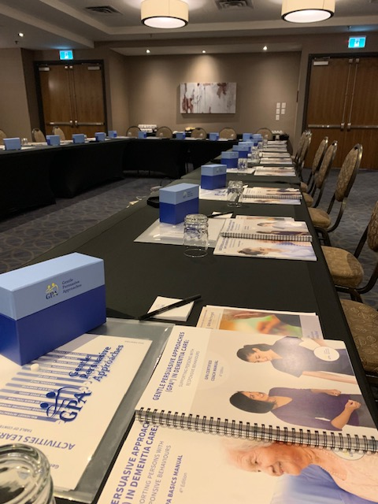
Fostering Future Success: Partner Engagement & Gentle Persuasive Approaches in Dementia Care (GPA™)
Presenters:
Don Seymour, Executive Director AGE
Lisa Wauchope, Director, Education and Program Development, AGE
Olivia Mouriopoulos, Education Program Specialist – Engagement, AGE

Slide 2
GPA ™
Equipping team members with the skills to respond to responsive behaviours with confidence.
The voice of persons living with cognitive impairments is critical in a caring relationship.
GPA focuses on the entire person.
Research & development is the foundation of our programs.
Notes:
Don

Slide 3
Strategic Objectives
Finance
Increase revenue and diversify business streams with targets based on realizing social and ethical benefits.
Notes:
Lisa-
By 2036, 25 % of the Canadian population will be 65 years or older. Aging in place or Living in Place means having the health, social supports, and services a person needs to live safely and independently in their home or community. It also means a person will age in the right place, which means having options to housing with the support required to stay.
As Don mentioned, GPA is evidence informed as well as competency based, practical application learning that supports knowledge transfer and broad application in practice. The program’s principles include self-efficacy and contextualized practice change implementation strategies based on the PARiHS framework. Hopefully, you have stopped by our booth to learn more about the research that supports the ongoing development and refinement of GPA.
GPA support all persons to age in place by providing care professionals and volunteers with knowledge, skill and abilities to provide respectful, person-centred care.
Kevin is a person that resides in a congregate setting and has since he was 9. He has developmental exceptionalities and as he is aging, his sister Erika is noticing significant changes in his behaviour. Erika is a nurse practitioner and a GPA Certified Coach. Erika reached out to us to have a conversation about Kevin and asked if GPA was available to all. The answer was simple, yes.
Erika shared that Kevin has been in care since he was 9 so his life, programs, care, has been in that setting. He now struggles with communication, completing adls that he used to do and more. Staff consider him high priority for LTC and he shares with his sister, I hate my life.
Erika started using some of the strategies within GPA with Kevin. She joined him where he was, she understands the brain and the communication challenges associated with cognitive impairment. And most of all, she focused on Kevin as a whole person, thus validating him in the moment.
Erika shared that since taking GPA she better understands how knowing the person and being aware of contributing factors such as pain, can impact a person’s demonstrated behaviours. Most of all, Kevin will hopefully be able to age in place, because that is all he has ever known, and staff are a key part of his life.

Slide 4
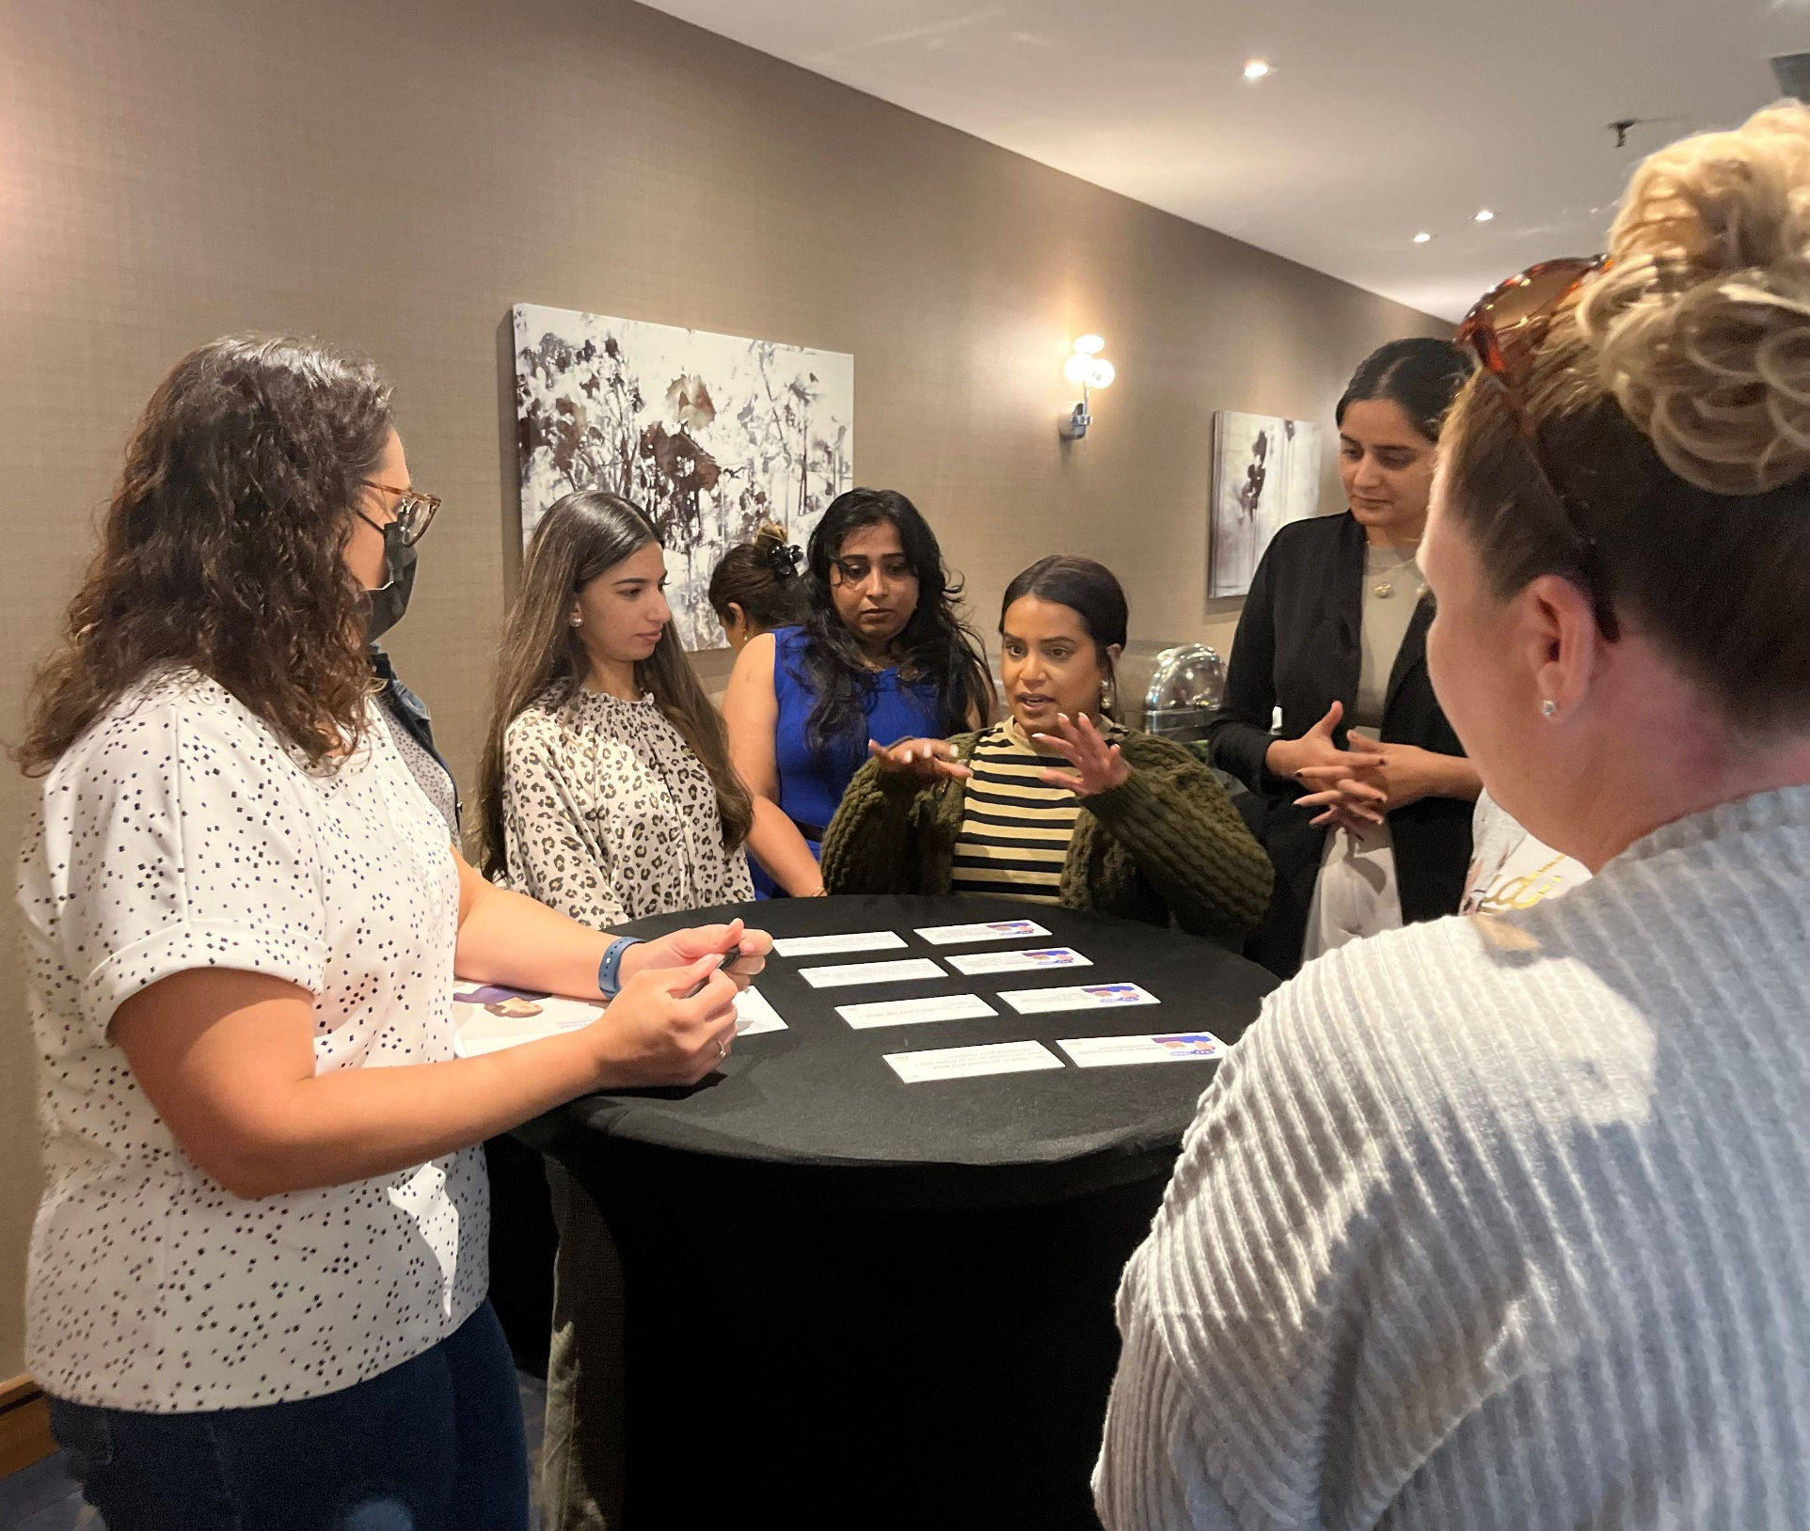
Principles Behind The Program
Gentle Persuasive Approaches (GPA™) is an evidence-informed, comprehensive, practical education program designed to support knowledge transfer and broad application in care communities.
Over 600,000 care professionals across Canada have taken GPA.
-2023 AGE Annual Report.
Notes:
Lisa
Aging occurs to all of us. And yet there is little research on the relationship between individuals with intellectual and developmental disabilities and dementia outcomes. The 2019 national dementia strategy included people with intellectual and developmental disabilities as a group that is at higher risk of both developing dementia and facing barriers to equitable care (Public Health Agency of Canada, 2019).
Intellectual impairment does raise some challenges in measuring declines in cognitive function, making it complex to determine dementia status. A recent systematic review found that cognitive assessment tools are lacking for adults with intellectual and developmental disabilities, and the authors suggest that this may lead to delayed access to care and treatment (Janicki et al., 2022).
This is why GPA can be implemented in care. GPA starts by exploring the meaning behind the term personhood and how vital to care, person centred language and actions are to a person with a neuro-cognitive impairment- in any care environment. We learn how changes in the brain impact a person’s ability to modulate their behaviour and we learn how crucial the interpersonal environment is for persons in care. Finally , we apply that learning to debriefing, documentation and how to respond respectfully to situations of risk. GPA is about staff and volunteers feeling confident in their approaches and recognizing the importance of person-centred approaches in the interpersonal environment. As Erika said earlier, with GPA, Kevin would be supported where he is at.
Evaluations show GPA significantly positively influences staff confidence and ability. Care professionals reported increased competence in identifying contributing factors to responsive behaviours and they showed statistically significant increases in self-perceived behaviour management competencies after completing GPA. This increase was sustained 6 weeks later. AGE has worked alongside various LTC homes, acute care, community settings and educational institutions to evaluate the impact of all the GPA products. Evidence from these evaluations supports the effectiveness of GPA. Overall, GPA significantly influences staff confidence and ability to discover the meaning behind responsive behaviours and work with persons with dementia to satisfy their unmet needs. Situations that Erika described are not unique to AGE, in fact AGE has developed tools and process to support the role of GPA Certified Coaches as change agents in care settings. GPA is facilitated by a GPA Certified Coach and taking GPA is focused on a team-based approaches and strategies for each unique location.

Slide 5
GPA™ Format Options
GPA Basics
Integrated GPA (iGPA)
GPA eLearning
Part 1
Part 2
Notes:
Olivia
Explaining main GPA format options

Slide 6
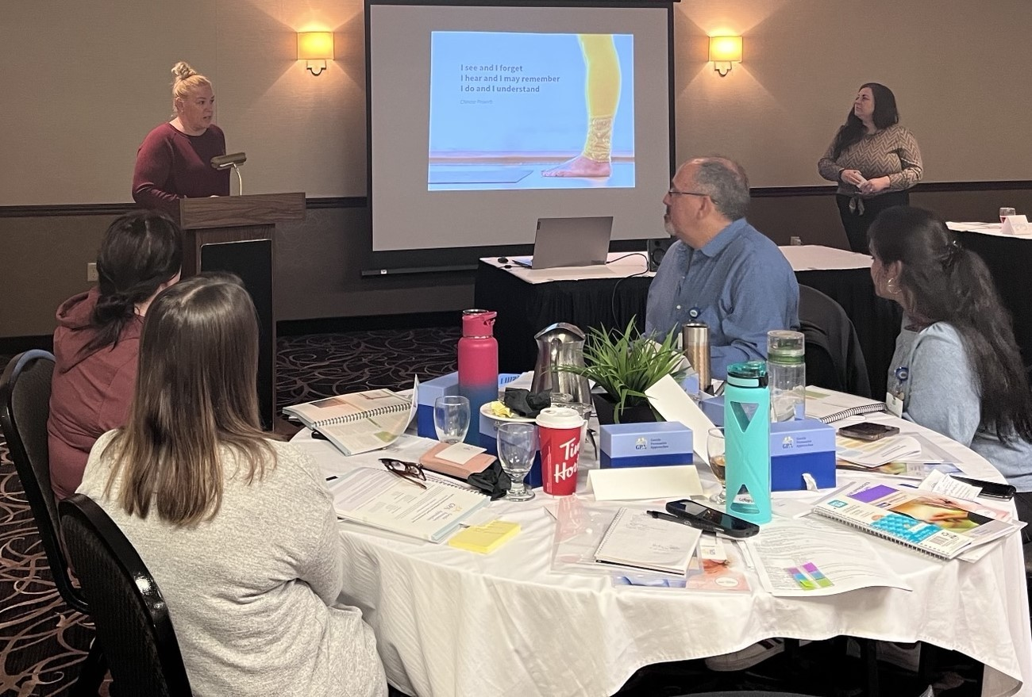
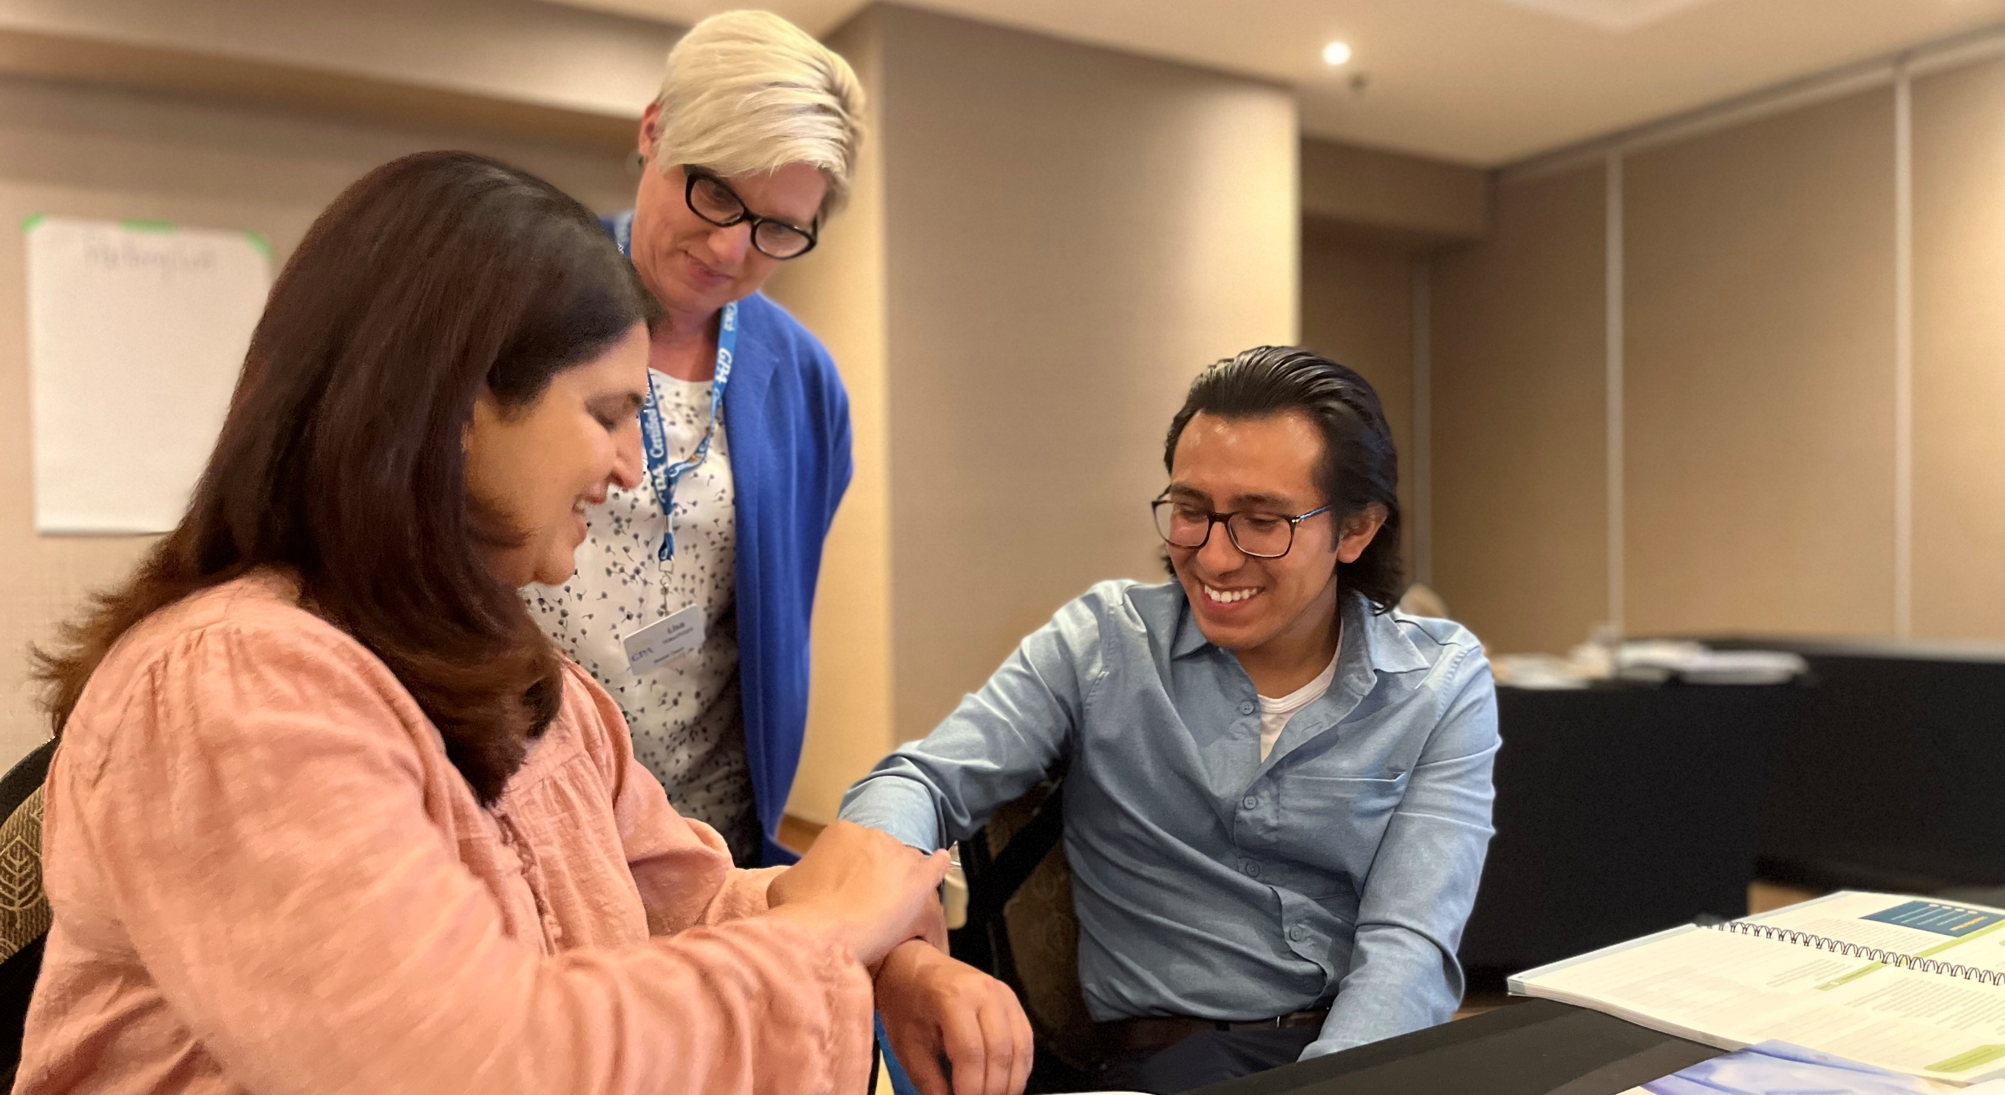
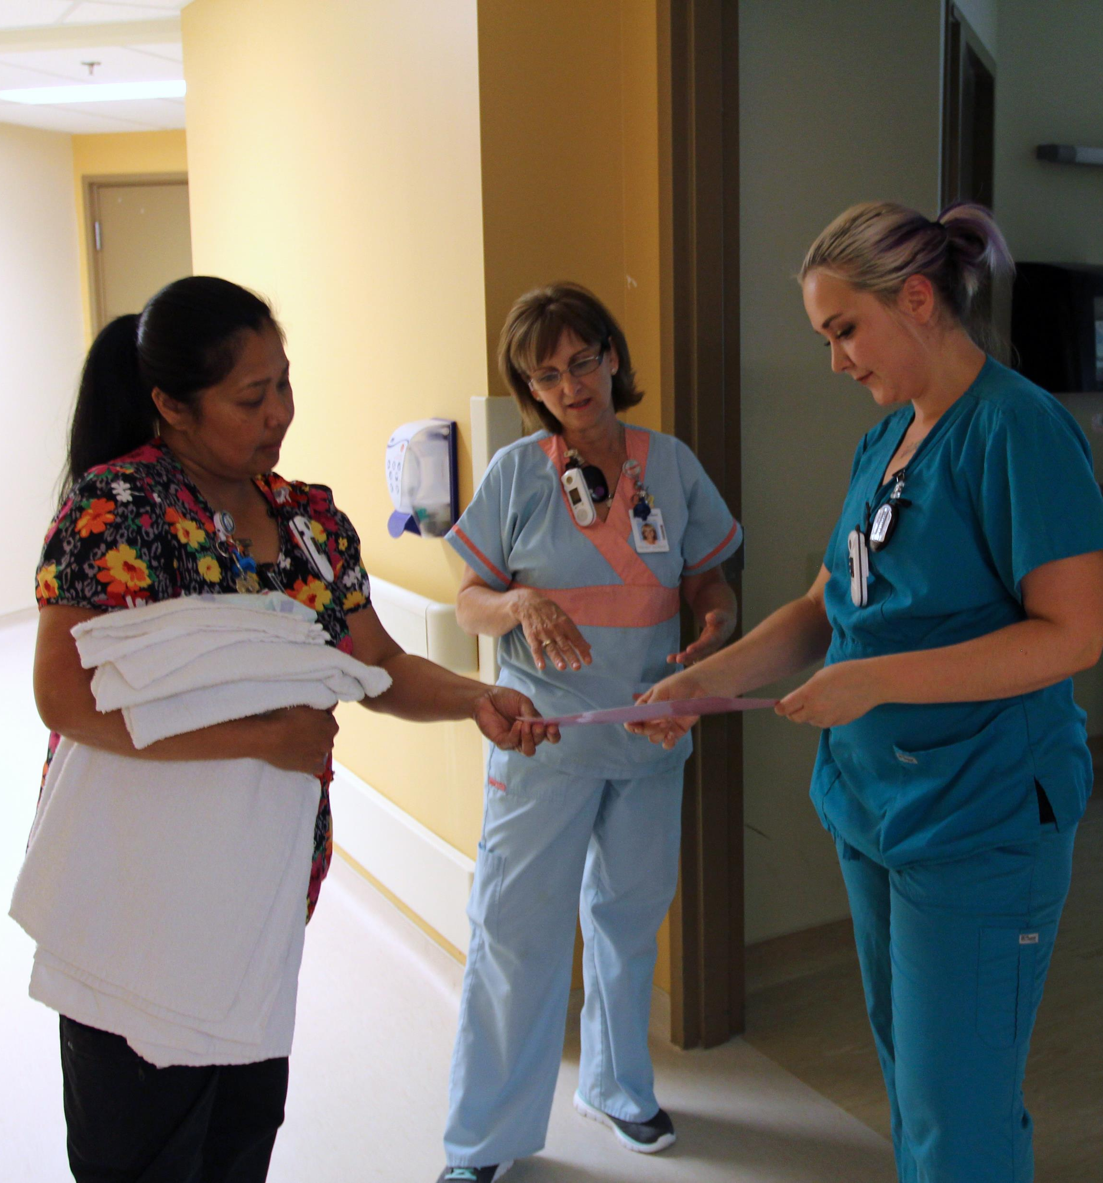
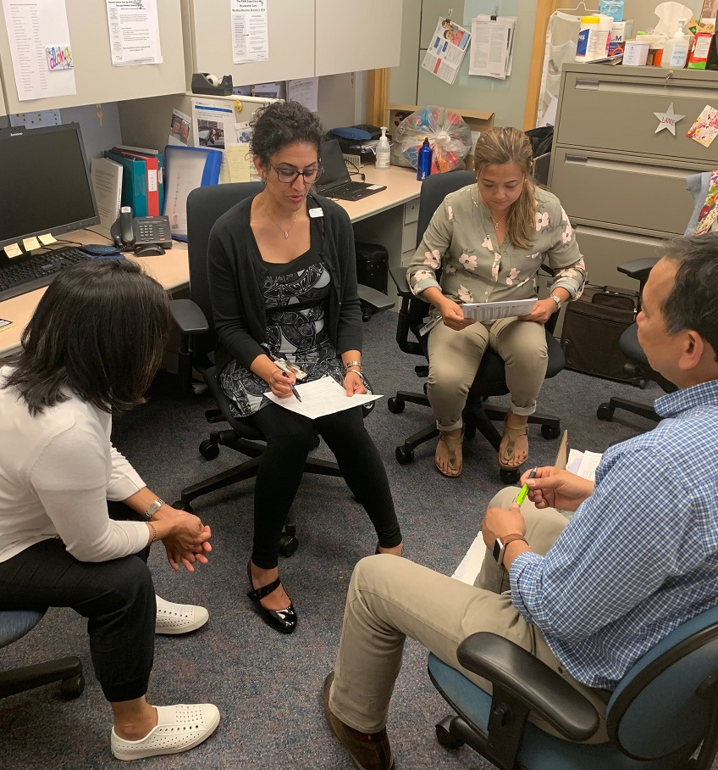
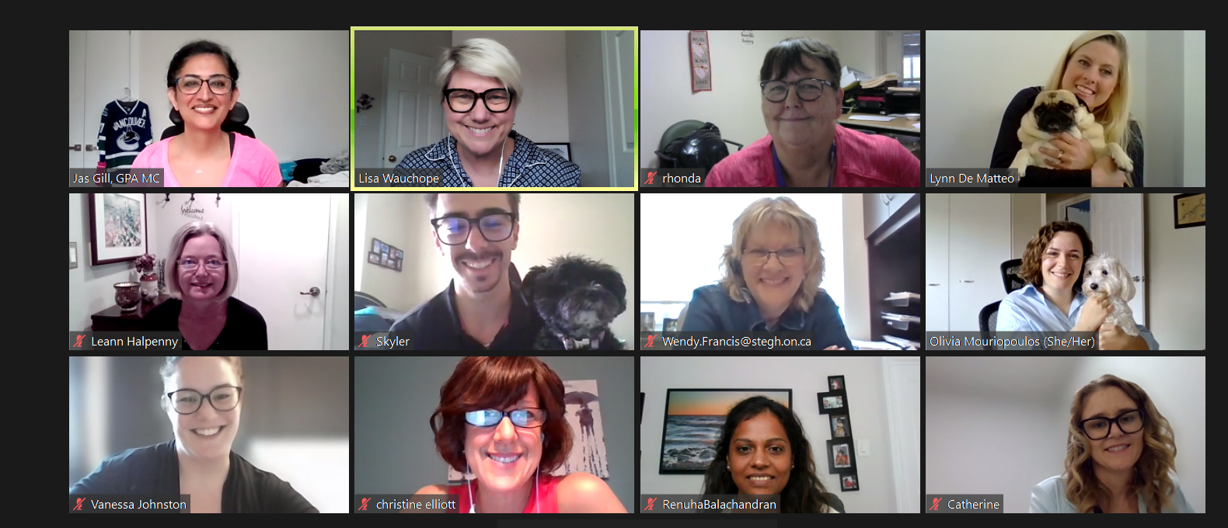
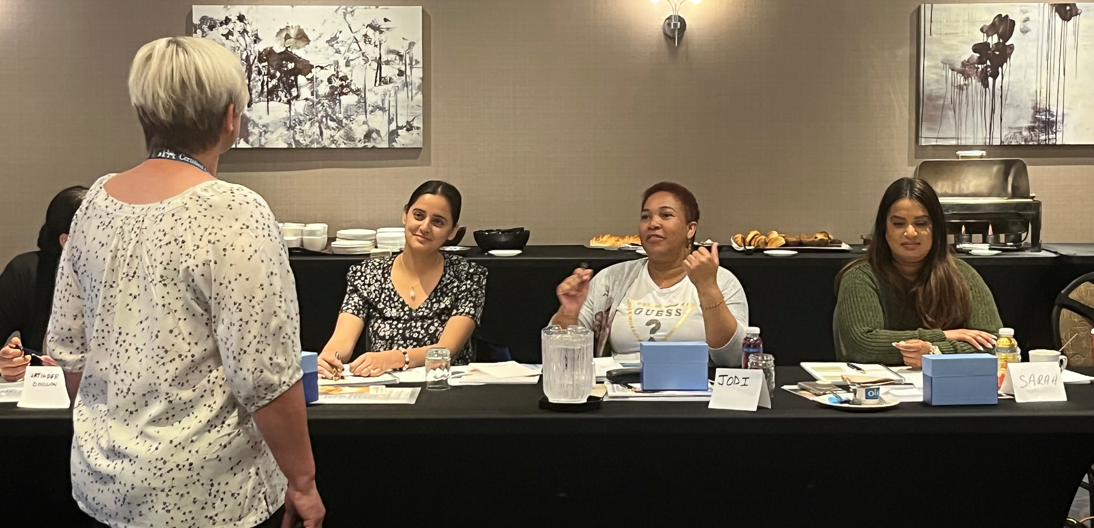
GPA™ Certified Coaches
In-Person
GPA Certified Coach Workshops
Ongoing Team Support
Virtual
GPA Certified Coach Workshops
Practicing Facilitation Skills
Notes:
Olivia
Responsibilities of GPA CCs

Slide 7
Logistics – Registration & Materials
Education Calendar
Customer Support
AGE Webstore
Notes:
Olivia
How to register for a GPA CCW
How to purchase GPA materials
Contact us for support

Slide 8
ageinc.ca

