Slide 1
Monopolizing Technology to Bridge the Gap and Foster Healthy Workplace Cultures
Presented by: Stuart White Dunk & Associates Inc./Systems 24-7

Slide 2
Introduction
Stuart White
Manager of Health & Safety Excellence program
Dunk & Associates Inc/Systems 24-7
www.systems24-7.com
Experts in using technology to bridge the gap and foster healthy workplaces.
Notes:
Good morning/afternoon. My name is Stuart White. I am the Manager of the WSIB Health & Safety Excellence program at Dunk & Associates. However, I am not going to be talking about that with you today, what I would love to talk to you about is how to monopolize technology to bridge the gap and foster healthy workplaces.
Just a bit about us - Dunk & Associates Inc./Systems 24-7 is a Canadian-based business specializing in providing affordable support and services in Health & Safety and Human Resources. We have been in business since 2000.
We are experts in this field as Dunk & Associates recognized early on that technology is one of the most effective ways to increase efficiency and deliver programs. Our program, called Systems 24-7, is designed and developed in-house and it’s an innovative online portal that goes beyond a traditional Learning Management System (LMS). It offers employees a secure online gateway to access policies, procedures, forms, resources, and comprehensive safety and HR training. What makes us stand out is that all content on our platform is maintained by our qualified professionals to ensure legislative compliance, thereby significantly reducing the workload for our clients and assisting them in "Navigating Change.”
Today I will not be speaking specifically about how programs (although I welcome you to come find me at the vendor booths to have those discussions), but I will talk to you about some things for you to consider when using technology within the workplace.

Slide 3
Overview
In today's rapidly evolving work landscape, the integration of technology is paramount for achieving heightened health and safety & HR outcomes. However, acknowledging the diversity in technological literacy among employees is crucial. This session aims to explore practical and accessible technological solutions that organizations can adopt to enhance performance and foster a healthy workplace culture while catering to the varied needs of a diverse workforce.
Notes:
In today's rapidly evolving work landscape, integrating technology is paramount in your business, and you can monopolize on it to achieve heightened health and safety & HR outcomes. However, we know this comes with struggles. Acknowledging the diversity in technological literacy among employees is crucial. In our time together today, we will explore practical and accessible technological solutions that organizations can adopt to enhance performance and foster a healthy workplace culture while catering to the varied needs of a diverse workforce.

Slide 4
Agenda
We will discuss the following topics:
Overcoming Technological Resistance
Centralized Management through Software Platforms
Resources for Non-Experts
Accessibility and User-Friendliness
Reporting and Training Simplified
QR Codes for Quick Information
Benefits of Online Training

Slide 5
Overcoming Technological Resistance
Section 1

Slide 6
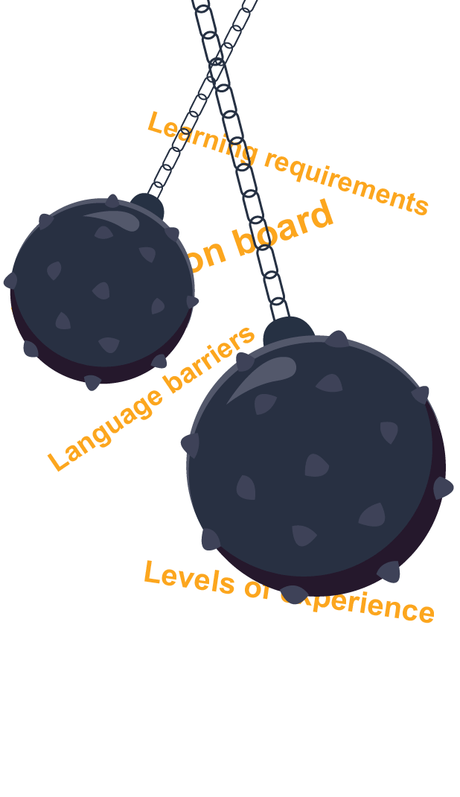
Overcoming Technological Resistance
Challenges
Getting everyone on board to use technology
Differing levels of experience and understanding of technology
Language barriers
Different learning requirements
Notes:
Before we get into discussing technology, we must recognize that there are challenges any time we want to introduce a new program into the workplace. It can be a struggle to get everyone on board, our employees have differing levels of experience and understanding, language barriers, and also different ways in which our employees learn. Some employees need to learn by doing, while others will need more active demonstration.

Slide 7
Overcoming Technological Resistance
Solutions
Get employees involved
Survey staff and create a needs assessment
Research!
Select software solutions with technical support
Trial software solutions
Ensure solutions are user-friendly and accessible
Notes:
With that said, don’t get discouraged! There are many solutions that you can explore to alleviate these challenges.
Get employees involved in the process of selecting new programs and survey them. You can create a stakeholder group and survey your staff to create a business requirements document or needs analysis on all the issues you need this new piece of technology to provide. What you select may not end up checking off all the boxes, but when you can demonstrate that you have listened, you’ll receive better buy-in later.
Research solutions that check off your boxes. You might need to talk to colleagues in similar industries to see what they are using. You may even decide to put our RFP (Request for Proposal) so vendors can approach you to explain how they can fill your needs.
Select software solutions with technical support. There’s nothing worse than when you need help, that you find out that there’s no one that you can talk to.
Trial software solutions: create committees to demo and play in the software to see how they like it. What are the advantages and disadvantages of each solution? Along with this, collect the feedback!
Ensure solutions are user-friendly and accessible. We will talk more about accessibility a little later on in this presentation.

Slide 8
Overcoming Technological Resistance
Most importantly
Ensure adequate internal training – webinars, recorded demos, user guides, videos
Adults learn best through reinforcement; repeat concepts you want them to remember. Don’t be afraid of “over-communication”
Assign at least one person to “champion” the software and act as an internal support
Notes:
Most importantly
Ensure adequate internal training – webinars, recorded demos, user guides, videos. Again, keep in mind that your staff all have different approaches to learning. Make sure that the training you offer considers this. Any time you train internally, make sure you reinforce the key concepts you want staff to remember. Create training goals before you start so you don’t get sidetracked with information that isn’t necessary and repeat those concepts often. The best way for adults to learn is by repetition so don’t be afraid of overcommunication. There isn’t such a thing as long as the message is consistent.
Also assign at least one person to “champion” the software and act as an internal support. This person can serve as the point of contact between the technology provider and your organization. They can also be the person your staff go to when there are questions.

Slide 9
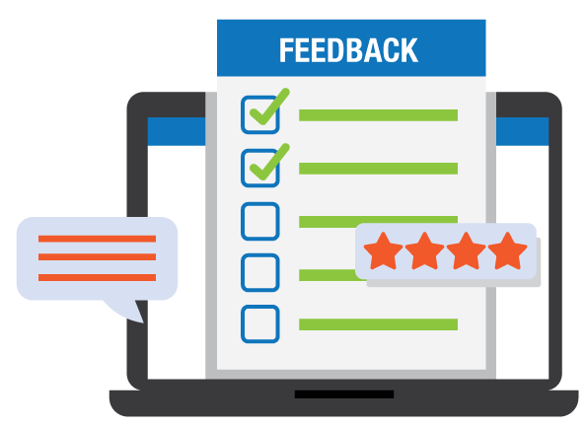
Overcoming Technological Resistance
The importance of change management
You need to manage the change
Have a launch plan, which can include a progressive roll-out
Ensure clear communication
Engage with employees; initiate post-launch surveys, gather feedback, make improvements
Notes:
Anytime we look at bringing in new software to the organization, change management is going to be crucial. I am not suggesting that you need to hire someone specifically as a change manager, although yes, this job does exist, but you need to plan carefully.
Have a launch plan, which can include a progressive roll-out. Sometimes it is best to select one department to trial a piece of software within first, before you roll it out across the entire organization. You can also consider breaking down the program into different components. For example, if you started using our program Systems 24-7 to manage your internal health and safety, often we would get your employees started on the platform right away with the necessary training. This gets their fingers into the software, and over time we can roll out other features such as online policy sign-offs, monthly online safety talks, online incident reporting, etc. You don’t have to chew it all off at once. A lot of the time, it’s actually better to not.
Also, when you have a plan, assign benchmarks and expectations. It will be easier to measure your success when the plan is more tangible.
Ensure clear communication so that everyone knows what their roles and responsibilities are. If your management team has different access than your front-line employees, do they know what they need to be doing? You might want to create written procedures as part of your communication initiatives.
Engage with employees; initiate post-launch surveys, gather feedback, and make improvements.

Slide 10
Overcoming Technological Resistance
Role of Software Programs in Managing Change
Project management
Software programs can provide you with features for planning, tracking, and managing change initiatives
Communication and Collaboration
Share information, discuss ideas, and collaborate on tasks
Documentation and Knowledge Management
Software programs offer capabilities for documenting change management plans, processes, and procedures
Training and Learning Management
Feedback and Measurement
Notes:
Software programs play a crucial role in managing change by providing tools and platforms to facilitate various aspects of the change management process. Some key roles of software programs in managing change include:
Project Management: Software programs offer features for planning, tracking, and managing change initiatives. They provide tools for setting timelines, assigning tasks, tracking progress, and managing resources, and helping teams stay organized and on track throughout the change process.
Communication and Collaboration: Change management software enables effective communication and collaboration among stakeholders involved in the change process. It provides centralized platforms for sharing information, discussing ideas, and collaborating on tasks, and fostering transparency and alignment among team members. This can be as simple as creating project groups on teams.
Documentation and Knowledge Management: Software programs offer capabilities for documenting change management plans, processes, and procedures. They provide repositories for storing relevant documents, resources, and best practices, ensuring that valuable knowledge is captured and accessible to stakeholders throughout the organization.
Training and Learning Management: Change management software may include features for delivering training and educational materials to support users in adapting to changes effectively. It provides platforms for creating and delivering training modules, tracking learner progress, assessing comprehension, and enabling organizations to ensure that employees are adequately prepared for change.
Feedback and Measurement: Software programs enable organizations to gather feedback from stakeholders and measure the impact of change initiatives. They provide mechanisms for collecting feedback through surveys, polls, or feedback forms, as well as tools for analyzing data and identifying areas for improvement, enabling organizations to iteratively refine their change management strategies.
Overall, software programs play a pivotal role in streamlining and enhancing various aspects of the change management process, ultimately supporting organizations in successfully navigating and implementing change initiatives.

Slide 11
Centralized Management
Section 2

Slide 12
Centralized Management through Software Platforms
What is centralized management?
Centralized management refers to the organizational structure or approach in which decision-making authority, control, and oversight are concentrated within a single entity or location within an organization.
Decision-making authority
Control and oversight
Standardization and Consistency
Resource Allocation
Communication and Coordination
Notes:
Centralized management refers to the organizational structure or approach in which decision-making authority, control, and oversight are concentrated within a single entity or location within an organization. In a centralized management system:
Decision-making Authority: Key decisions regarding policies, procedures, resource allocation, and strategic direction are made by a central authority, such as top management or a designated leadership team.
Control and Oversight: The central management entity exercises control and oversight over various functions, departments, or branches of the organization. This includes monitoring performance, ensuring compliance with policies and regulations, and coordinating activities to achieve organizational goals.
Standardization and Consistency: Centralized management often involves standardizing processes, practices, and procedures across the organization to ensure consistency and efficiency in operations. This can help streamline workflows, reduce duplication of efforts, and improve overall effectiveness.
Resource Allocation: Centralized management typically involves central control over resource allocation, including budgeting, staffing, and project prioritization. This allows for strategic allocation of resources based on organizational priorities and goals.
Communication and Coordination: Centralized management facilitates communication and coordination among different parts of the organization by providing a clear hierarchy of authority and channels for information flow. This helps ensure alignment of efforts and promotes collaboration toward common objectives.
While centralized management offers certain advantages, such as clear lines of authority and efficient resource allocation, it may also face challenges such as slower decision-making processes, reduced flexibility, and potential disconnect between central leadership and local operations. Organizations often balance centralized management with decentralized or distributed decision-making structures to optimize effectiveness and responsiveness to changing conditions.

Slide 13
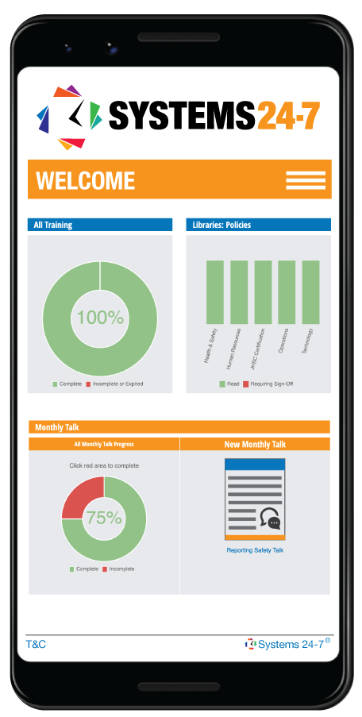
Centralized Management through Software Platforms
What are the benefits of a centralized location for information, policies, and communication?
Accessibility
Consistency
Compliance
Collaboration
Streamlined Communication
Notes:
The program that we offer provides a centralized location for your business programs, such as health and safety, HR, etc. Why would having a centralized location for things like your policies, programs, information, and communication be such an advantage?
It offers several benefits:
Accessibility: It provides easy access to important information and documents for all employees, regardless of their location or department, promoting transparency and efficiency in accessing necessary resources.
Compliance: It helps ensure compliance with regulatory requirements by providing a single source of truth for important policies and procedures, making it easier to track and enforce adherence to relevant laws and regulations.
Collaboration: Centralized information facilitates collaboration among teams by providing a common platform for sharing documents, ideas, updates, and fostering a more cohesive and productive work environment.
Streamlined Communication: By centralizing communication channels, such as company announcements, newsletters, or internal messaging systems, organizations can ensure that important messages reach all employees efficiently, reducing the likelihood of miscommunication or missed communications.

Slide 14
Centralized Management through Software Platforms
Why is employee engagement so important?
Buy-in and ownership
Understanding and clarity
Feedback and improvement
Advocacy and support
Adaptability and resilience
Notes:
Employee engagement is crucial for effective communication in successful technology adoption for several reasons:
Buy-In and Ownership: Engaged employees are more likely to feel invested in the success of technology adoption initiatives. When employees feel involved in decision-making processes and have a voice in how technology will be implemented, they are more likely to embrace the changes and take ownership of their role in the adoption process.
Understanding and Clarity: Engaged employees are more likely to seek out information and ask questions about the new technology. This active engagement fosters a deeper understanding of how the technology will impact their work processes, leading to greater clarity and fewer misunderstandings.
Feedback and Improvement: Engaged employees are more likely to provide valuable feedback throughout the technology adoption process. This feedback loop allows organizations to identify potential challenges or areas for improvement early on, leading to more effective implementation strategies and better outcomes in the long run.
Advocacy and Support: Engaged employees can serve as advocates for the new technology within the organization. When employees are enthusiastic about the benefits of the technology and its potential to improve workflows or outcomes, they are more likely to encourage their colleagues to embrace the changes and provide support during the transition period.
Adaptability and Resilience: Engaged employees are generally more adaptable and resilient in the face of change. Technology adoption often requires employees to learn new skills or adjust to new ways of working, and engaged employees are better equipped to navigate these challenges with a positive attitude and a willingness to learn.
Overall, employee engagement fosters a culture of open communication, collaboration, and continuous improvement, which are essential ingredients for successful technology adoption in any organization.

Slide 15
Resources for Non-Experts
Section 3

Slide 16
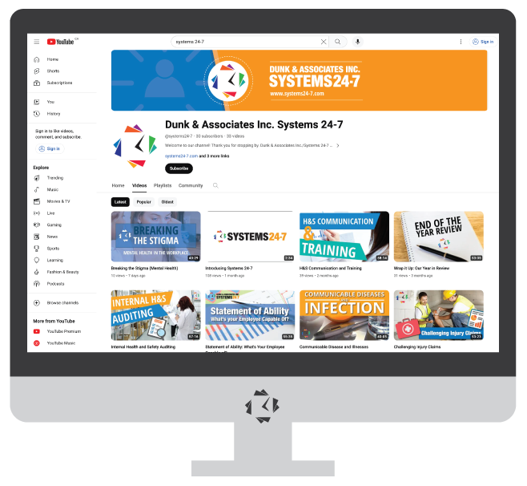
Resources for Non-Experts
Not everyone is an expert when it comes to managing technology.
Look at the resources available:
YouTube Videos
Product Videos
Technical Support
“Champion”
Slide Share
Online communities or forums
Don’t be afraid to ask for help! For change management, ensure you communicate resources for help.
Notes:
Don’t set the expectation that everyone will just “get it”.

Slide 17
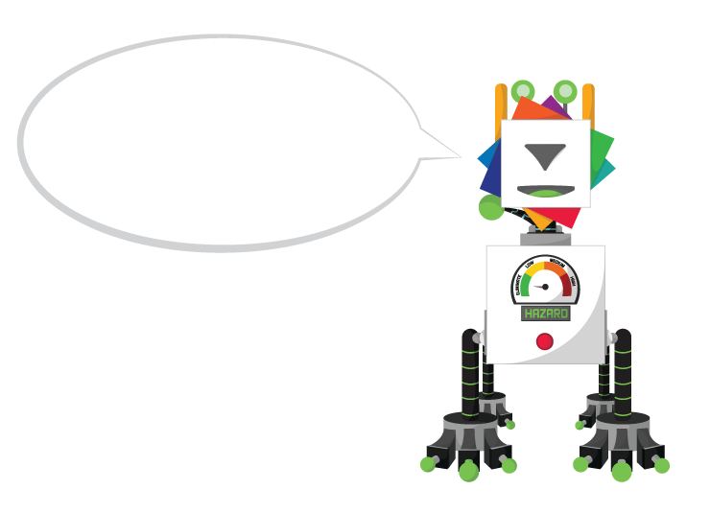
Resources for Non-Experts
AI for Support
There are a variety of new AI programs which can help you with an array of tasks – from resource creation to information gathering and more.
Chat GPT
Perplexity
Jasper AI
Chatsonic
Bing AI
And more!
Ask targeted questions to narrow your audience for example “Answer this question as a world-class trainer in the developmental services sector…”

Slide 18
Resources for Non-Experts
Answer: Motivating staff to complete online training can be challenging, but here are some strategies you can employ:
Highlight the Benefits
Set Clear Expectations
Make it Relevant
Provide Incentives
Offer Support
Encourage Collaboration
Track Progress
Lead by Example
Make it Engaging
Seek Feedback
Notes:
Here’s a sample of some questions we asked!
Motivating staff to complete online training can be challenging, but here are some strategies you can employ:
Highlight the Benefits: Emphasize how completing the training will benefit them personally and professionally. Whether it's improving skills, advancing their career, or staying up-to--date with industry trends; make it clear how the training aligns with their goals.
Set Clear Expectations: Clearly communicate the importance of the training and any deadlines associated with it. Let your staff know that completing the training is a priority and required for their roles.
Make it Relevant: Ensure that the training content is relevant to their job roles and responsibilities. When employees see the direct application of the knowledge gained from the training in their daily work, they are more likely to be motivated to complete it.
Provide Incentives: Offer rewards or recognition for completing the training. This could be anything from gift cards to extra time off or even opportunities for advancement within the company.
Offer Support: Provide support and resources to help employees complete the training successfully. This could include access to mentors, additional materials, or dedicated time during work hours to focus on the training.
Encourage Collaboration: Foster a sense of community and collaboration among your staff by creating discussion forums or study groups where employees can support and motivate each other through the training process.
Track Progress: Implement a system to track employees' progress through the training modules. Providing regular feedback and updates on their progress can help keep them motivated and accountable.
Lead by Example: Show your own commitment to continuous learning by participating in training programs yourself. Leading by example can inspire your staff to prioritize their own professional development.
Make it Engaging: Choose training platforms and materials that are interactive and engaging. Incorporate videos, quizzes, and other interactive elements to keep employees interested and motivated throughout the training process.
Seek Feedback: Ask for feedback from your staff about the training programs. Understanding their preferences and challenges can help you tailor future training initiatives to better meet their needs and keep them motivated.
By implementing these strategies, you can create a more motivating environment for your staff to complete online training successfully.

Slide 19
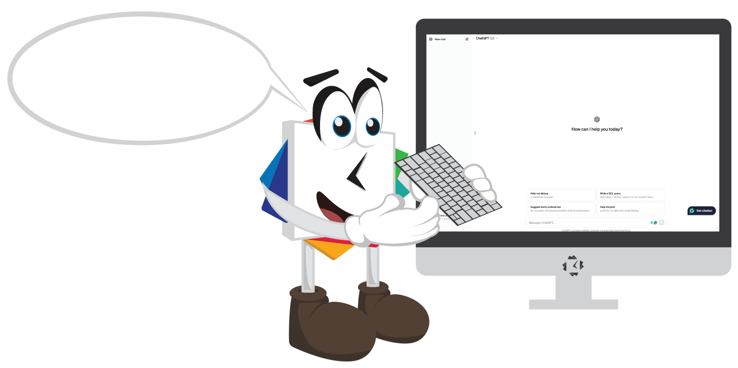
Resources for Non-Experts
AI for Support
Want to have better answers? Ask more targeted questions to narrow your audience.
For example:
“Answer this question as a world-class trainer in the developmental services sector…”
“Put yourself into the shoes of someone who has a ____ disability. How would you approach the following topic?”
Notes:
This solution isn’t perfect, so ensure you always read through the responses and cater them as needed. It is not always accurate and requires oversight.

Slide 20
Accessibility and User-Friendliness
Section 4

Slide 21
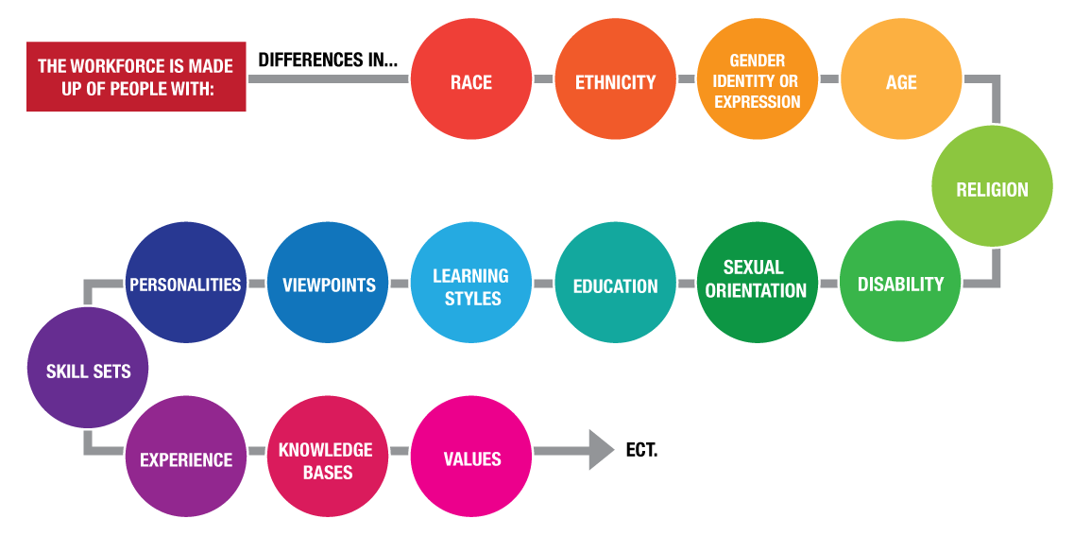
Accessibility and User-Friendliness
In today's diverse workplaces, it's essential to acknowledge and cater to the varying needs and abilities of employees.
Every workplace comprises individuals with diverse backgrounds, abilities, and preferences.
Accessibility in technology ensures that everyone, regardless of their physical abilities or limitations, can effectively utilize digital tools and resources.
Implementing accessible solutions not only fosters inclusivity but also enhances productivity and efficiency across the organization.

Slide 22
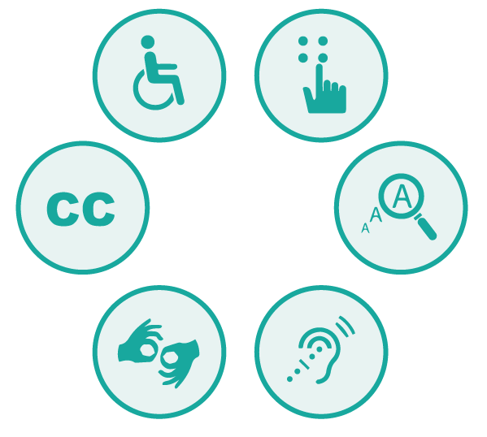
Accessibility and User-Friendliness
Technology should be inclusive and cater to a broad range of users.
Prioritizing accessibility and user-friendliness in technology is not just a matter of compliance; it's about creating an environment where every individual can thrive and contribute to the success of the organization.

Slide 23
Accessibility and User-Friendliness
Ask for product trials and ask for a diverse group of individuals to try it and provide feedback
Ask the technology provider to share their accessibility standards
Check for alternative content for non-text elements
Test keyboard accessibility (can you easily tab the elements)
Assess colour contrast
Verify the application is responsive (try it on desktop and mobile)
Stay updated!

Slide 24
Reporting and Training
Section 5

Slide 25
Reporting and Training Simplified
Incident reporting traditionally involves cumbersome paperwork and manual documentation.
With technology, employees can report incidents promptly through digital platforms, such as mobile apps or online forms.
Automated workflows and notifications ensure timely responses and follow-ups, reducing the risk of delays or oversight.
Leveraging technology for incident reporting enhances transparency, accountability, and the overall safety culture within the organization.
Notes:
Benefits include:
Efficiency: Simplifies the reporting process, saving time and resources for both employees and management.
Accuracy: Minimizes errors and ensures the completeness of incident reports through standardized digital forms.
Visibility: Provides real-time visibility into incident trends and data, enabling proactive risk management and decision-making.

Slide 26
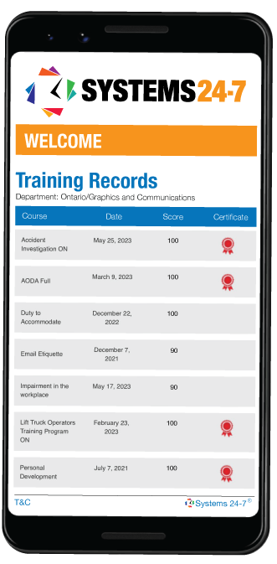
Reporting and Training Simplified
Traditional training record-keeping methods often involve manual filing systems or dispersed data sources.
Accessible training record databases or learning management systems (LMS) centralize training data and make it easily retrievable.
Instant access to training records enables timely verification of compliance, identification of skill gaps, and informed decision-making.
By centralizing and making training records accessible, organizations can enhance compliance, accountability, and the overall effectiveness of their training initiatives.
Notes:
Benefits:
Compliance: Ensures regulatory compliance by maintaining accurate and up-to-date training records accessible for audits or inspections.
Accountability: Enables tracking of individual training progress and completion, fostering accountability among employees and supervisors.
Insights: Facilitates data-driven analysis of training effectiveness, enabling adjustments and improvements to training programs as needed

Slide 27
QR Codes
Section 6

Slide 28
QR Codes for Quick Information
What is a QR Code?
A QR code, short for Quick Response code, is a two-dimensional barcode that contains encoded information. QR codes have become widely used for various purposes due to their ability to store a large amount of data compared to traditional barcodes.
When scanned using a QR code reader or a smartphone camera equipped with QR code scanning capabilities, the encoded information is decoded and can trigger various actions, such as opening a webpage, displaying text, initiating a phone call, or connecting to a Wi-Fi network.
QR codes are versatile and can be used for a wide range of applications.

Slide 29
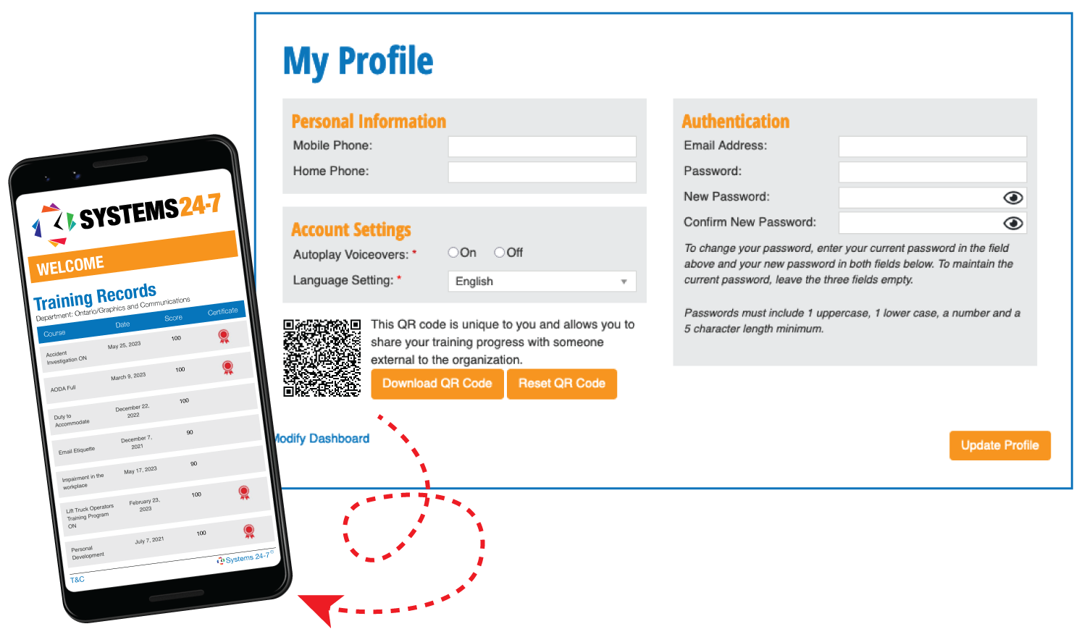
QR Codes for Quick Information
How can QR codes be used in the workplace?
Quick access to safety instructions and procedures.
Links to applications such as incident reporting, inventory tracking, anonymous feedback, visitor check-ins, meeting room booking, training videos, employee onboarding documentation, etc.
QR codes can be created unique to each employee to show training records and progress.
QR codes can contribute to easy information retrieval in diverse work environments!

Slide 30
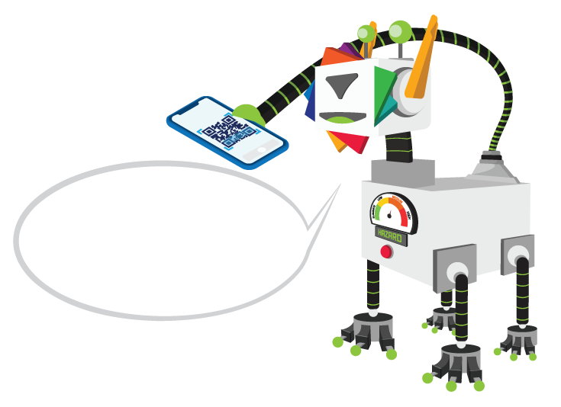
QR Codes for Quick Information
Give it a try! Pull out your smart phone and open-up your camera application.
Notes:
While you’re here….hit the like button!

Slide 31
Benefits of Online Training
Section 7

Slide 32
Benefits of Online Training
Online training enhances flexibility, accessibility, and engagement through various features and advantages inherent to digital learning platforms.
Flexibility:
Self-Paced Learning
Learners can progress through training modules at their own pace, allowing them to allocate time according to their schedule and learning preferences
On-Demand Access
Training materials are available 24/7, enabling learners to access content whenever and wherever it's convenient for them, eliminating the constraints of traditional classroom-based schedules
Modular Structure
Content is often divided into manageable modules or sections, giving learners the flexibility to focus on specific topics or revisit sections as needed

Slide 33
Benefits of Online Training
2. Accessibility:
Geographical Reach
Online training eliminates geographical barriers, enabling learners to participate regardless of their location, whether they're in the office, working remotely, or traveling
Device Compatibility
Most online training platforms are accessible from desktop computers, laptops, tablets, and smartphones, allowing learners to access content using their preferred devices
Adaptive Learning
Some platforms offer adaptive learning features that cater to diverse learning needs and abilities, ensuring accessibility for learners with different backgrounds and skill levels

Slide 34
Benefits of Online Training
3. Engagement:
Interactive Content
Online training often includes interactive elements such as videos, simulations, quizzes, and gamified activities that enhance learner engagement and participation
Social Learning Features
Collaborative tools such as discussion forums, chat rooms, and peer-to-peer feedback mechanisms foster interaction and knowledge sharing among learners, promoting engagement and community building
Personalization
Online training platforms may offer personalized learning experiences tailored to individual learner preferences and performance, increasing engagement by delivering relevant content and adaptive challenges
Real-Time Feedback:
Immediate feedback mechanisms, such as instant quiz results or progress trackers provide learners with timely insights into their performance, motivating them to stay engaged and track their progress

Slide 35
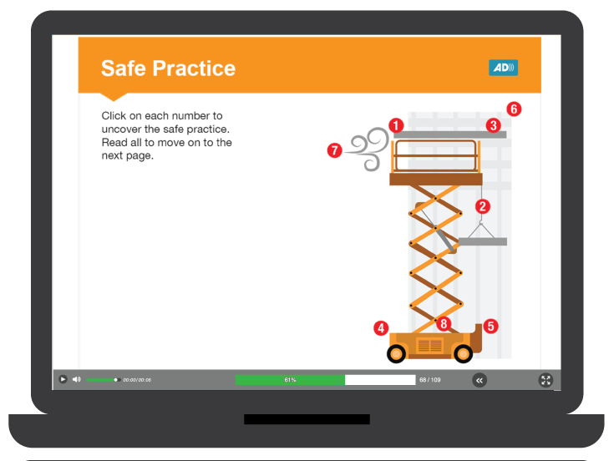
Benefits of Online Training
By leveraging these features, online training not only offers flexibility and accessibility but also enhances learner engagement by providing interactive, personalized, and socially connected learning experiences. This combination of flexibility, accessibility, and engagement contributes to more effective and impactful training outcomes for organizations and learners alike.
Accessibility
Interactive
Flexibility

Slide 36
Conclusion
Section 8

Slide 37
Conclusion
In conclusion, leverage technology as a catalyst for improved workplace culture. By adopting accessible and user-friendly solutions, create safer and healthier working environments, enhance employee performance, and effectively manage change. The incorporation of technology is not only an investment in safety but also a strategic move towards a more connected and efficient workplace.

Slide 38
Connect With Us!
Are you subscribed to our newsletters? Each month we share important news, updates, and any changes in legislation across Canada.
We also provide free resources and provide you with links to join our upcoming webinars. If you want to be part of our mailing list, email communications@systems24-7.com.
www.facebook.com/systems247
www.Instagram.com/dunk247
www.linkedin.com/systems-24-7
https://www.youtube.com/
@systems24-7

