Slide 1
Exploring Access and Utilization of Passport Funding: Perspectives of People with the label of Intellectual Disabilities and Their Families
Research By Us With Us
Successful Advocacy Research Group

Slide 2
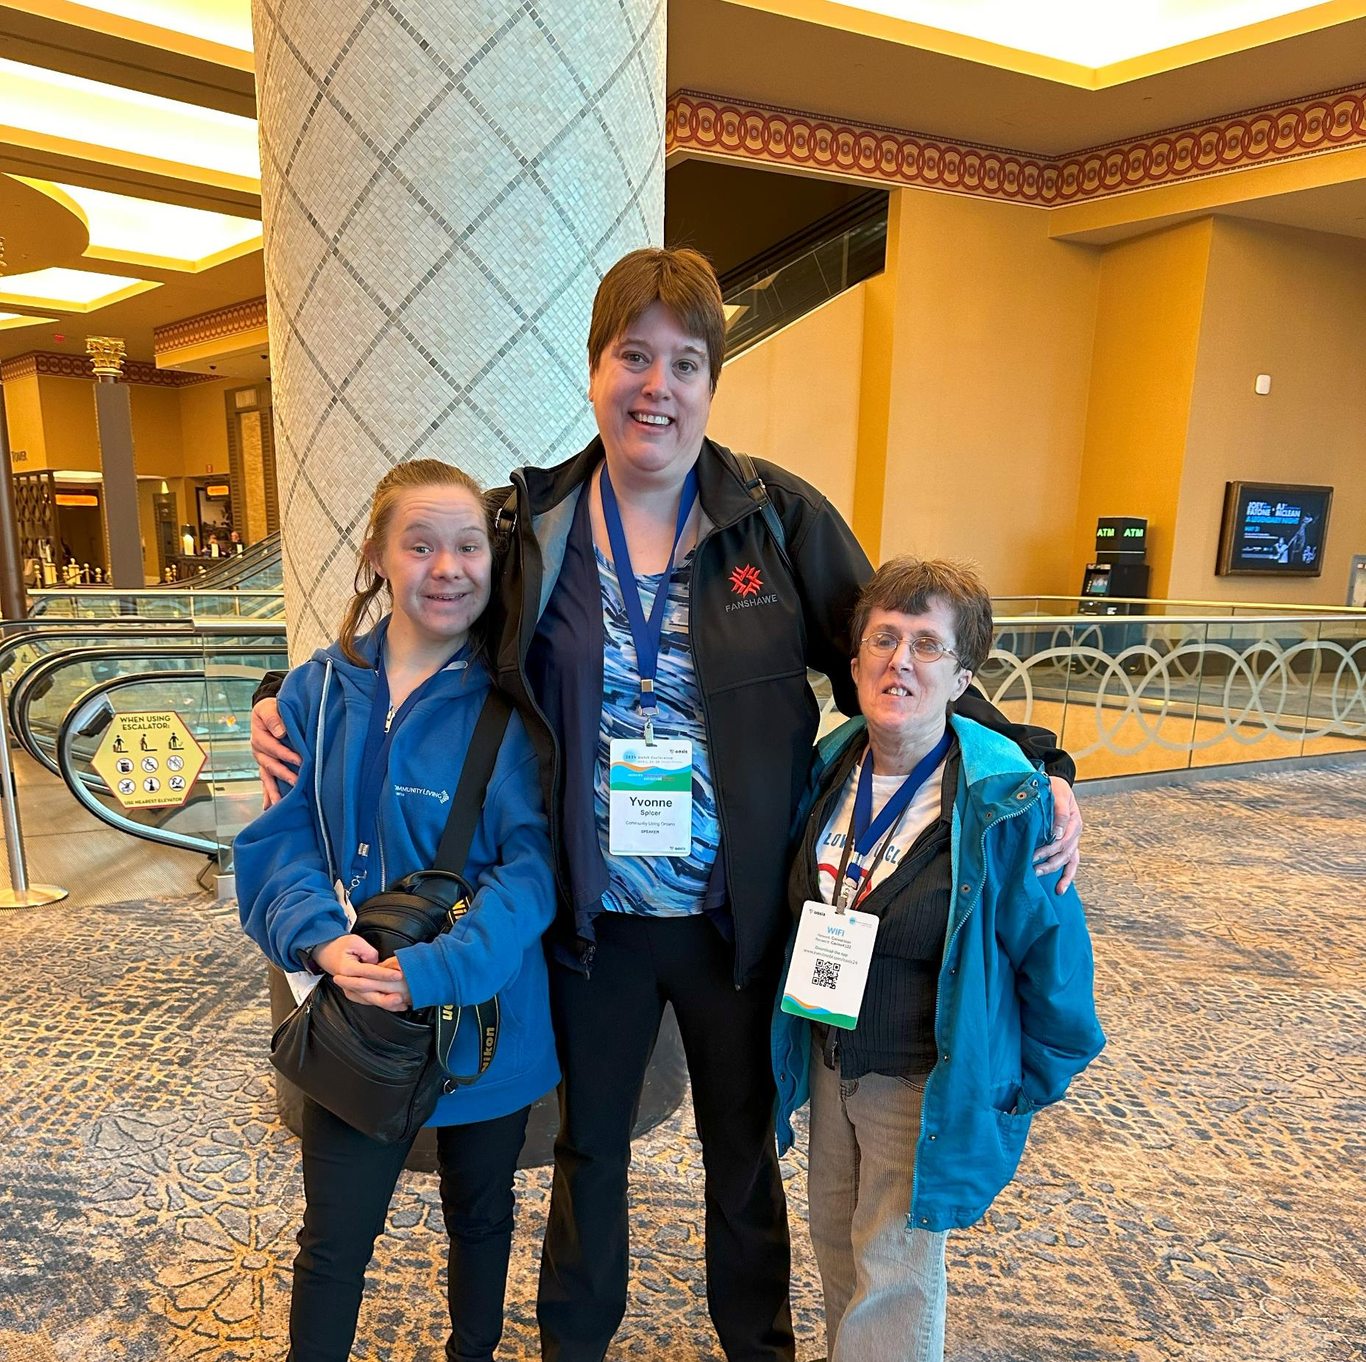
Self Advocate Research Group
Nicole Flynn
Yvonne Spicer
Theresa Somerton

Slide 3
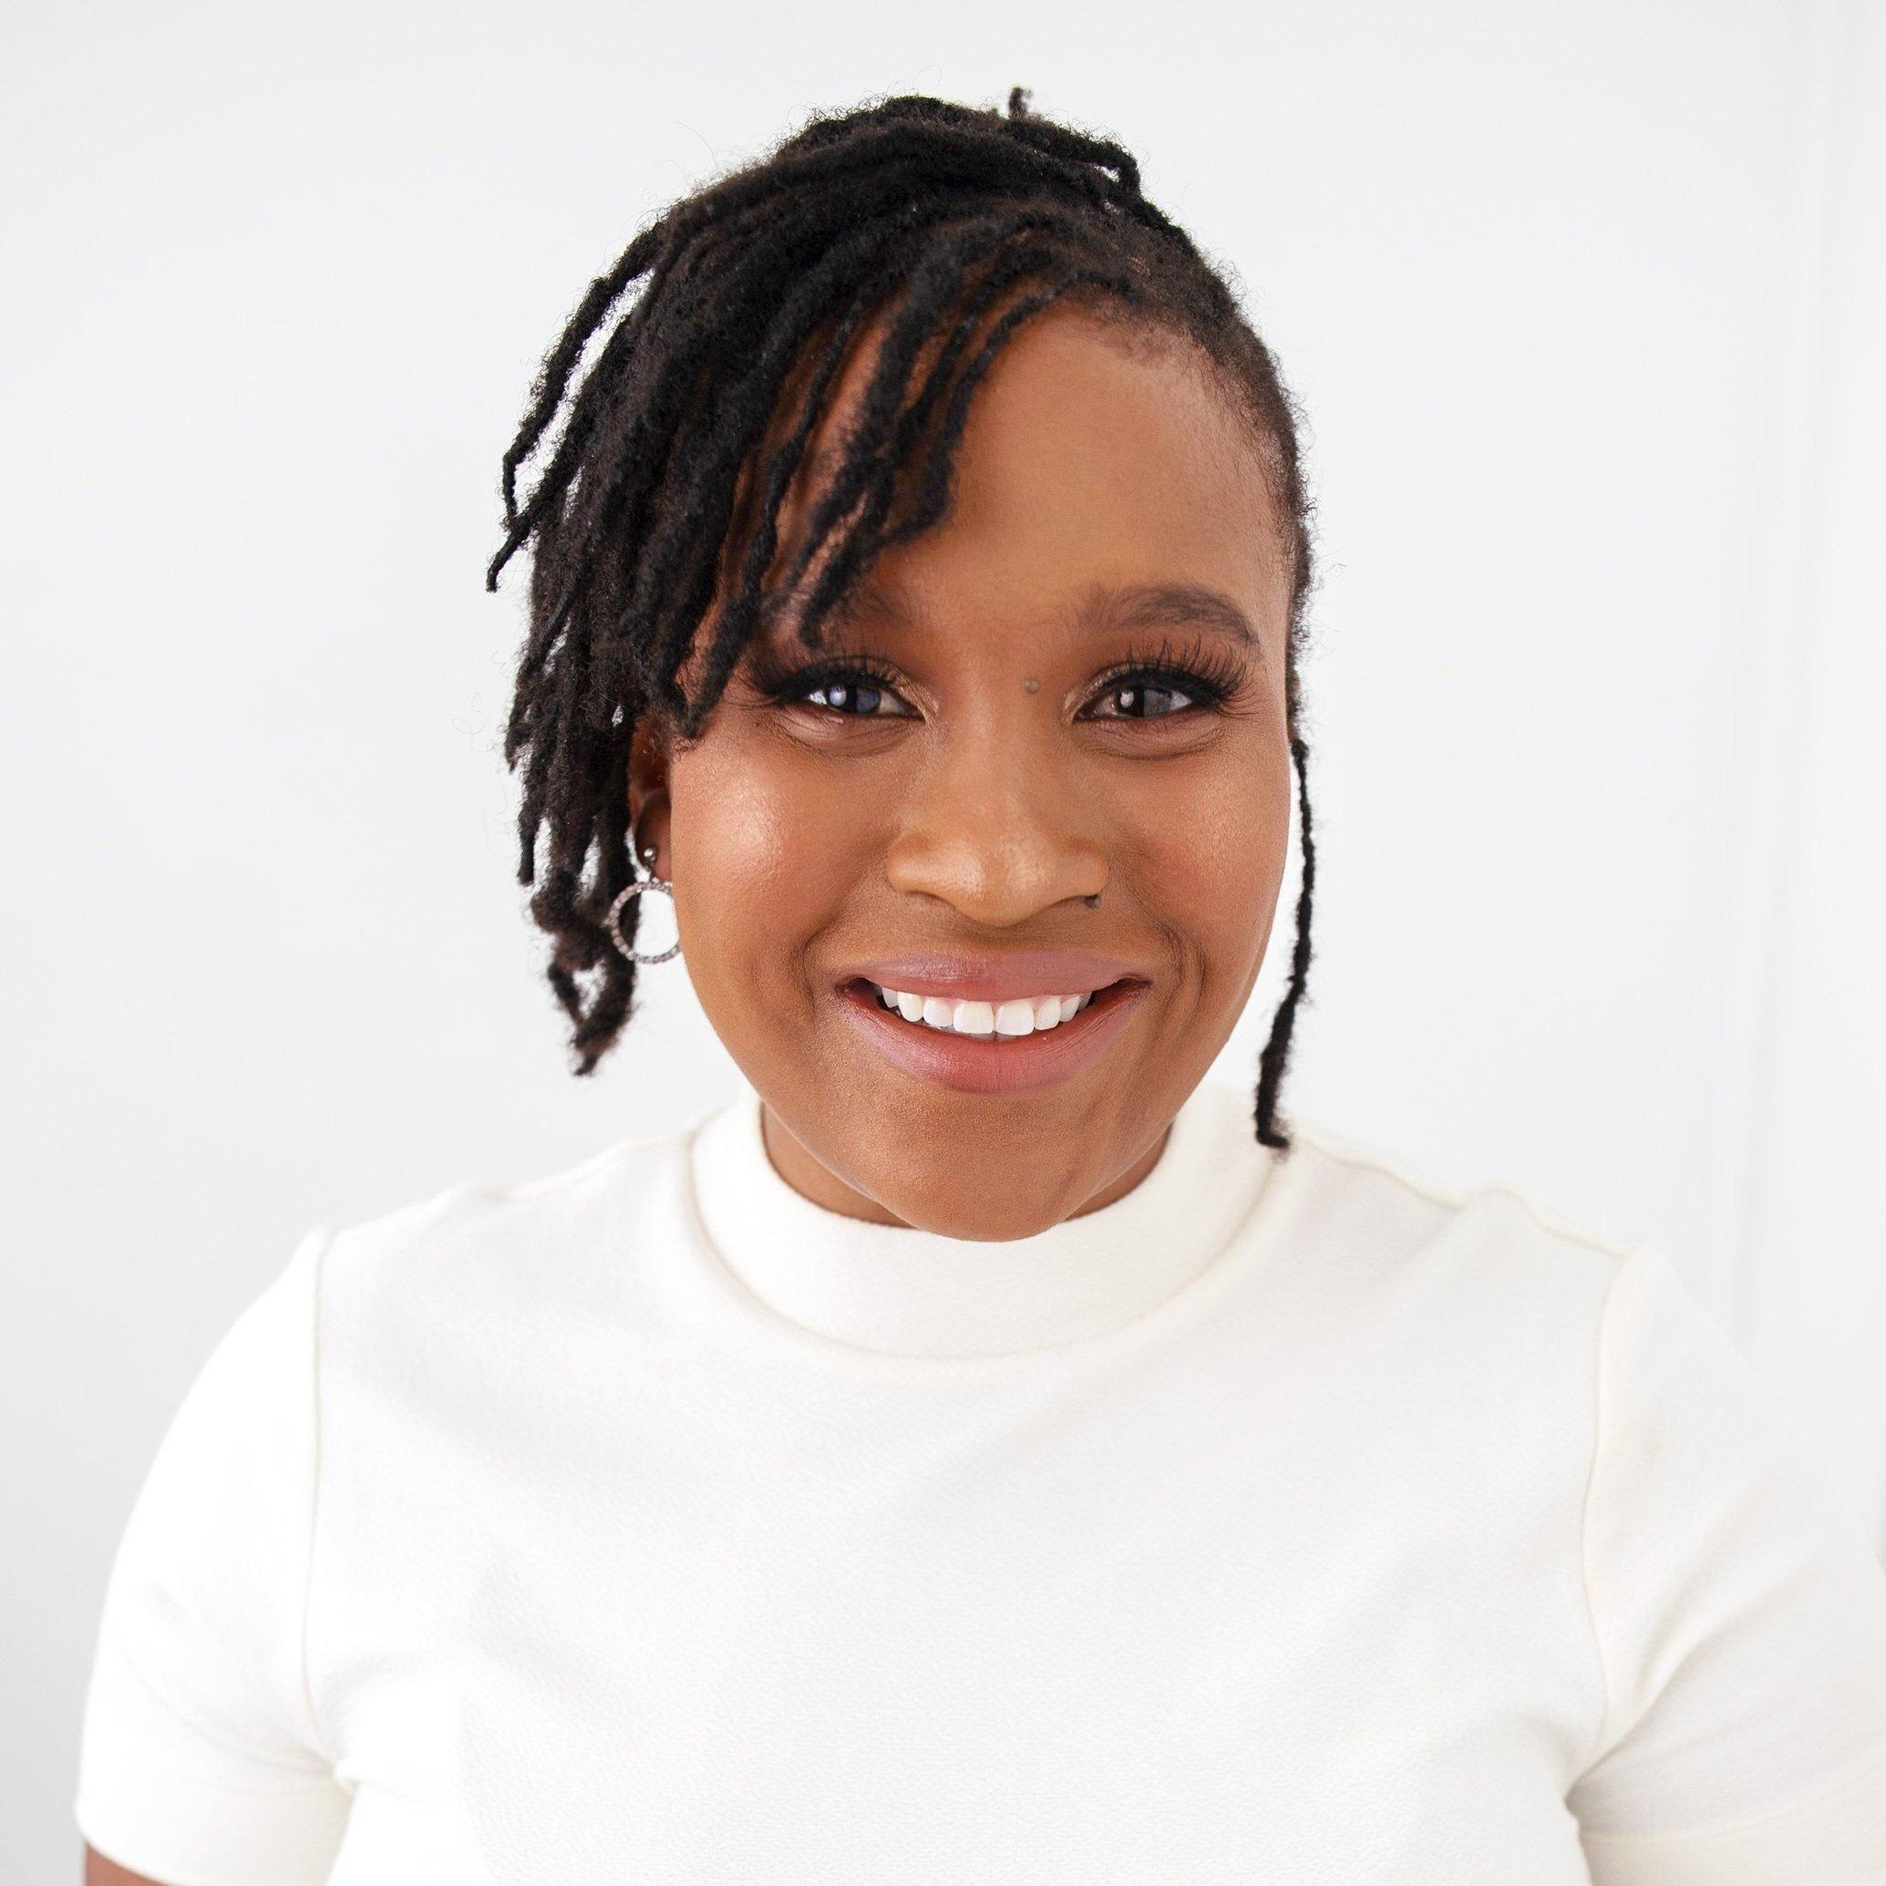
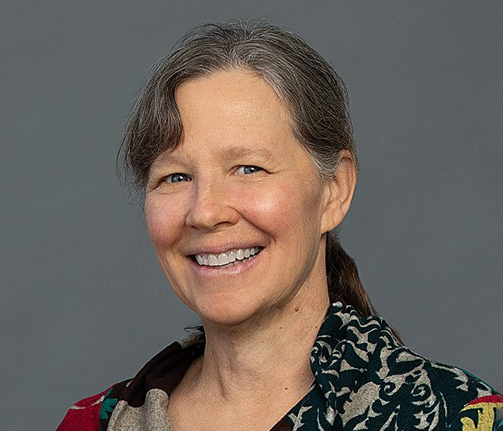
Research Advisors
Alison McLean
Kathryn Primrose

Slide 4
Reasons we did the survey

Slide 5
Ownership Control Access Possession

Slide 6
Questions we asked

Slide 7
Our research plan

Slide 8
The purpose of the research

Slide 9
Who are we going to survey

Slide 10
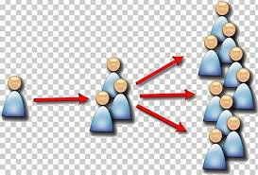
How will we reach the people

Slide 11
What will the survey tell us

Slide 12
How did we write the survey

Slide 13
Who we asked for feedback to make improvements

Slide 14
Creating and testing the survey

Slide 15
What was the response

Slide 16
What did the survey tell us

Slide 17
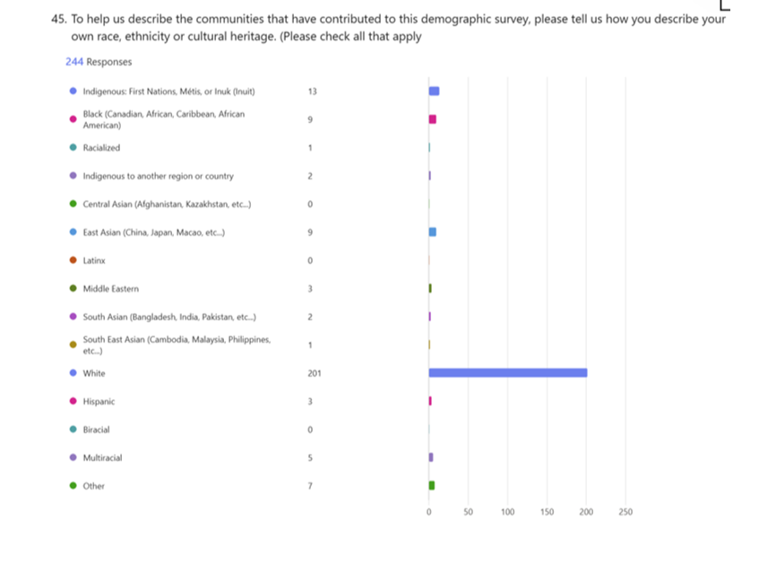
Race, Ethnicity or Cultural Heritage

Slide 18
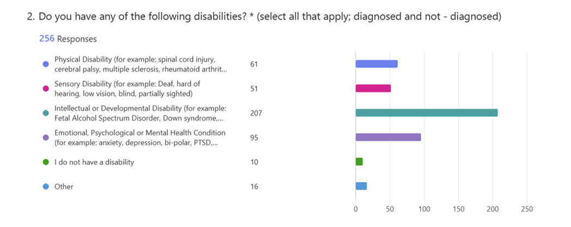
Labels of Disability

Slide 19
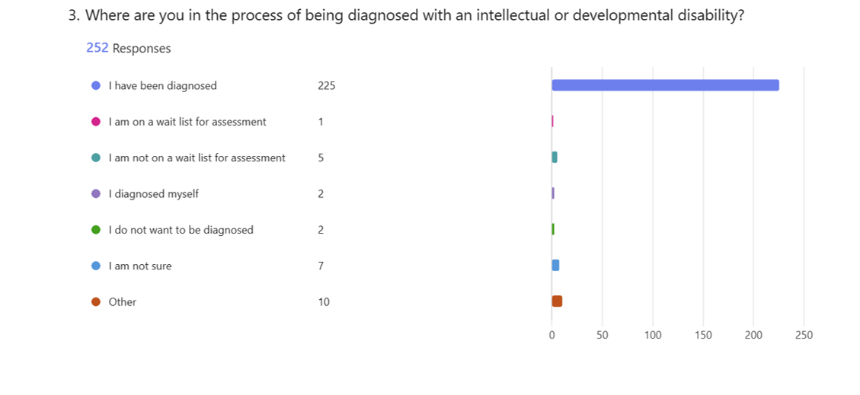
Process of being diagnosed

Slide 20
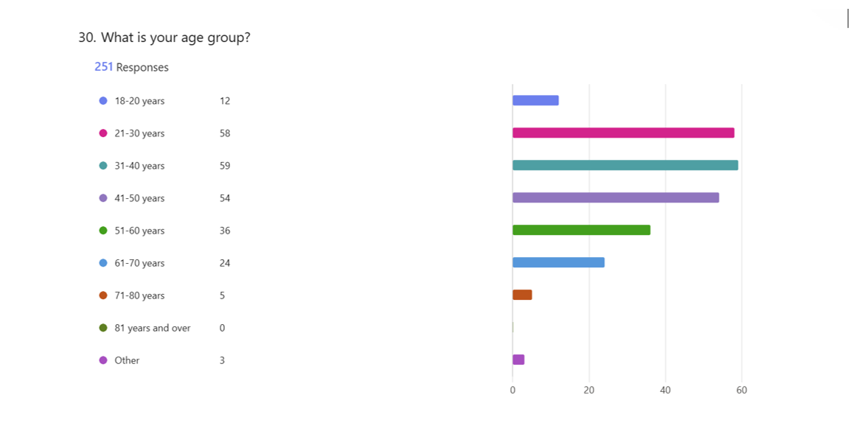
Age Group

Slide 21
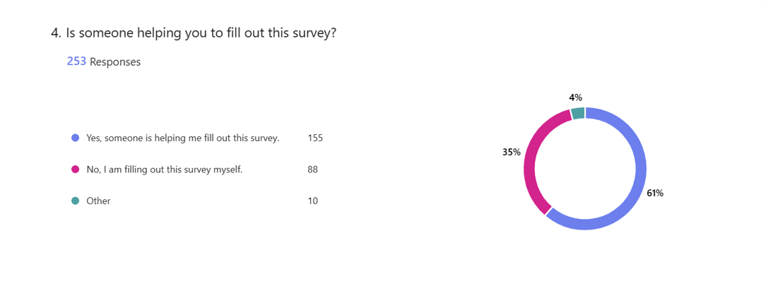
Is someone helping you

Slide 22
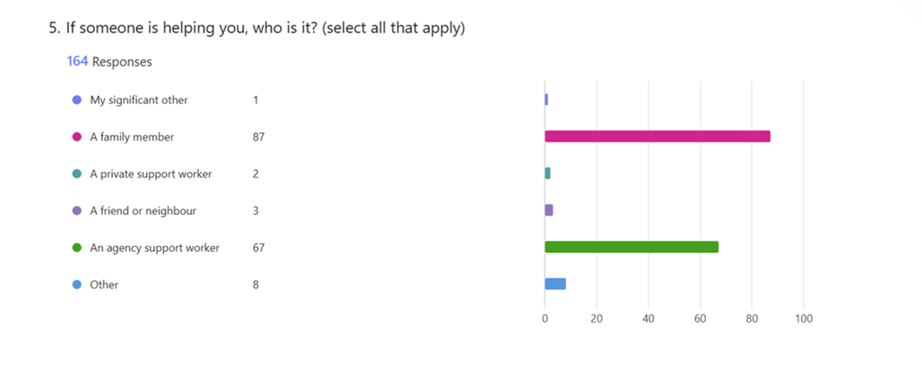
Who is helping you

Slide 23
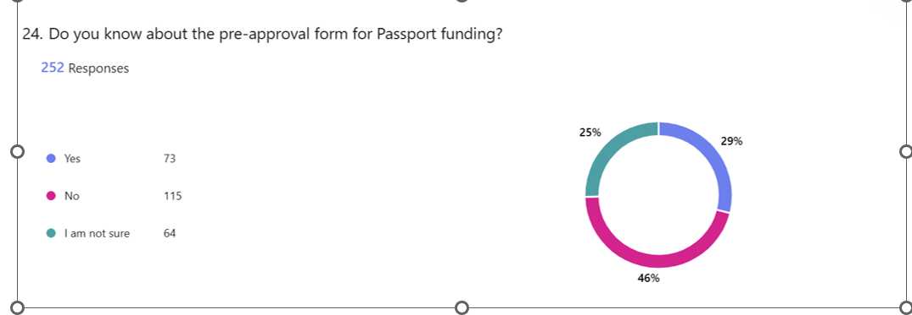
Pre – Approval Application

Slide 24
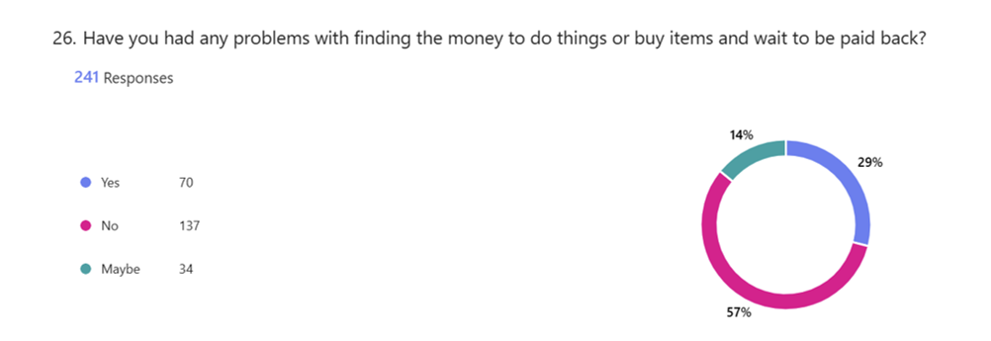
Waiting to be paid back.

Slide 25
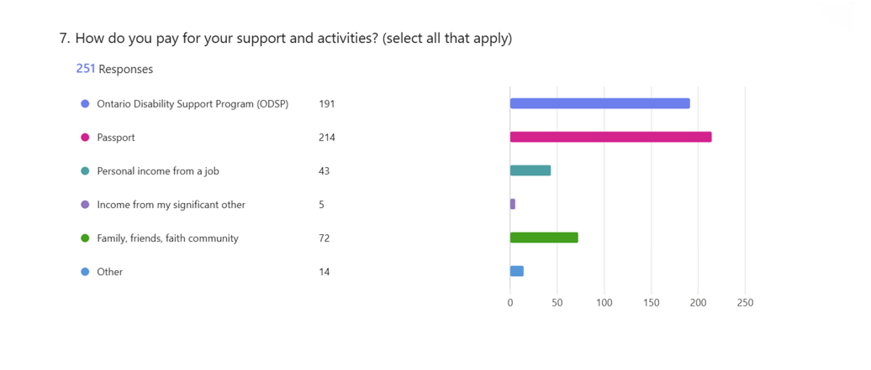
Paying for support and activities

Slide 26
What were the takeaways from the responses

Slide 27
What did we learn from this experience

Slide 28
What were challenges

Slide 29
What would help?

Slide 30
What’s next?

Slide 31
Leading Research about People who Live with the Label of Intellectual Disability

Slide 32
Participatory Advocacy Research Network

Slide 33
Conclusion

Slide 34
Contact Information
YTNSARG@gmail.com

