Slide 1
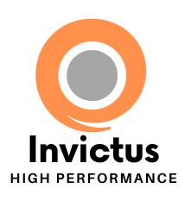
Future-Proofing Community Organizations:
Building Sustainable, High-Performing Teams Before Change Arrives
May 1, 2025

Slide 2
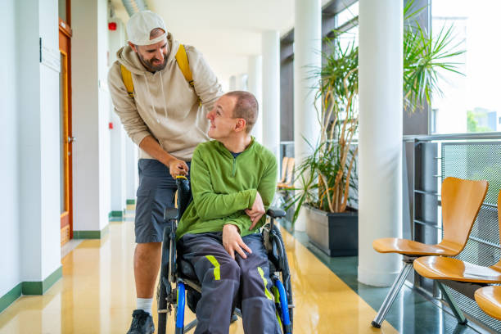
Today You Will Learn
The goals of this session are to help you understand
What it takes to “future proof” your organization
How you can use those factors to create a high performing, thriving community organization
Lessons learned from Community Living Huntsville’s journey
To Get There we will:
Review some of the challenges we are dealing with as a system
The factors research and experience tell us are the most important to be resilient and sustainable
How to build a high performing, thriving organization
How you can learn from Community Living Huntsville’s journey

Slide 3
Your Best Way to Learn Today
Neuroscience studies have repeatedly shown that there are 3 key things to being able to learn from today’s session:
Intentional Focus: Focus with intention during the session
Take Immediate Action: Applying what you have learned right away (again intentionally)
Accountable: Holding yourself accountable for taking action and applying what you have learned

Slide 4
With my High-Performance Coaching Hat On…
As you participate in this training/workshop, I want you to think about:
Is this topic important to me?
How could we benefit from being a high performing, thriving organization?
What would stop me from doing something like this?

Slide 5
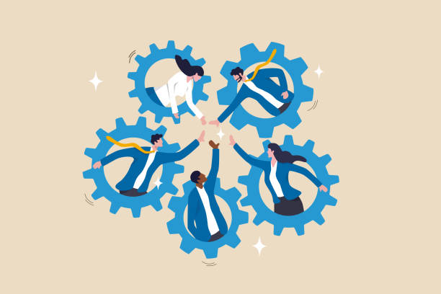
Challenges We are Facing
What community organizations are up against:
System transformation and policy shifts
Workforce shortages and burnout
Growing demand and complex needs
Funding constraints and operational demands
Increased accountability and change fatigue
Leadership gaps and generational transitions
The pressure is real. But pressure doesn’t have to break us—if we build the internal capacity to adapt, align, and thrive.

Slide 6
How System Challenges Impact Community Organizations
Why These Pressures Require a New Kind of Internal Strength
System-level transformations—such as policy shifts, funding changes, and evolving service delivery models—exert profound effects on community organizations.
Increased client complexity and changing service delivery models can lead to challenges with team cohesion, increased staff stress and overwhelm, and a need for resilience
Rapid changes can create uncertainty, leading to decreased trust among staff and between staff and leadership. This erosion undermines psychological safety, which is essential for effective teamwork and adaptability
The complexity of change can lead to decision fatigue, emotional dysregulation and overwhelm for your management team and staff
Inadequate internal communication strategies during transformations can result in fragmented information flow, leading to inconsistent decision-making and a lack of cohesive direction.
Changing finances and service delivery expectations can require new or deeper skill sets, more flexible staffing models, stronger or diverse service delivery models
Legacy organizational structures often struggle to adapt to new demands, leading to inefficiencies and misaligned processes.

Slide 7
High-Performing Community Organizations Excel in Adaptability
Research and experience indicate that organizations characterized by high performance and thriving cultures exhibit enhanced adaptability in the face of systemic challenges:
Enhanced resilience and agility
Improved problem-solving capabilities
Increased employee engagement
Stronger alignment across teams and functions
Greater capacity for change adoption
Improved staff well-being
Improved staff retention

Slide 8
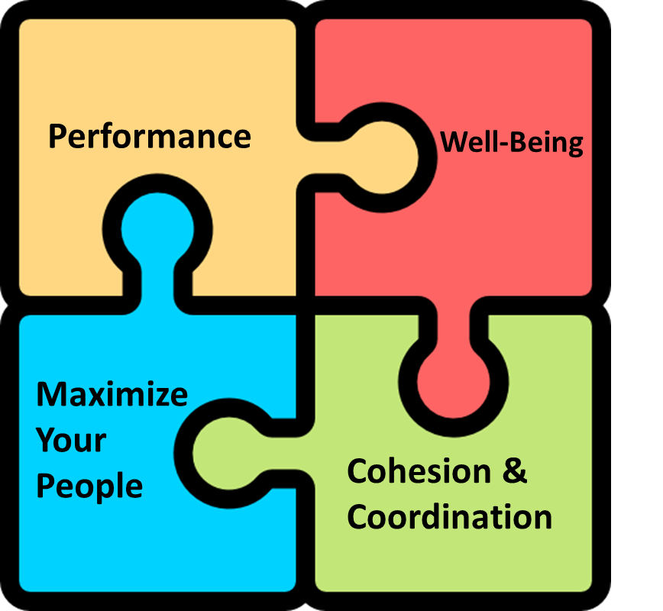
High Performing Community Team
A high performing team is one that consistently performs at a high-level, supports employee/team/ organizational well-being, and maximizes your people and is cohesive.
The team is supported by deep safety and trust
Safety and Trust

Slide 9
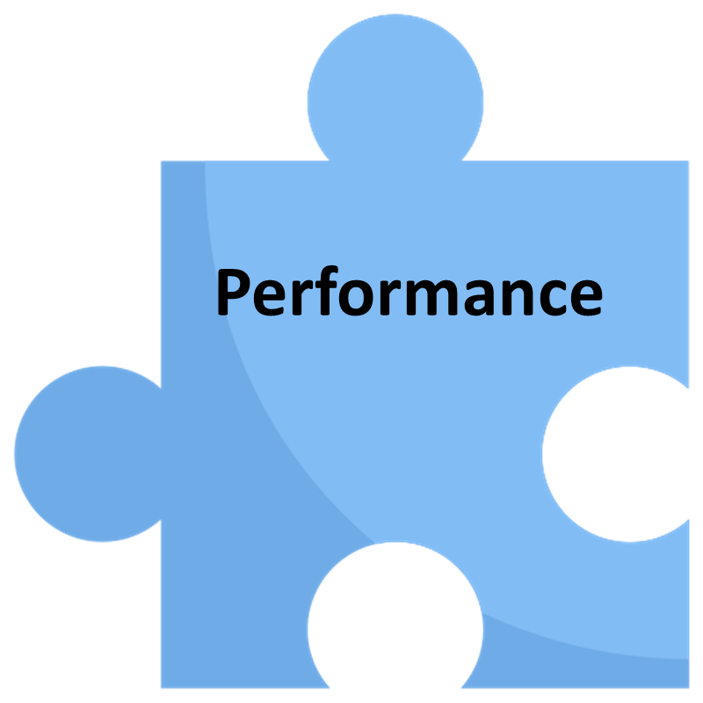
How Does a Team Consistently Perform at a High Level?
Evidence and experience shows us that the factors that matter most:
Clarity – Do the Team members know, understand, and accept what the goals of the Team are? Is there clarity in what they are pursuing?
Identity/Relevance – High performing teams show a strong connection between personal and collective team (and even organizational) identifies, values and goals.
Alignment – High performing community organization teams have a strong alignment between their team’s work, the organization’s vision, and even the goals of the funding agency/Ministry.
Efficiency and Effectiveness – A highly successful team is one that has the approaches, processes and tools to repeatedly achieve their goals with a low amount of resources
The Right People, Skills, Roles - High performing and effective teams have the right set of roles, responsibilities and skills for the work that is to be completed. This also includes conflict management, inter-relationship and other skills that are important for teams to work effectively.
…but the real magic happens with…
Collective Creativity – The ability of a group to generate innovative ideas and solutions by working together, drawing on diverse perspectives, skills, and experiences.

Slide 10
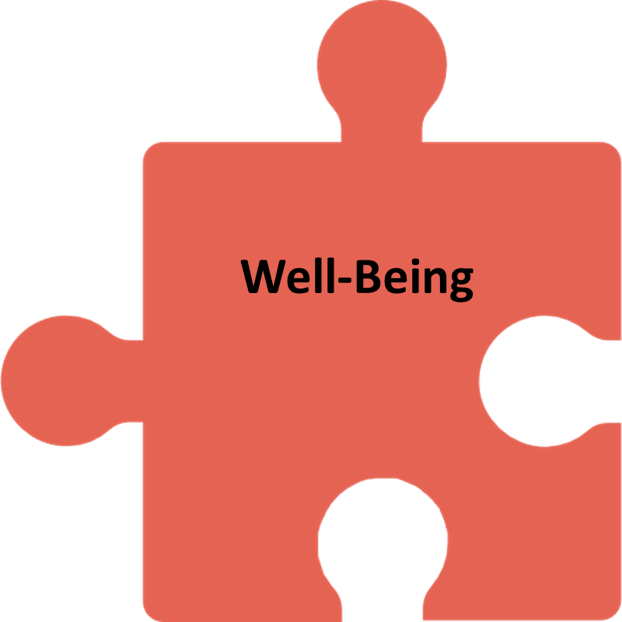
One Magic Ingredient Can Lead to Thriving…
If you marry Well-Being with High Performance, you can achieve sustained team performance without burning out the team members.
Thriving happens when individuals or teams experience both high performance and well-being simultaneously.
It’s not just about excelling in tasks or hitting targets, but also maintaining health, happiness, and balance while doing so.

Slide 11
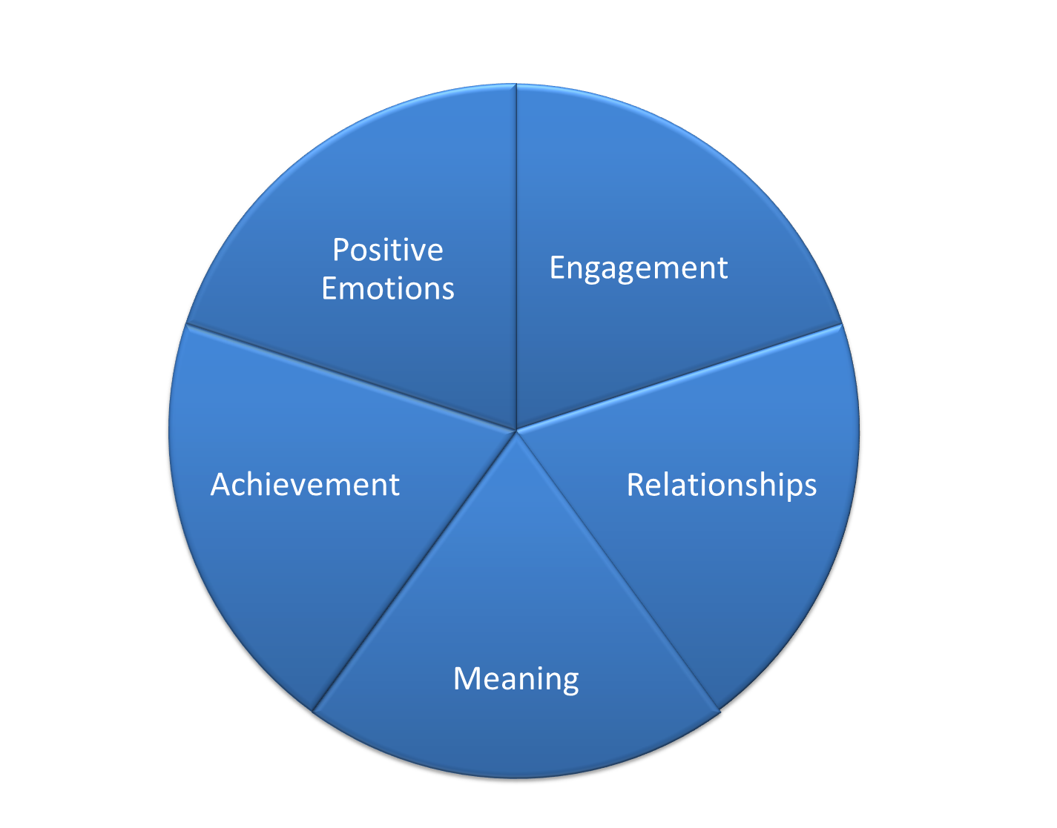
What is Well-Being?
Well-being is a dynamic state in which individuals experience a balance of physical vitality, mental clarity, emotional resilience, and social connection.
It enables sustained performance, fulfillment, and adaptability in the face of challenges.
It is typically built and sustained through multiple areas: positivity, engagement, etc. (different models have different factors)

Slide 12
PERMA Model of Well-Being
Positive Emotions – Cultivating joy, gratitude, and optimism enhances resilience and motivation, fueling sustained high performance.
Engagement – Deep focus and immersion in meaningful work (flow state) lead to higher productivity, creativity, and job satisfaction.
Relationships – Strong, trusting connections with colleagues improve collaboration, psychological safety, and team cohesion.
Meaning – Connecting daily work to a larger purpose boosts motivation, commitment, and long-term fulfillment.
Achievement – Setting and accomplishing meaningful goals builds confidence, drives progress, and reinforces a high-performance mindset.

Slide 13
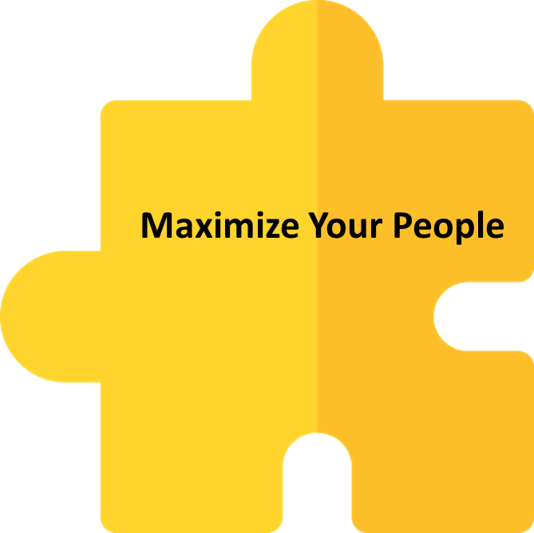
Maximize Your People
The highest performing teams are those that create the environments so that their people can perform at their best, play to their strengths, and develop themselves. At a strategic level this includes:
A job that they like doing every day (i.e. career wellbeing)
Employee engagement
A good culture
A job that aligns with one’s natural strengths
A coaching and mentoring supervisor
Collective creativity
Enhanced motivation and engagement
Improved performance and productivity
Improved resilience
Improved problem solving
Improved retention
Gallup: Organizations that do this have 11% greater profitability and are twice as likely to retain their employees.

Slide 14
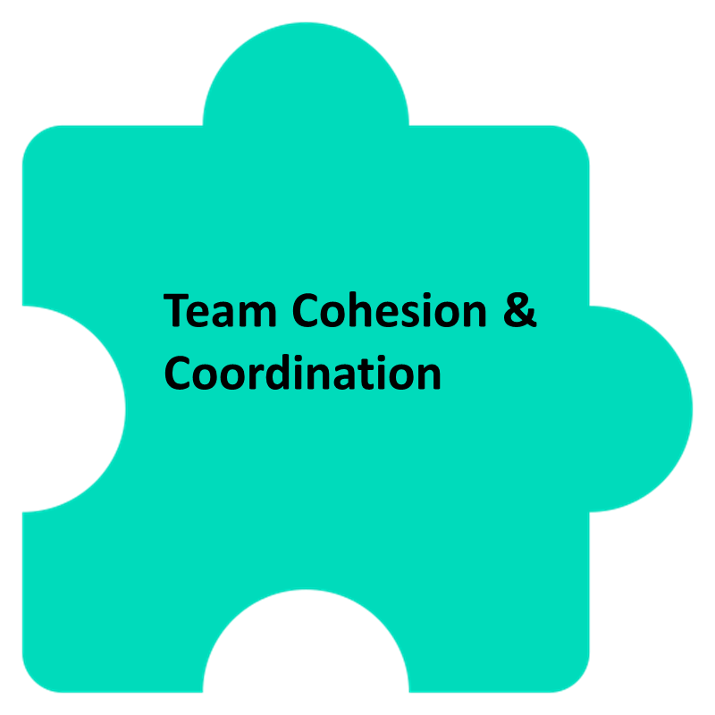
Team Cohesion and Coordination
Research supports that teams with high levels of cohesion, shared goals, clear communication, and coordinated actions tend to outperform those that lack these qualities.
Some of the factors that help build it:
Shared purpose and meaning
Clear roles and responsibilities
Psychological safety and trust among team members
Effective communication norms
Shared accountability/extreme ownership
Strengths-based collaboration
Positive social relationships
Factoid: a more diverse team is actually more productive and performs at a higher level if the above elements are present

Slide 15
Safety and Trust
Psychological safety and trust underlie the 3 other sets of factors, because none of them work without safety and trust.
This comes from Team Safety and Trust research, psychology research, neuroscience research, and many experts in the field of Team performance.
What is Psychological Safety?
Psychological Safety is the shared belief that the team is safe for interpersonal risk-taking.
This means that team members feel comfortable expressing their thoughts, asking questions, admitting mistakes, or sharing concerns without fear of embarrassment, rejection, or punishment.
What is Trust?
The belief or confidence in another person's reliability, integrity, and competence.
It’s about expecting that others will act in ways that are supportive, beneficial, or at least not harmful, to you.
Trust involves the willingness to be vulnerable to the actions of others, with the expectation that they will be supportive and respectful.

Slide 16
Community Living Huntsville Was Facing Some Challenges
The organization needed to address some growing challenges the management team was sensing in the organization including:
Growing lack of trust or safety between the staff and leadership
Growing mistrust in the leadership team
The culture is not what it should be
Staff motivation and engagement was low
The management team wanted a project that:
Confirmed whether and to what degree these challenges existed
Sought to understand why they existed
Helped create a thriving, high performing culture

Slide 17
We Created the Thriving Culture Project
The goals of the project were to:
Understand whether and to what degree the factors that lead to High Performance, Wellbeing, and a Thriving Culture were present
To assess whether and why those challenges exist
To understand what is required to achieving the thriving, high performing culture the organization is seeking
To “future proof” against impending system change

Slide 18
What We Did
Part of the Project Success Was in How We Completed the Project
The project would be successful if:
The staff and management learned what it took to create a thriving, high performing organization
Staff and management were actively engaged in the project
Staff and management collectively acknowledged what was happening and why
Staff and management are involved in creating and implementing the solution
How We Did it:
Integrated the project with our strategic planning process
Completed some evidence-based surveys
Series of facilitated staff focus groups and interviews
Rounds of analysis and discussion'

Slide 19
What We Found
The main challenges and barriers noted through the process included:
Lack of staff/staff turnover
Inconsistent communication and engagement, transparency
Perception of divide between staff and management
Supervisors aren’t always coaches and supportive
Staff not getting enough quality time with supervisors
Inconsistent work/life balance
Personal well-being is suffering – high cost of living, etc.
Impact of personal wellbeing stressors impacting career wellbeing
Inconsistent or worsening work/life balance
Perception of increasingly feeling overwhelmed at work
The Prioritized List to Focus On
Working with staff and management, we whittled down the list to the top priority areas to work on moving forward (since we cannot work on everything):
Safety and trust
Future state cultural values
Well-being
Staff recruitment and retention
Leadership training

Slide 20
Some Budding Hope
From anger to understanding
Reaching out with ideas
Support of a staffing agency
Meetings with negotiating team
Regular All Staff Meetings
Coffee and Conversations
Learn to Lead Program

Slide 21
Lessons Learned/Takeaways
Communicate, communicate, and then communicate more
The importance of one-on-ones and bringing staff together
Engaging the staff in focused discussions
Bottom-up determination of values
It takes more than strategic planning to work on culture
Combining this project with our strategic plan worked well
It is not as bad as it might feel

Slide 22
Thank You!
Michael Schiel
Director, Invictus High Performance
Email: Michael@invictus.coach
Suzanne Willett, CHRL Executive Director
Community Living Huntsville
Email: Suzanne.willett@clhuntsville.ca

