Slide 1
Presented by: Tracey Berman, Jennifer Shaw and
Michelle Del Carmen

Slide 2
LAND ACKNOWLEDGEMENT
The OADD office is situated in the city of Peterborough. We respectfully acknowledge that we are on the treaty and traditional territory of the Mississauga Anishinaabeg. We offer our gratitude to the First Peoples for their care for, and teachings about, our earth and our relations. May we honour those teachings.
Notes:
Michelle

Slide 3
AGENDA FOR TODAY
01
02
03
OADD – WHO WE ARE
HISTORICAL CONTEXT
KEY ACTIVITIES
04
05
06
BECOME A MEMBER
RECAP OF SPRING 2025 CONFERENCE
UPCOMING EVENTS
Notes:
Michelle

Slide 4
01
OADD – WHO WE ARE

Slide 5
THE ONTARIO ASSOCIATION ON DEVELOPMENTAL DISABILITIES
OADD is a professional organization of people working and studying in the field of developmental disabilities, throughout Ontario. OADD’s members include agencies and organizations; university and community college students and instructors; service providers, direct care staff and managers; family support workers; case managers; psychologists; social workers; and other dedicated individuals.
Notes:
Michelle
the OADD serves as a central hub for professionals in the developmental services sector in Ontario, fostering knowledge, promoting best practices, and supporting the workforce that serves individuals with developmental disabilities.
The OADD plays a significant role by:
Supporting Professionals and Students: It provides resources, education, and networking opportunities for a diverse membership, including direct support professionals, managers, educators, researchers, psychologists, social workers, and family support workers.
Promoting Best Practices: OADD aims to translate research and evidence-informed practices into practical, interdisciplinary best practices within the sector.
Facilitating Knowledge Exchange: It encourages collaboration and shared learning among its members through events and networking opportunities.
Disseminating Research: OADD promotes and supports the sharing of research findings through its publications, including the Journal on Developmental Disabilities.
Organizing Educational Events: The association hosts conferences, workshops, and an annual general meeting, providing platforms for learning and professional development.
Offering Scholarships and Awards: OADD provides scholarships and awards to support individuals in the field of developmental disabilities.
Advocacy and Collaboration: While not a direct service provider to individuals with developmental disabilities, OADD acts as a collective voice for its members and collaborates with other sector groups on issues of common interest. It also has special interest groups like the Developmental Services Special Interest Group (DSSIG) and the OADD Research Group (RSIG).

Slide 6
VISION
PURPOSE
VALUES
MISSION
People with IDD are supported by knowledgeable professionals who provide innovative and evidence-informed services.
Our focus is bringing educational and networking opportunities to our members and others in the community, disseminating evidence informed research and best practice information as broadly as possible.
We value research and
practice that is:
-Collaborative
-Inclusive
-Innovative
-Evidence-Informed
OADD promotes and supports research dissemination and evidence informed practice through collaborative networking and knowledge exchange in the field of developmental
disabilities.
Notes:
Michelle

Slide 7
Board & Committee Structure
OADD Chair
Chair-Elect
Past Chair
Secretary
Treasurer
Membership Chair
Publications Chair
Conference Chair
Members at Large
Research Liaison
DSSIG Liaison
Administration
Notes:
VOLUNTEER BOARD B/C WE RECEIVE NO MINISTRY FUNDING
ONLY ONE STAFF PERSON – INTERNALLY FUNDED

Slide 8
Position | Name | Organization
OADD Chair | Michelle Del Carmen | The Centre for Dreams
Chair-Elect | Tracey Berman | Reena
Past Chair | Sue Coke | Kerry’s Place Autism Services
Secretary | Colleen Ashmore-Miehm | New Leaf
Treasurer | Jason Young | Regional Support Associates
Publications Committee Chair | Claudine Cousins | Empowering Simcoe
Conference Committee Chair | Tracey Berman | Reena
Membership Committee Chair | Amanda Burkholder | Central West Specialized Developmental Services
RSIG Chair | Courtney Bishop | Durham College
DSIG Chair | Mark Benner | Fanshawe College
Director | Marnie McDermitt | SCDSN
Director | Claudia Ferryman | Rainmaker Strategies Group
Director | Leah Jeffrey | Bethesda Services
Members of the Board
Notes:
HOW TO GET INVOLVED – BOARD AND COMMITTEE

Slide 9
02
HISTORICAL CONTEXT

Slide 10
HISTORICAL CONTEXT
1986-1990: Becoming OADD
OCAAMD decided to separate from the American AAMD to become a truly Canadian organization.
By 1990, the Ontario Association on Developmental Disabilities (OADD) was fully established.
Post-1990: Continued Growth and Challenges
OADD held successful conferences and recognized leaders in the field.
The mid-1990s brought challenges due to significant changes in the sector known as the the DS Transformation which led to a transformation with OADD’s focus
Notes:
Jennifer
1989-1990
Ontario Chapter of the American Association for Mental Deficiency
Maintained links to US groups like NADD but focused on issues in Ontario & Canada
Strong leadership navigated the legal and procedural challenges
First big event was the OADD conference in 1990 in London called Renaissance
Post 1990
Membership expanded to include professionals from diverse settings.
Focused on excellence in exchange of expertise and networking though annual conferences
We tried to become an information conduit between the Ministry and service providers – still have links

Slide 11
HISTORICAL CONTEXT
Recent Years: Resurgence
Strategic planning has led to a resurgence in OADD's influence, membership, and conference attendance.
The organization has strengthened ties with related associations and government.
Publications like the Journal on Developmental Disabilities and Developmental Disabilities in Ontario (Editions 1-4) have contributed to its growth.
Overall Impact
OADD has been driven by dedicated members and leaders.
It has prioritized education, research and networking to enhance services for individuals with developmental disabilities by improving capacity in areas of best practice.
Notes:
Jennifer
Recent Years
OADD pivots regularly to meet the changing needs in the sector focusing as always on the educational and networking needs of people working and studying in the field
Organizational membership includes all staff – increases engagement and areas of focus
Collaboration with other agencies and government is essential – OADD Board members often wear “two hats”
Overall impact
About us, By us, For us.
We are our own best resources – OADD facilitates that exchange

Slide 12
03
KEY ACTIVITIES

Slide 13
CONFERENCES & EVENTS
Annual 2-day Spring conference focused on issues relevant to the sector with multiple streams, concurrent sessions and engaging networking events
Annual 2-day November event – single themed educational presentations and networking opportunities
Notes:
Tracey
New starting this November Professional Development Lecture Series: Shaping Tomorrow’s Supervisors: Skill Development I the DS Sector
- 6 Sessions that will be an add on to each of the conferences and events

Slide 14
SUPPORT FOR RESEARCH AND DIRECT SERVICE PROFESSIONALS
OADD supports RSIG (Research Special Interest Group) through work on the Journal and a seminar day for researchers and students
OADD began and is now re-initializing the DSP working group to professionalize the sector in collaboration with other community groups
Notes:
Tracey
RSIG
To provide and update regarding the research being conducted to advance the field of intellectual and/or developmental disabilities
To provide an opportunity for networking and collaboration for researchers, students, professionals and self-advocates with an interest in the field of developmental disabilities
To facilitate interest and support for research regarding developmental disabilities at the level of universities, colleges, community and government)
The day consists of poster and presentation from professionals and student researches from diverse disciplines

Slide 15
LINK WITH OTHER ORGANIZATIONS WITHIN THE DS SECTOR
COLLABORATIONS
-OASIS, Provincial Network, Specialized Clinical Developmental services Network (SCDSN), Community Living Ontario, DS HR Forum, Colleges & Universities
-Cross-sector collaborations with health and mental health sectors.
LINKAGES
-Existing link with TAY & adult services
-Future link with children’s services
Notes:
Tracey
OADD actively collaborates with a range of organizations across the developmental services (DS) sector, including OASIS, the Provincial Network, SCDSN, Community Living Ontario, the DS HR Forum, and academic institutions such as colleges and universities.
The organization also engages in cross-sector partnerships with the health and mental health sectors.
OADD maintains connections with existing Transition-Aged Youth (TAY) and adult services and is working toward future linkages with children’s services.

Slide 16
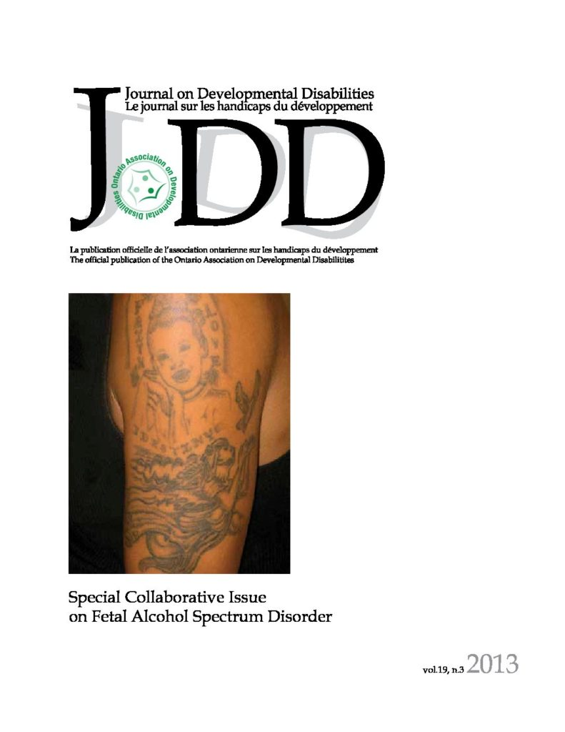
JOURNAL ON DEVELOPMENTAL DISABILITIES
OADD publishes the Journal on Developmental Disabilities a peer –reviewed journal focused on new research in the field of developmental disabilities
Members of the editorial committee for the Journal are connected to OADD through our Research arm OADD-RSIG and come from universities across Canada
Notes:
Jennifer
Journal first published in 1992 – usually two issues per you but may vary
Have always been posted on-line and are now only published on-line
Access is free on the OADD website under the publications tab – all issues
Volunteer editors
Articles are peer-reviewed
International contributions - majority are Canadian talking about Canadian issues
Excellent venue for publishing emerging research projects

Slide 17
AWARDS & SCHOLARSHIPS
Scholarships
To support students in studying to enter the field
Awards
To recognize the contributions of those in the field
Notes:
Jennifer
Annual scholarships and awards adjudicated by volunteer committee
Scholarship
OADD funds the Kay Sansom scholarships (3 - $1,000 student scholarships)
OADD manages the OADD-NADD scholarships funded by a grant from NADD Ontario on its dissolution (2 - $1,000 scholarships)
OADD administers the Dr. Bruce McCreary Scholarship ($5,000) on behalf of Ongwanada
Awards
Over the years the number and type of awards have changed
Currently two Hull-Rohrer Award and OADD award of excellence.
HR – for significant sector wide impact
OADD – for contribution to understanding or enhanced quality of care for people with IDD

Slide 18
04
BECOME A MEMBER

Slide 19
Notes:
Speak to value of being a
PRICING
PROMOTIONAL ASPECTS

Slide 20
05
RECAP OF SPRING 2025 CONFERENCE

Slide 21
SPRING 2025 CONFERENCE RECAP
3 days of learning
SCDSN & OADD Collaboration
SCDSN - Clinical Transition Planning: Cross Sectoral Collaboration
OADD- Navigating Life’s Transitions: Holistic Supports thought the Lifespan
21 -Presentations by your colleagues across clinical, community and research
Provided the opportunity to connect with other professionals through networking events
Over 290 Participants -OADD’s largest in-person conference to date!
Networking opportunities, connecting with other professionals
Enjoyed good food, music and memories with the photo booth
Testimonial from participants
Notes:
Tracey
3 days of exceptional learning – Day 1 Specialized Clinical DS Network – Clinical Transition Planning: Cross Sectoral Collaboration
March 25 and 26th OADD’S 35TH Annual conference –Navigating Life’s Transition : Holistic Supports through the Lifespan (Streams- Access to Health Care, Education/life skills, Innovative Housing Options and Day Programming)
Total of 21 presentations including the Key Note speaker David Ben . Presentations by your colleagues across clinical, community and research sharing innovative practices, emerging trends and solution focused ideas.
Over 290 participants
Testimonials (read a few)

Slide 22
Testimonials
The sessions were insightful and thought-provoking. I attended presentations on chronic disease management, dual diagnosis, and complex service coordination, as well as one on creative and innovative ways to secure approval and funding for housing for individuals with developmental disabilities. Each session left me thinking about how collaboration and forward-thinking solutions can improve services for the people we support. What stood out the most, though, was the people. The conversations with others in the sector, sharing ideas, experiences, and challenges, were invaluable. It reminded me how much there is to learn from each other and how important it is to foster these connections.
Thank you to OADD for hosting such a collaborative and inspiring event. I’m excited to see how the ideas, insights, and connections from this conference will shape my work going forward.
Rachna C.
Notes:
Tracey
3 days of exceptional learning – Day 1 Specialized Clinical DS Network – Clinical Transition Planning: Cross Sectoral Collaboration
March 25 and 26th OADD’S 35TH Annual conference –Navigating Life’s Transition : Holistic Supports through the Lifespan (Streams- Access to Health Care, Education/life skills, Innovative Housing Options and Day Programming)
Total of 21 presentations including the Key Note speaker David Ben . Presentations by your colleagues across clinical, community and research sharing innovative practices, emerging trends and solution focused ideas.
Over 290 participants
Testimonials (read a few)

Slide 23
06
UPCOMING EVENTS

Slide 24
Professional Development Lecture Series
Shaping Tomorrow’s Supervisors: Skill Development in the DS Sector
Series of 6- topic designed to enhance potential, new or current supervisors
1st topic of the series is on Effective communication strategies
Participants will receive a certificate on completion of all 6 sessions
Notes:
Tracey
Sessions conducted by Claudia Ferryman
New professional Development Lecture series- consisting of 6 session all covering a different topic
1st topic is around communication
Complete all 6 sessions to receive a certificate
This six-part lecture series introduces essential leadership skills for supervisors and team leaders interested in elevating their competencies and professional growth with practical insights to support and foster enhanced personal self-leadership and team effectiveness.

Slide 25
Professional Development Lecture Series
Shaping Tomorrow’s Supervisors: Skill Development in the DS Sector
Lecture Titles
Adaptive Communication
Emotionally Resilient Leaders
Navigating Difficult Conversations
Creating a Culture of Belonging
Enhancing Team Dynamics
Empathetic Leadership- Leading with Heart
Notes:
Tracey
Sessions conducted by Claudia Ferryman
New professional Development Lecture series- consisting of 6 session all covering a different topic
1st topic is around communication
Complete all 6 sessions to receive a certificate

Slide 26
FALL 2025 CONFERENCE
Notes:
REGISTRATION OPEN
CALL FOR ABSTRACTS
STREAMS
SCAN QR CODE TO REGISTER

Slide 27
SPRING 2026 CONFERENCE
Notes:
Tracey
Save the date;
Theme to be determine
Help shape Next years conference – what do you want to learn more about ? Any suggestion on topic- please write them on the slip of paper at the back of the room
OADD will be returning to Caesar Windsor March 25 & 26 of 2026

Slide 28
IN DEPTH
ANY QUESTIONS?

Slide 29
FOR MORE INFORMATION
oadd@oadd.org 647-325-4960
Follow us on LinkedIN
Notes:
Michelle

