Slide 1
Navigating Transformation: MyServicesConnect
Unveiling the Journey of Implementing CLTO's ERP and CRM System

Slide 2
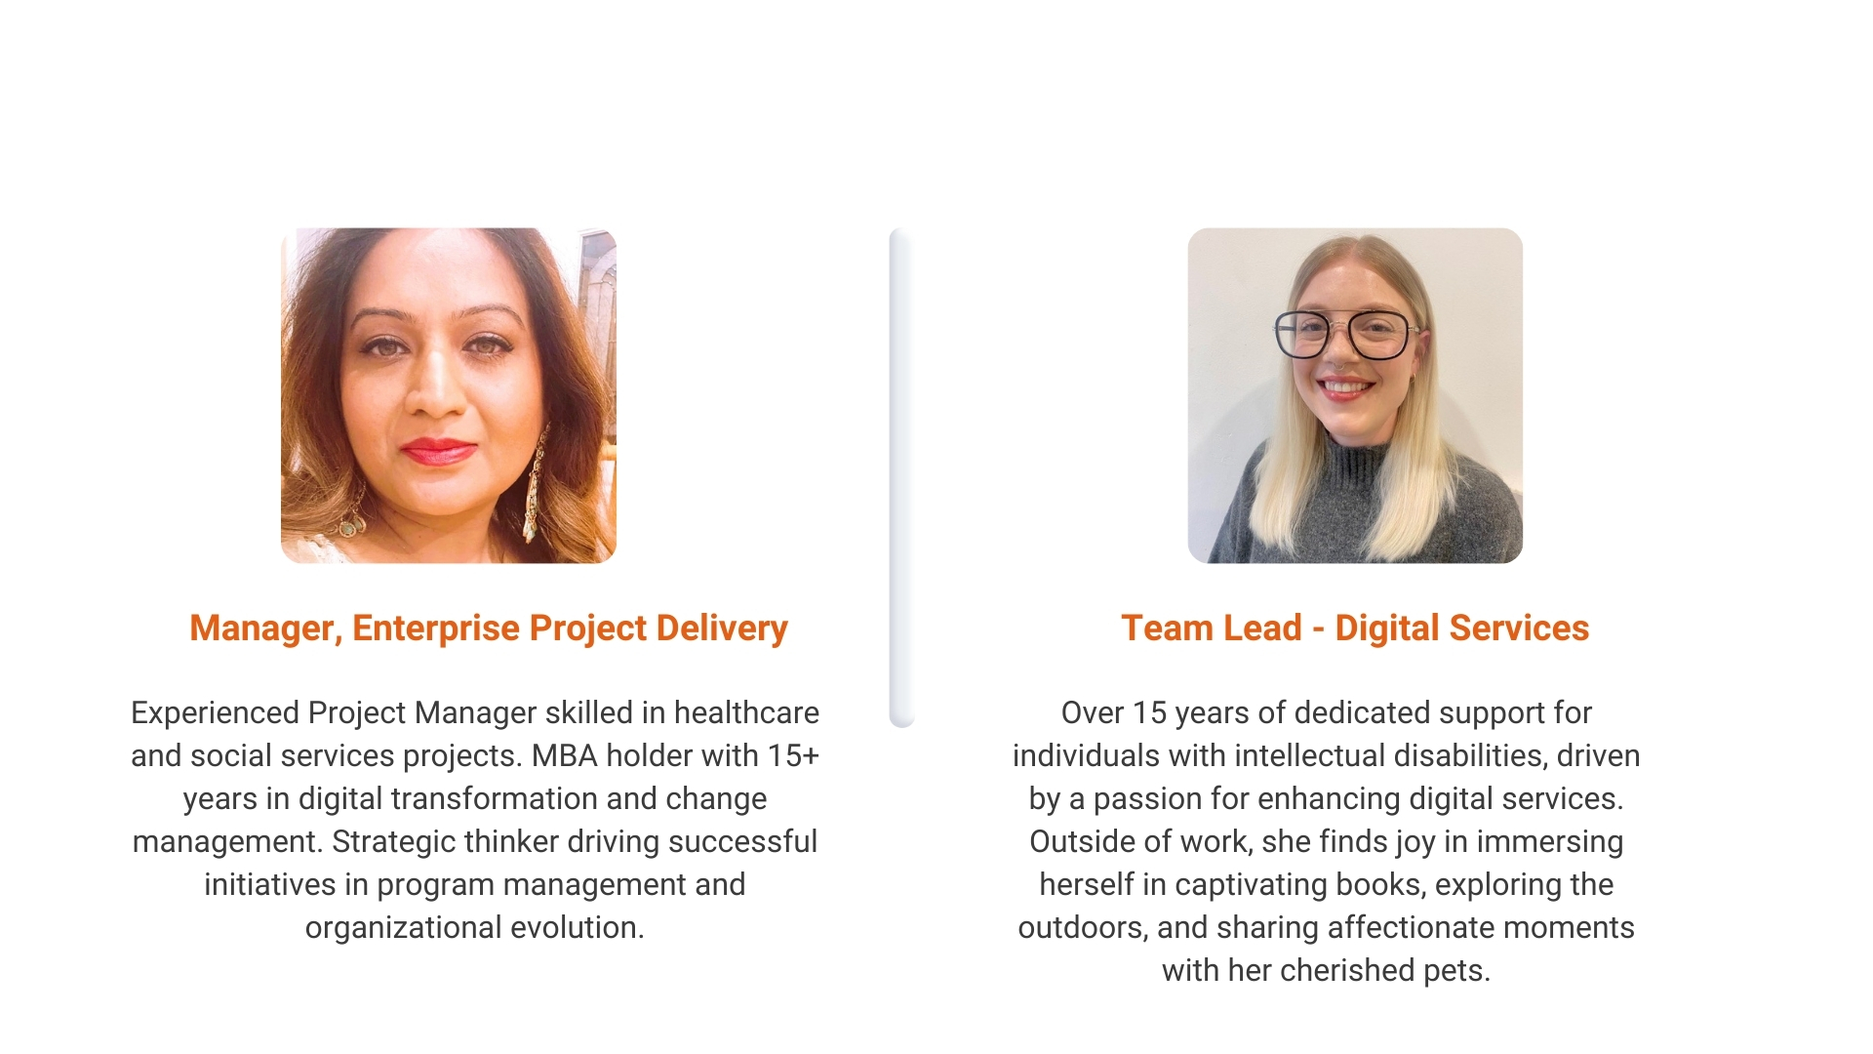
Presenters

Slide 3
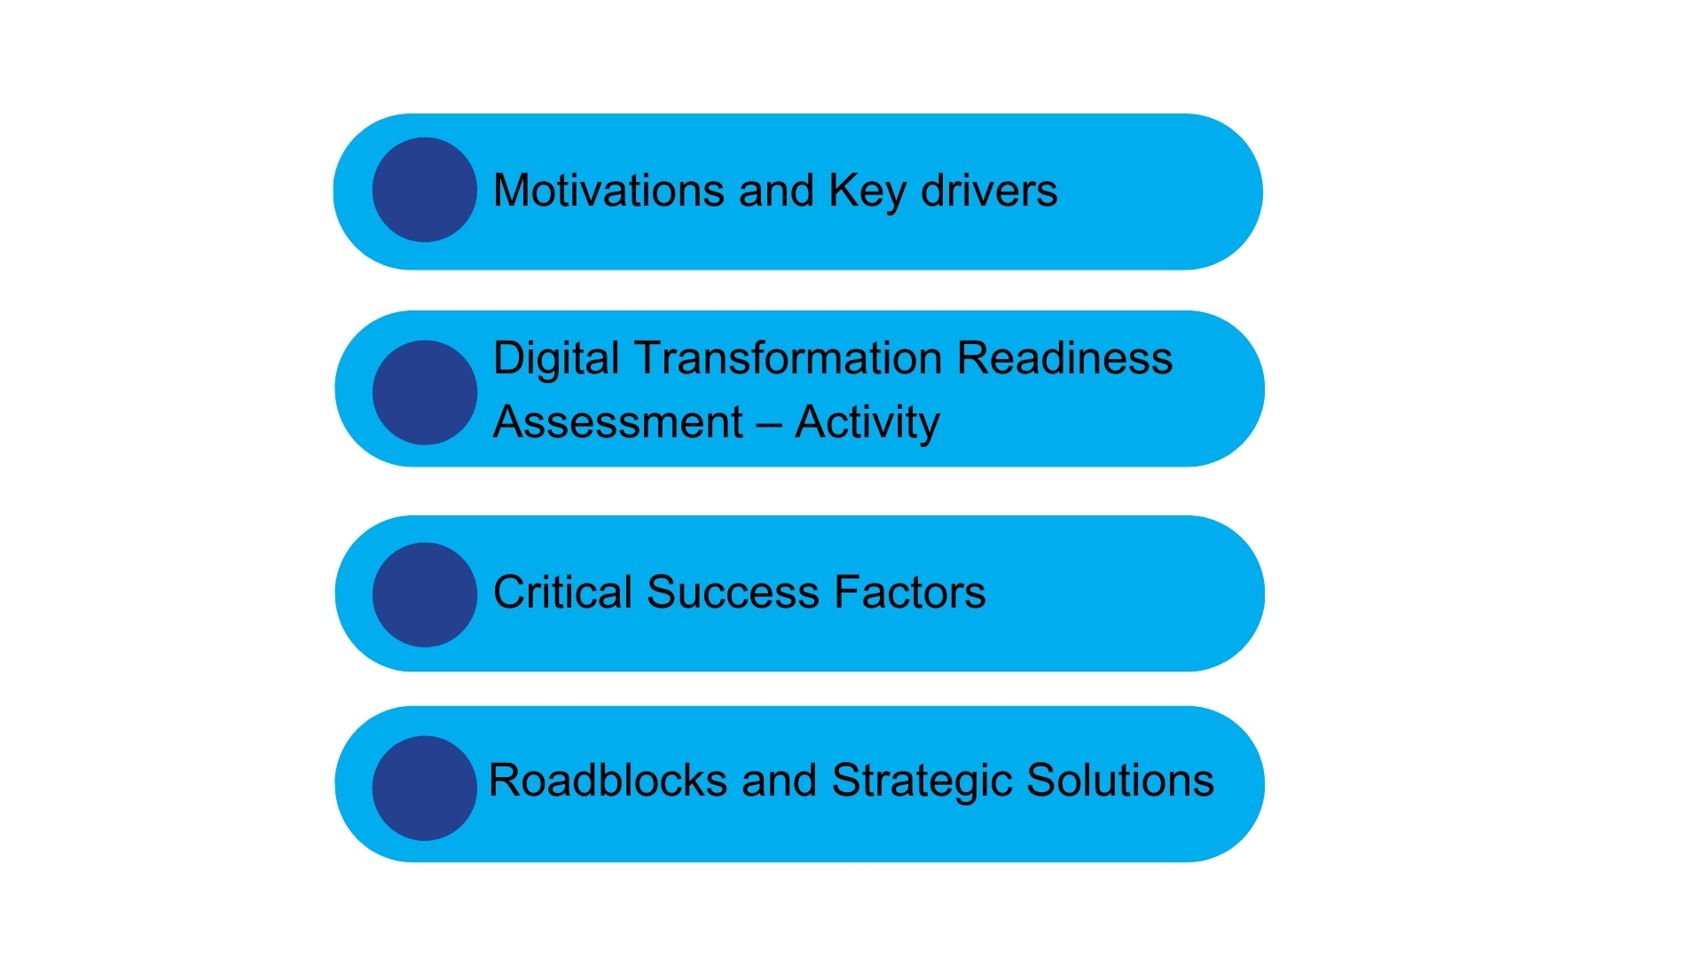
Section 1 - Project Implementation

Slide 5
Standalone Applications and Data Silos
Notes:
Standalone software applications; not communicating with one another leading to duplicate/ inaccurate data entries

Slide 6
Management of Hardware and Software
Notes:
Intent to move away from management hardware/sw – move towards cloud strategy; achieving business value;

Slide 7
Notes:
Budgets were consumed for patching/maintaining the applications – no room for expansion/adoption

Slide 9
Notes:
https://forms.office.com/r/YseeJqdUPN

Slide 12
Product Selection

Slide 13
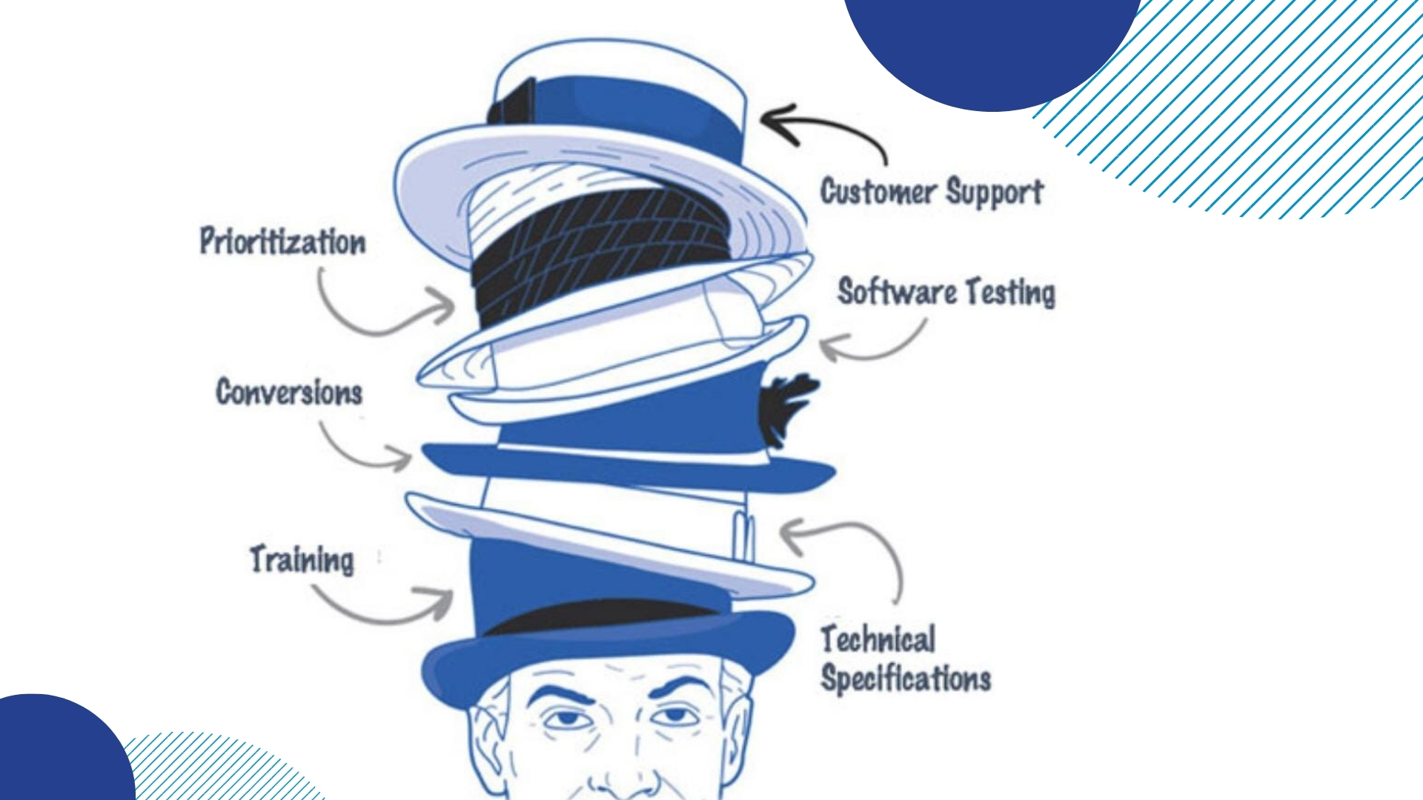
Project Team

Slide 14
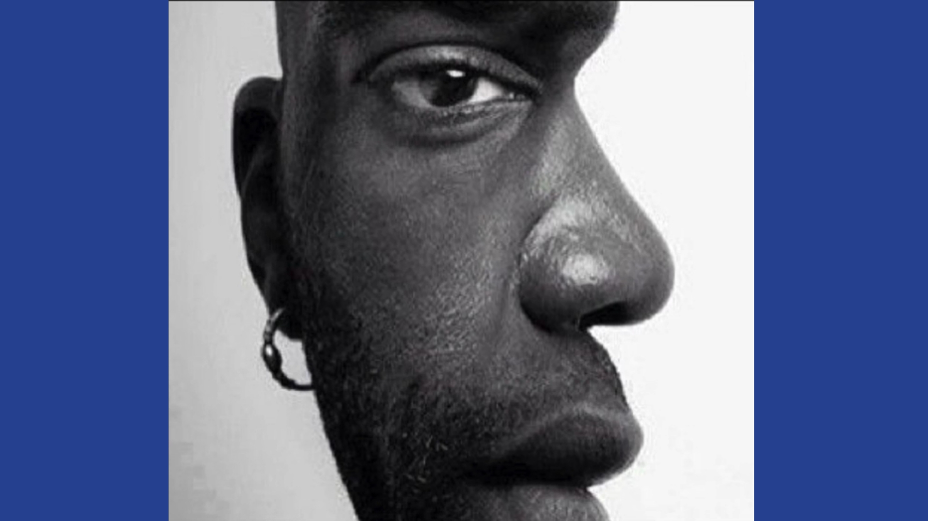
Change management

Slide 15
Project Methodology

Slide 16
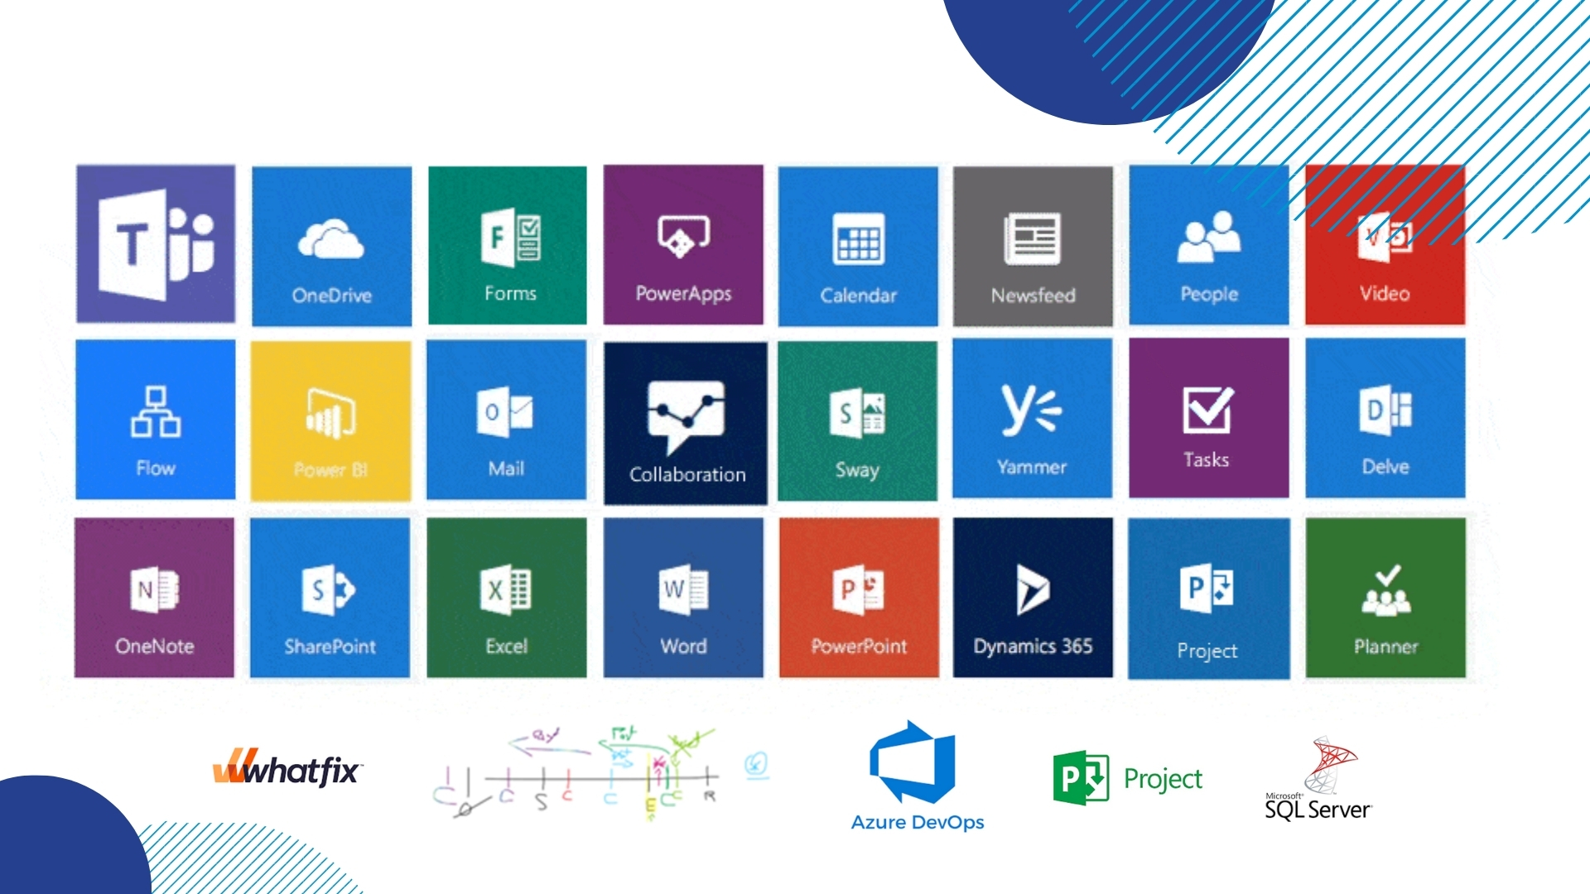
Tools and Techniques

Slide 18
Roadblocks and Strategic Solutions

Slide 19
Scope Creep

Slide 20
Skills Gap

Slide 21
Lack of Accountability

Slide 22
Stakeholder Disengagement

Slide 23
Unrealistic Deadlines

Slide 24
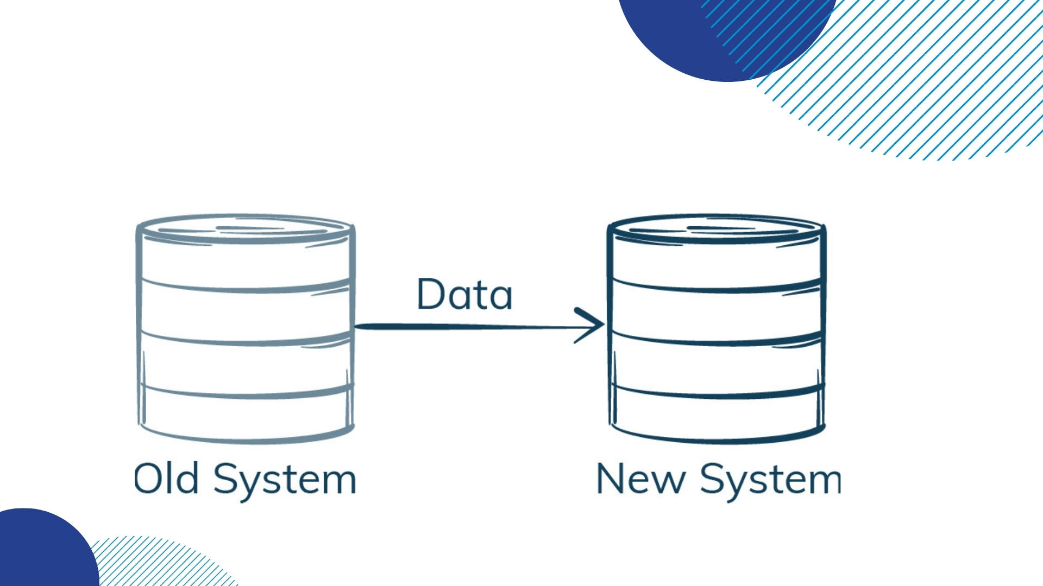
Data Migration

Slide 25
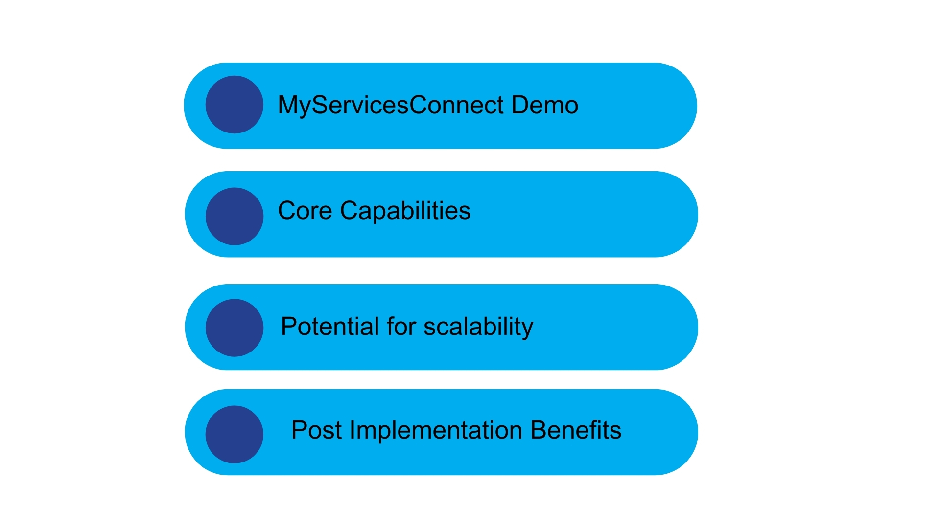
Section 2 - Technology and Strategy

Slide 26
Roadblocks and Strategic Solutions

Slide 27
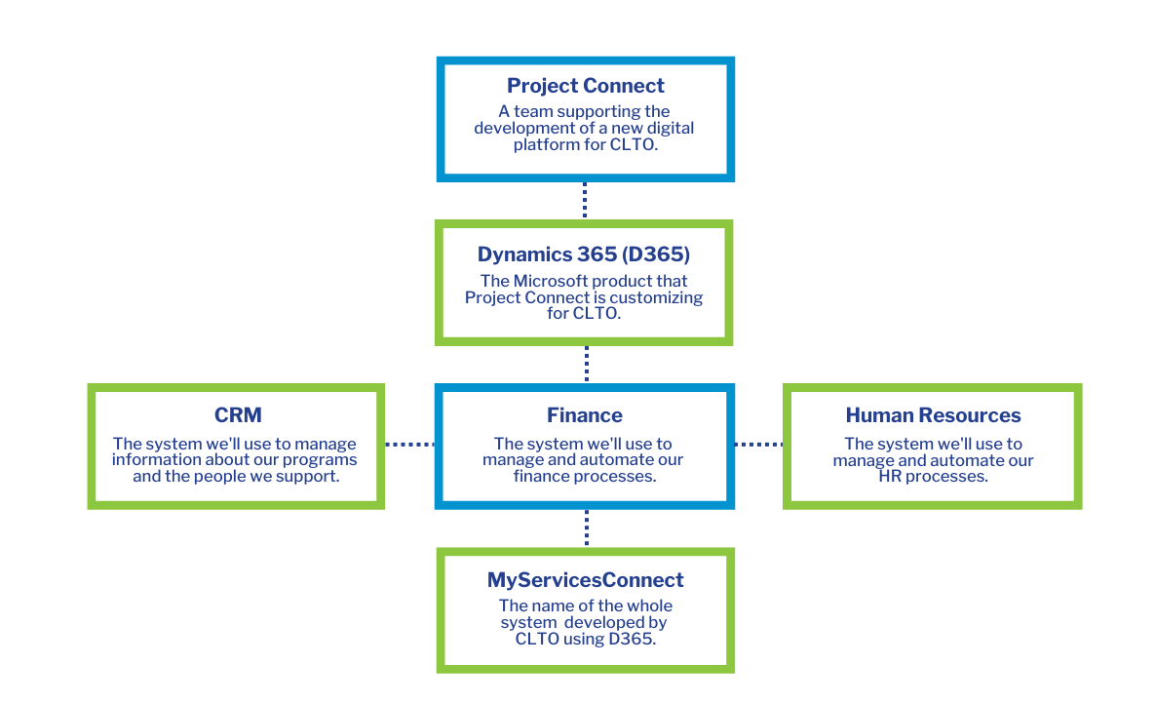
MyServicesConnect

Slide 28
CRM- Functionality

Slide 29
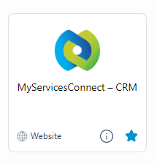
CRM Demonstration

Slide 31
CORE CAPABILITIES
Platform Integration between CRM and ERP
Streamlined People Management services
Continuous Enhancement
MS Eco-system
User Experience
Improved Financial Operations
Custom Reporting

Slide 32
Platform Integration between CRM and ERP

Slide 33
People Management services

Slide 34
Continuous Enhancement

Slide 35
Microsoft Eco-System

Slide 36
User Experience

Slide 37
Improved Financial Operations

Slide 38
Custom Reporting & Dashboards

Slide 40
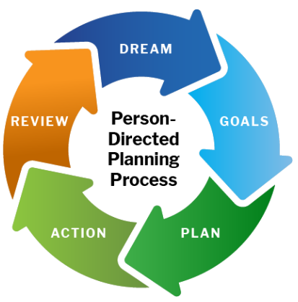
POTENTIAL FOR SCALABILITY
Performance Appraisal & Succession Planning
CRM Integration for Goal Planning
Platform Expansion
Ability to Embed AI

Slide 42
POST-IMPLEMENTATION BENEFITS

Slide 43
Presenters
Thank you!
Please feel free to contact:
Nandita.Saxena@CLToronto.ca
Haley.Dale@CLToronto.ca

