Slide 1
Do not edit How to change the design
Join at slido.com #2127040
The Slido app must be installed on every computer you’re presenting from

Slide 2
Do not edit How to change the design
Have you joined us on Slido?
The Slido app must be installed on every computer you’re presenting from

Slide 3
Leading The Way
The Role of Executive Leadership in Quality Services for People with Developmental Disabilities
Presented By:
Dawn Lee, Executive Director, Inclusion Northumberland and former National Consultant with Accreditation Ontario/CQL
OASIS Conference 2025

Slide 4
Do not edit How to change the design
What does "quality service" mean to you in one word/short statement?
The Slido app must be installed on every computer you’re presenting from

Slide 5
Leaderships Commitment to Quality
As Executive Directors and CEOs, we are the driving force behind service excellence.
Focusing on quality services is not just an operational priority, it’s a leadership imperative that reflects an organization’s values.
Leadership commitment and tools such as accreditation standards, Key Performance Indicators and outcomes measures, can create a culture of continuous quality improvement.

Slide 6
Do not edit How to change the design
What quality tools are currently used in your organization?
The Slido app must be installed on every computer you’re presenting from

Slide 7
The Strategic Value of Quality
High-quality service delivery secures trust from funders, supporters, and the communities we serve, which leads to long-term sustainability and growth opportunities.
Quality services ensure positive, person-centred outcomes for people.
Strong quality services mitigate risks, such as staff burnout, legal liabilities, and community reputation damage.

Slide 8
Do not edit How to change the design
In your opinion, what's the biggest benefit of quality service delivery?
The Slido app must be installed on every computer you’re presenting from

Slide 9
How Leadership Drives Quality Excellence
Vision & Strategic Focus: Leadership must embed quality as a core organizational value. Quality needs to be a key component of a strategic plan and aligned with the mission of an organization.
Resource Allocation: Invest in the training, development and systems that are needed to implement person-centred services and meeting the evolving service standards.
Promoting a Culture of Excellence: Executive leadership must promote an environment where employees and teams are encouraged to prioritize the individual needs and goals of the people that they support.
Data-Drive Decision Making: Use tools like the Personal Outcome Measures (POMs) and accreditation frameworks to track and assess outcomes, which can help leadership to make informed strategic decisions.

Slide 10
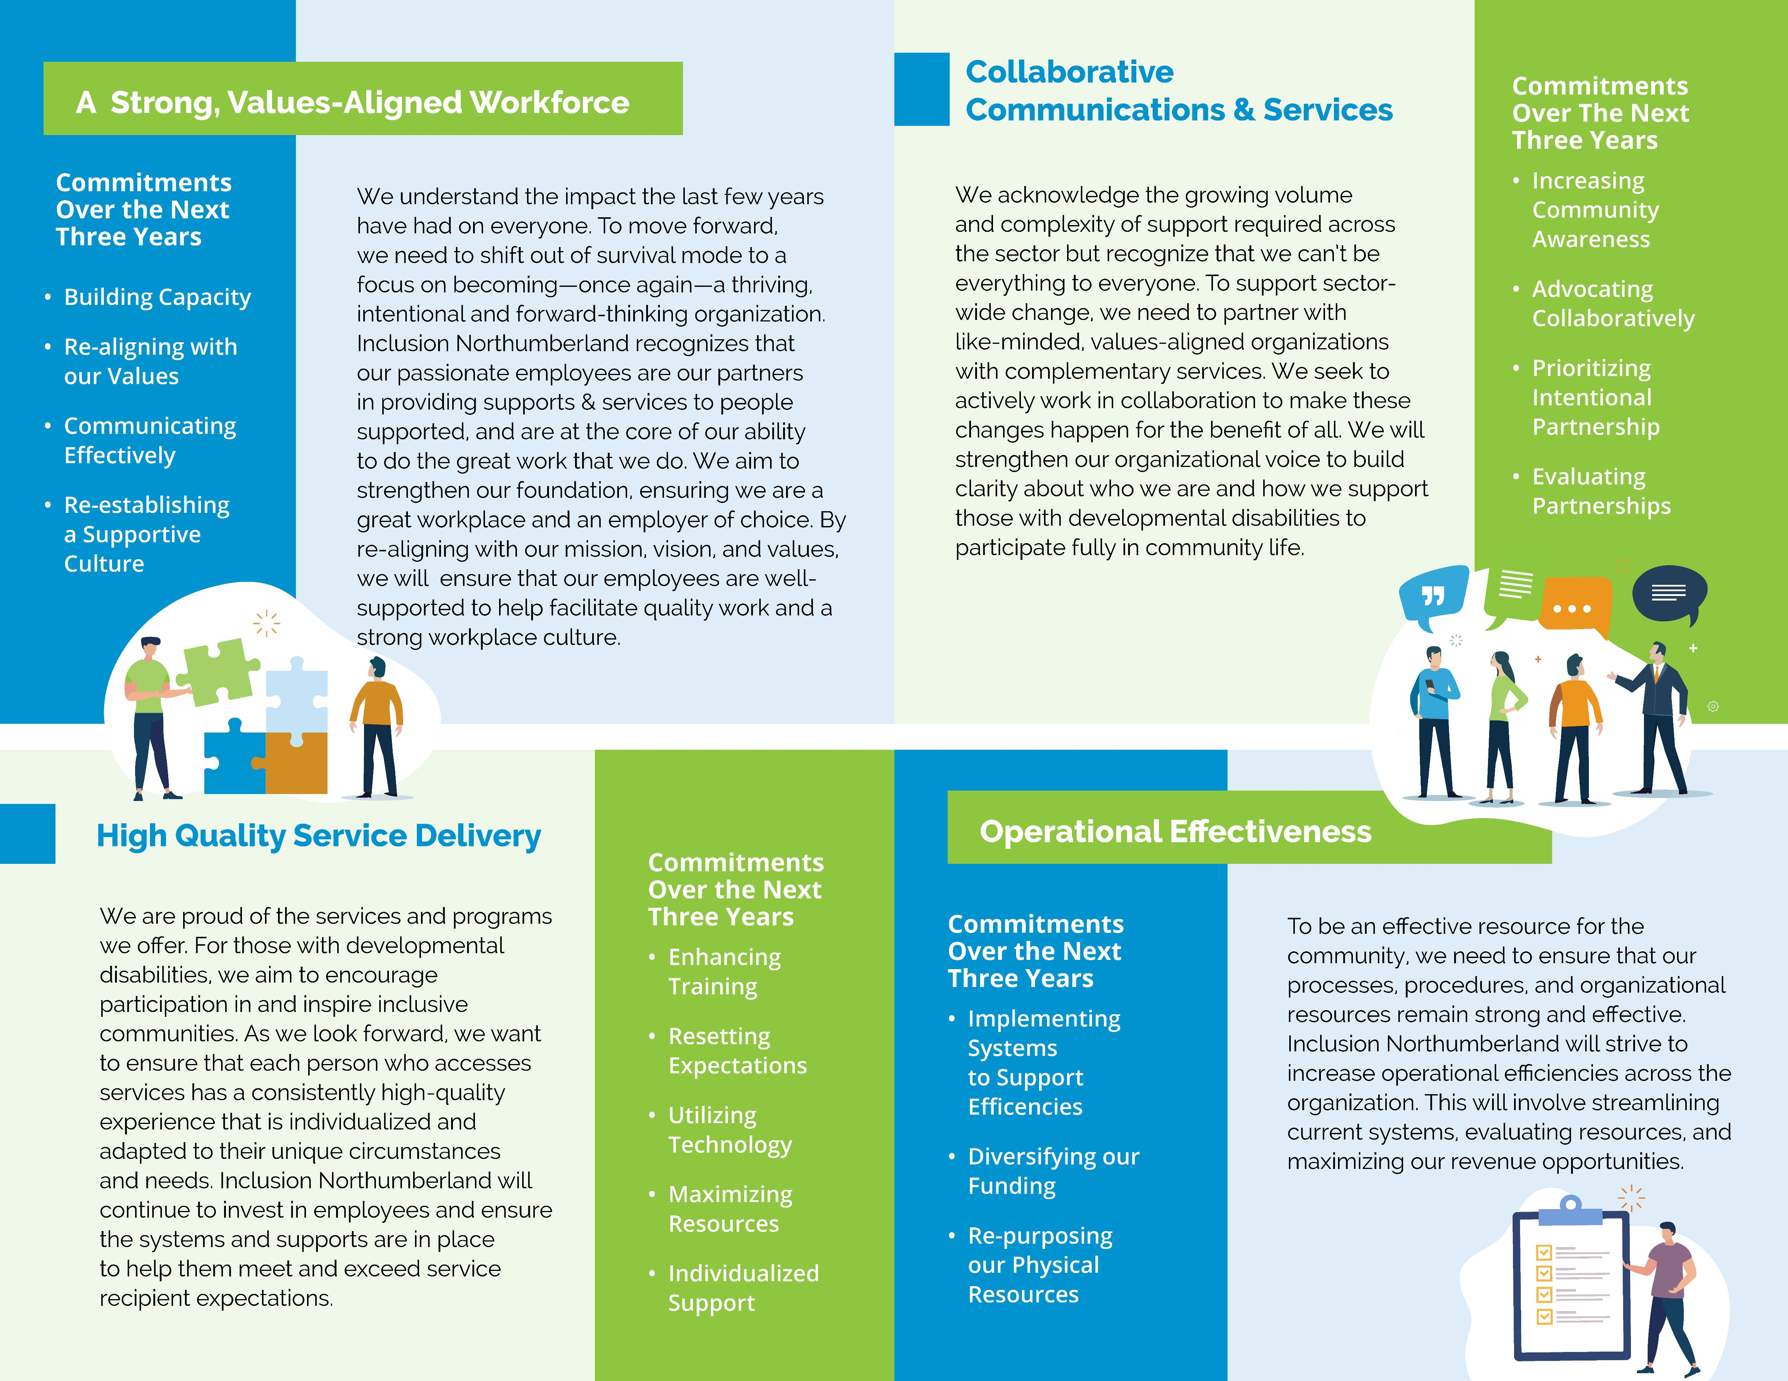
Vision & Strategic Planning – Inclusion Northumberland

Slide 11
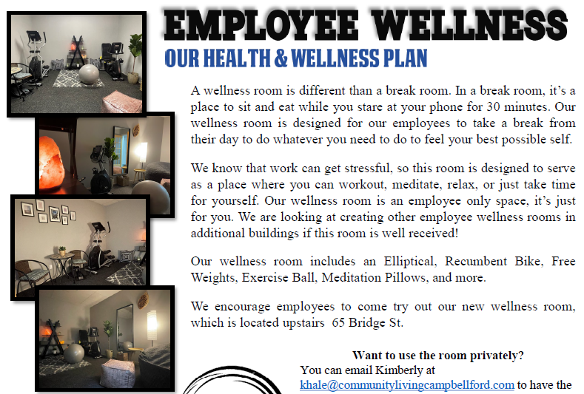
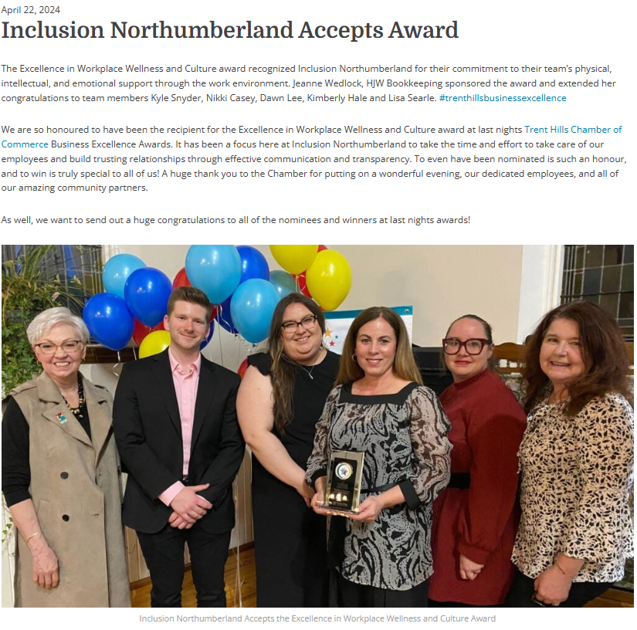
Workplace Wellness & Culture

Slide 12
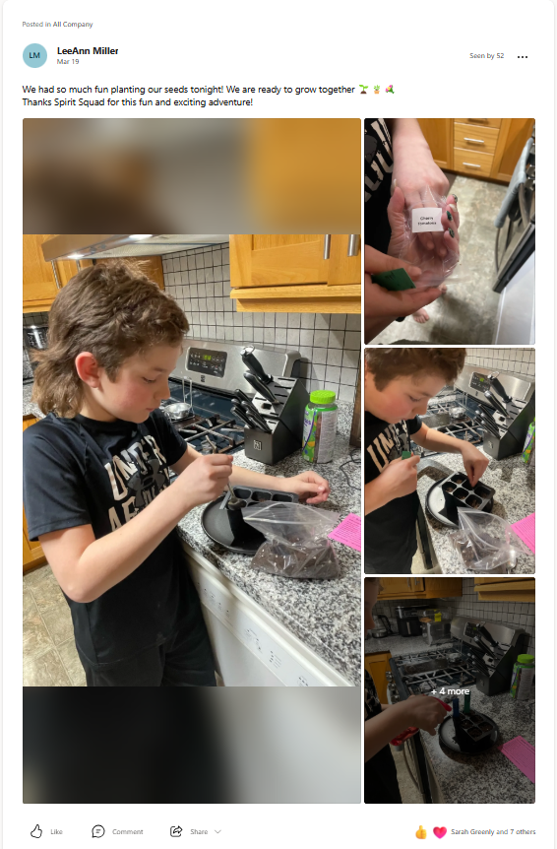
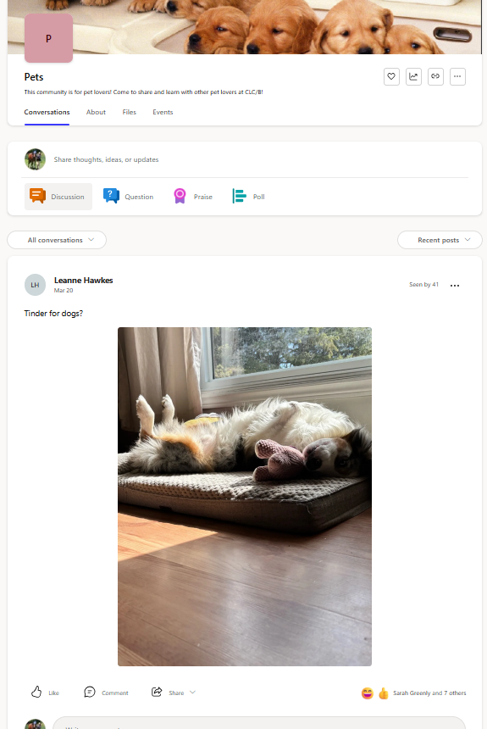
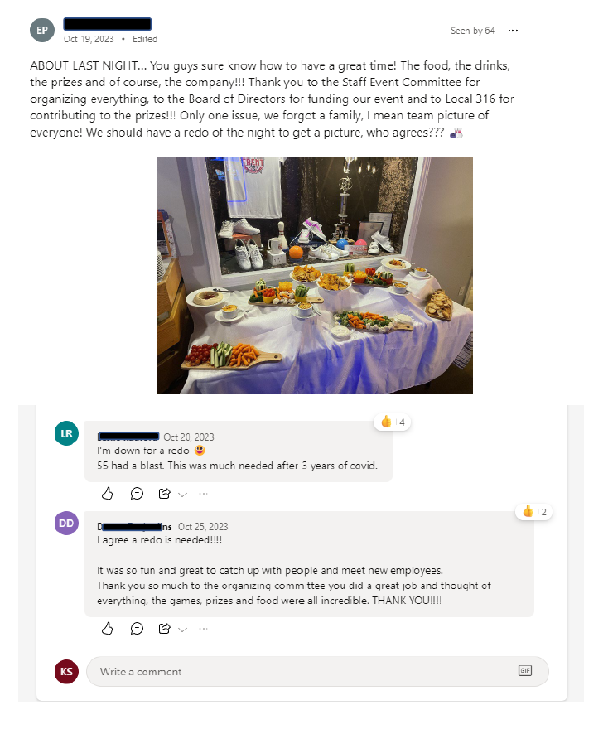
Viva Engage

Slide 13
Viva Engage

Slide 14
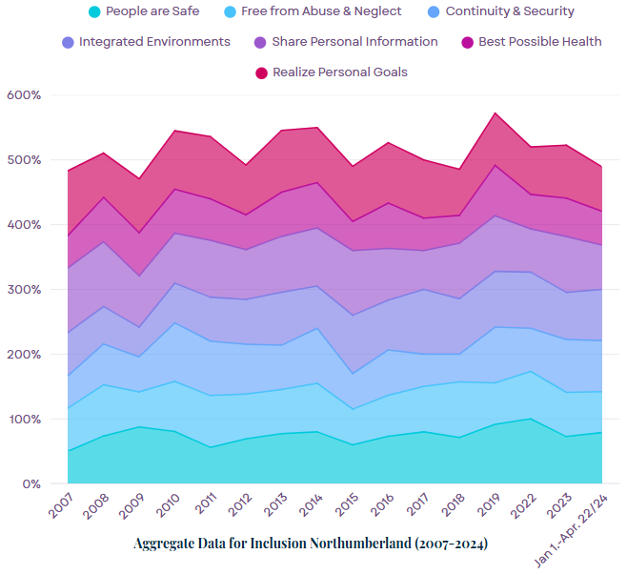
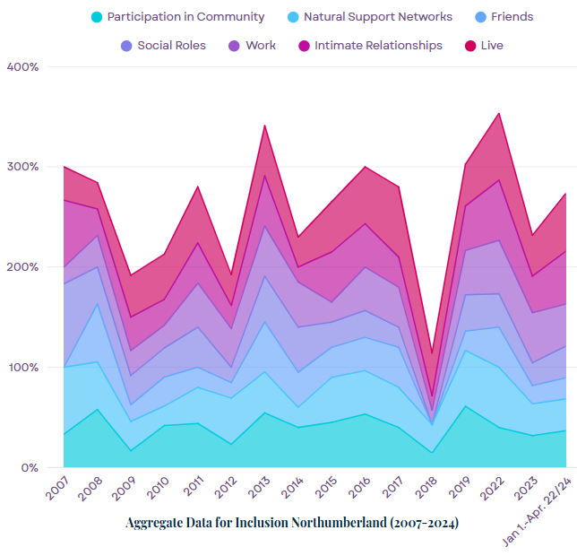

Slide 15
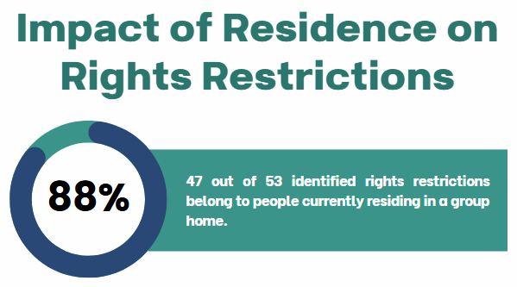

Slide 16
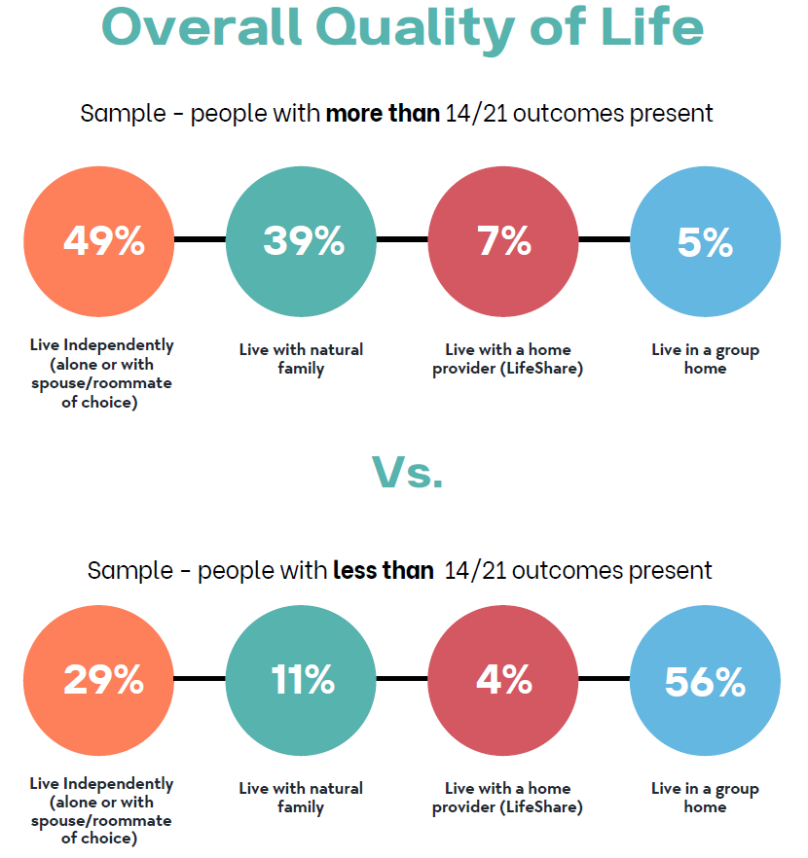
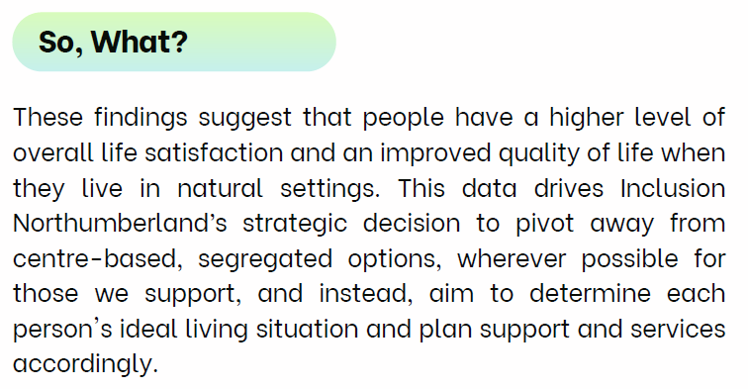
Impact of Residence

Slide 17
Do not edit How to change the design
What barriers do you face in promoting a culture of excellence?
The Slido app must be installed on every computer you’re presenting from

Slide 18
Essential Tools to Lead and Monitor Quality
Accreditation: Through organizations such as CQL (Council on Quality & Leadership), FOCUS, CARF, Imagine Canada, etc. provide a clear framework for organizations to standardize and enhance quality service delivery. Basic standards ensure that services protect people’s safety, rights and dignity.
Personal Outcome Measures (POMs): and tools like this focus on what is important to and for each person receiving services, ensuring that services are individualized and outcome-driven, promoting self-determination and meaningful life experiences.
Outcome Data & Metrics: Tracking outcomes related to personal safety, social inclusion and relationships, and employment allows leadership to measure success and ensure continuous quality improvement.
Documentation & Knowledge Sharing: play a critical role in improving the quality of services for people with disabilities by fostering better communication, accountability, and continuous learning across the organization.

Slide 19
HOW DOCUMENTATION & KNOWLEDGE SHARING PLAY A CRITICAL ROLE
3.
Data-Driven Decision Making
1.
6.
Consistency in Service Delivery
Crisis & Incident Management
4.
Knowledge Sharing & Collaboration
2.
7.
Accountability & Transparency
Continuous Quality Improvement
5.
Improving Personalized Support

Slide 20
How Does Your Team Share Knowledge?

Slide 21
Building a High-Quality Workforce
Quality services require an engaged, skilled, and motivated workforce, which is a direct reflection of leadership’s commitment to employee development.
Ongoing training and person-centred approaches, ensures that employees can deliver the highest level of quality support.
As leaders, we are responsible for creating a positive workplace culture that promotes employee retention and supports professional growth and continuous learning.
Engagement strategies like mentoring, coaching, and promoting career development help to retrain employees and maintain high-quality service delivery.

Slide 22
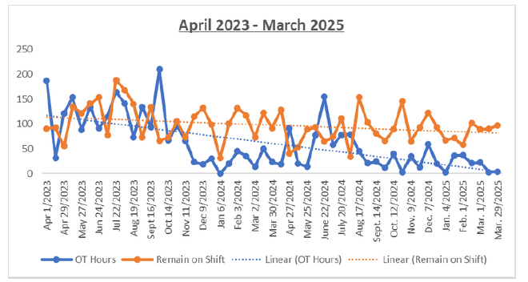
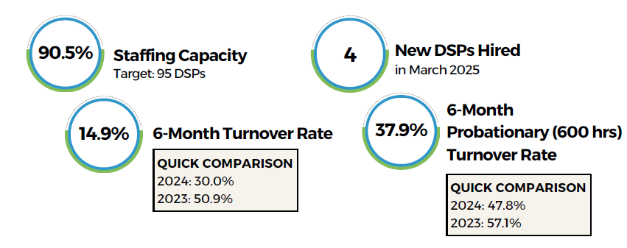
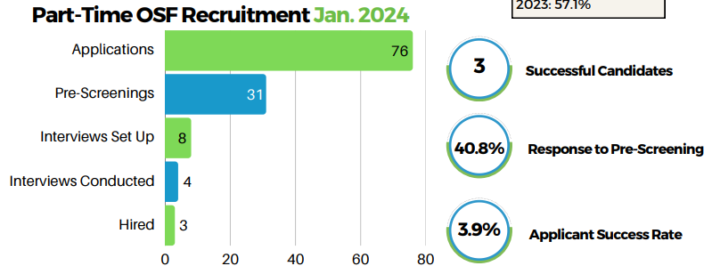
Building a High-Quality Workforce

Slide 23
Do not edit How to change the design
What do you need to be able to make quality a bigger strategic priority in your organization?
The Slido app must be installed on every computer you’re presenting from

Slide 24
The Quality Position/Committee’s Role in Driving Excellence
Who Is On It?
A quality committee is composed of executive leadership, Direct Support Professionals, board members, community members, and people with lived experience.
Focus Areas:
Uses the quality data to align services and strategic directions
Tracks and analyzes data such as personal safety, rights, and inclusion, and makes recommendations to the ED/Board as a result.
Identify areas for continuous improvement/learning and drive cultural change across the organization.

Slide 25
Who is currently on a quality, or similar, committee?

Slide 26
Leadership’s Role in
Sustaining Quality
Leadership sets the direction and tone for quality excellence
Use tools like accreditation, Key Performance Indicators, and Personal Outcome Measures to make data-driven decisions that enhance service delivery and organizational performance.
A long-term commitment to quality services benefits service recipients, staff, and the community, creating a more sustainable, resilient, and reputable organization.

Slide 27
Do not edit How to change the design
What would help you sustain quality more effectively?
The Slido app must be installed on every computer you’re presenting from

Slide 28
Building a Future of Quality
By embedding quality in your leadership strategy, you can ensure better outcomes for people, greater organizational success, and a lasting impact on the community.
Thank you for your leadership and dedication to promoting excellence.

Slide 29
Do not edit How to change the design
What's one thing you'll take back to your organization from today's session?
The Slido app must be installed on every computer you’re presenting from

Slide 30
Members of the Work Group on Quality Disability Supports that Respect the Person:
Yvonne Spicer, Advocate
Stephanie Anderson, Community Living Six Nations
Dawn Lee, Inclusion Northumberland
Sherry Baum, Community Living Dryden-Sioux Lookout
Tina Williams, Community Living Upper Ottawa Valley
Susan Treverton, Community Living Prince Edward
Maria Tzirakos, Middlesex Community Living
Bob Butella, Community Living Haldimand
Sherry Salo, Community Living Greater Sudbury (Chair)
Brad Saunders, Community Living Toronto
Jennifer Wiwchar, Community Living Algoma
Theresa Somerton, Advocate

Slide 31
Thank You
Dawn Lee, Executive Director
Inclusion Northumberland
dlee@inclusionnorthumberland.ca
705-653-1821 ext. 204

