Slide 1
1C - Expanding Our Horizons On The Developmental Services Sector
Alison Mclean, Nicole Flynn, Yvonne Spicer, Theresa Somerton Kathryn Primrose, Allan Mills, Courtney Horowitz

Slide 2
Agenda Panel Discussion
Introduction of Panelists
Intersectionality And Seeing The Whole Person
Barriers to Inclusion People Face
Questions for the Panelists
Barriers to Inclusion Sector Wide

Slide 3
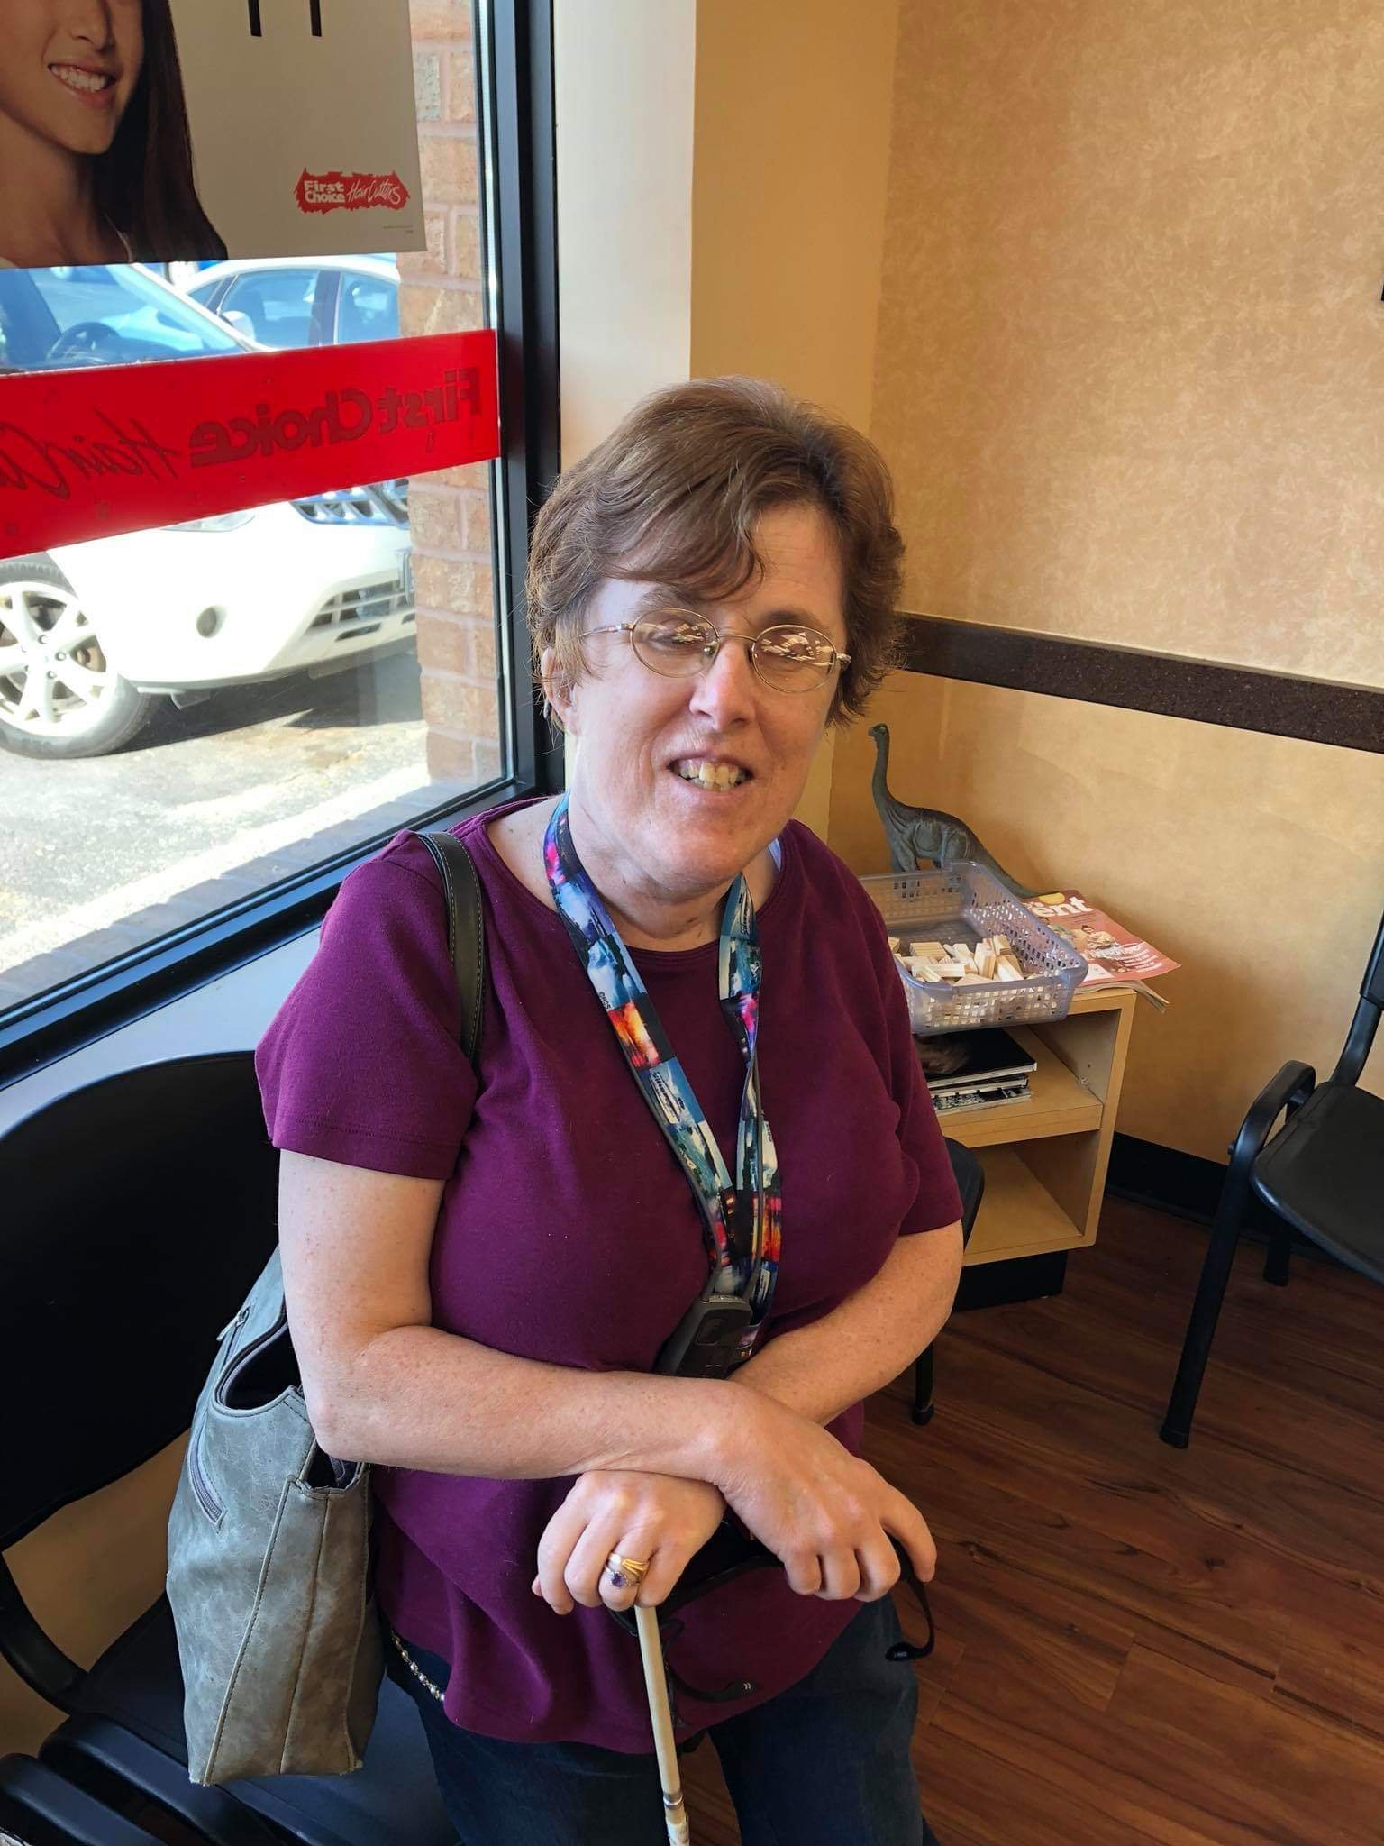
Introduction of Panelists
Yvonne Spicer
Nicole Flynn
Theresa Somerton

Slide 4
What Is Intersectionality

Slide 5
Tell us one aspect of who you are that is important for people to know.

Slide 6
Will one of you tell us about a time that you were not fully seen or that a significant attribute was overlooked?

Slide 7
Role Play! (Don’t worry, the panelists will do the role playing for you, you just have to pay attention and have ideas for how it could be better!)

Slide 8
At Work…

Slide 9
In A Medical Situation…

Slide 10
At School…

Slide 11
Does anyone want to share a personal experience related to not being fully seen or a barrier that has been experienced based on intersectionality?

Slide 12
Intersectionality and Economics

Slide 13
Intersectionality and Housing

Slide 14
Can you tell us ways that your organization is recognizing someone beyond their disability? How have you adapted your support to reflect that person’s preferences, culture, goals and gifts?

Slide 15
Can one of you share an example of how someone in a supportive role in your life has adapted their approach to reflect who you are and what support you want or need?

Slide 16
Agenda EAFWR Demographic Survey Case Study
Brief Overview of EAFWR
What Did We Ask and Why
Case for Data Collection at EAFWR
Case for Data Collection Sector Wide
Pilot Projects
Full Study
Successes and Opportunities
Next Steps
Key Takeaways
Resources

Slide 17
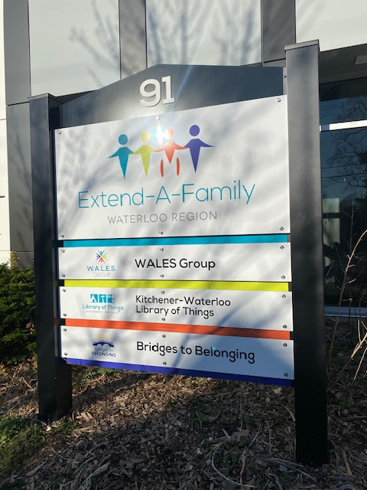
About EAFWR
Support 2400 people within Waterloo Region Range in age from birth to over 70
Approximately 60 full time staff, 120 community-based Direct Support People working within Passport and Specia Services at Home
Individualized funding contracts Passport (717) SSAH (1703)
Community participation group (45)
FamilyHome (23) and Supported Independent Living (11)
Kitchener-Waterloo Library of Things

Slide 18
What Did We Ask?
Were you born in Canada?
How would you describe your racial or ethnic group?
What language do you use most often at home?
What is the highest degree or level of school you have completed?
What is your gender identity?
What type of housing are you current residing in?
What was your total family income before taxes last year?
How many people does this income support?
What is your sexual identity?

Slide 19
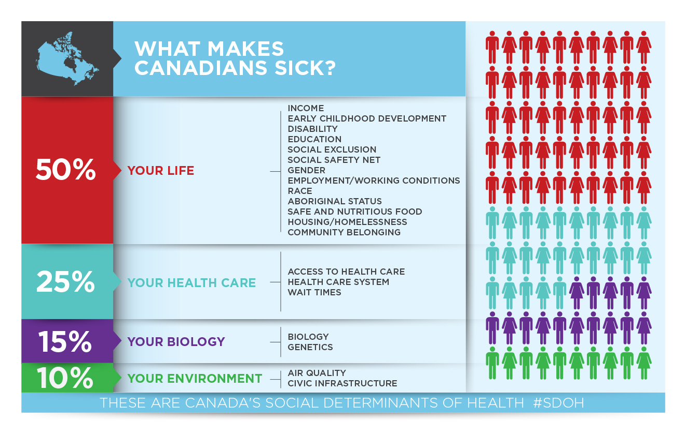
Why Did We These Questions?
“Health equity is the ideal state in which people are able to reach their full health potential and receive high quality care that is fair and appropriate from each person’s perspective, no matter where they live, who they are, or what they have”. - Health Quality Ontario, 2016
As an agency focused on supporting people to live full lives in the community, this is very well aligned with our values

Slide 20
Case for Data Collection at EAFWR
Have identified anti-oppressive practice as an organizational value for almost 20 years
Anecdotal evidence that families and team members likely do not mirror demographic makeup of Waterloo Region
Recognition that underrepresentation could have varied causes based on different groups
Desire to invest in building representation, but in targeted, efficient and authentic ways

Slide 21
Case for Data Collection at EAFWR
Believed that demographic factors were impacting the level of service people received
Committed to more equitable hiring practices
Developed a deeper understanding about the importance of intersectionality
Create a baseline and roadmap for success around investment in EDIB initiatives for people we support, families and our team

Slide 22
Case for Data Collection Sector Wide
Importance of intersectionality
Health outcomes are linked with demographics, so why would outcomes in developmental services be different?
Journey to Belonging focus on matching services and supports to the whole person
We are data poor in this area, as “disability” is seen as the most important

Slide 23
Student Pilot Project #1
Connected with Applied Community Research Program through Wilfrid Laurier University in September of 2021 at no cost to EAFWR
Developed a survey mirroring demographic data collected by the Health Equity Office, Sinai Health System for the “Toronto Central LHIN Measuring Health Equity” project
Used categories to mirror Canadian census data to allow for comparison to regional challenges
Survey sent by email only in English
Did not include staff or board members

Slide 24
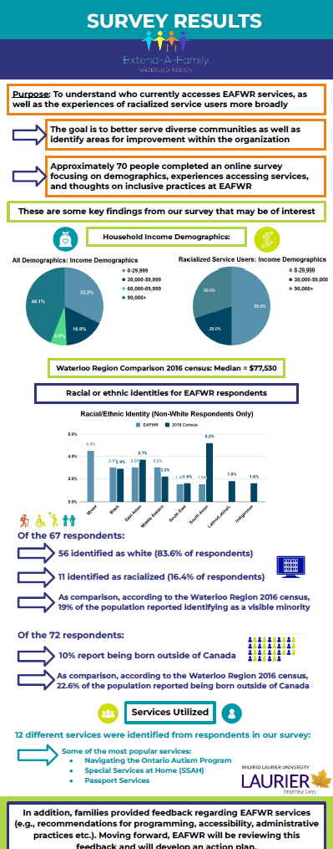
Student Pilot Project #1- Key Learnings
70 responses (<3% response rate)
South Asian, Latinx and Indigenous populations least represented
Percentage of people receiving services who were born outside of Canada was 50% lower than regional average
Half of non-racialized EAFWR service users had a higher income than the census median, but half of racialized service users had incomes below the poverty line

Slide 25
Student Pilot Study #2
Connected with a new group of students in September of 2022 through the same program, also at no cost to EAFWR
Focus was qualitative interviews with Latinx and South Asian service users about what had worked well with EAFWR to overcome barriers to service, as well as with EAFWR staff members to discuss perceived barriers to service
Sample size was smaller and participants were difficult to reach, despite offering incentives

Slide 26
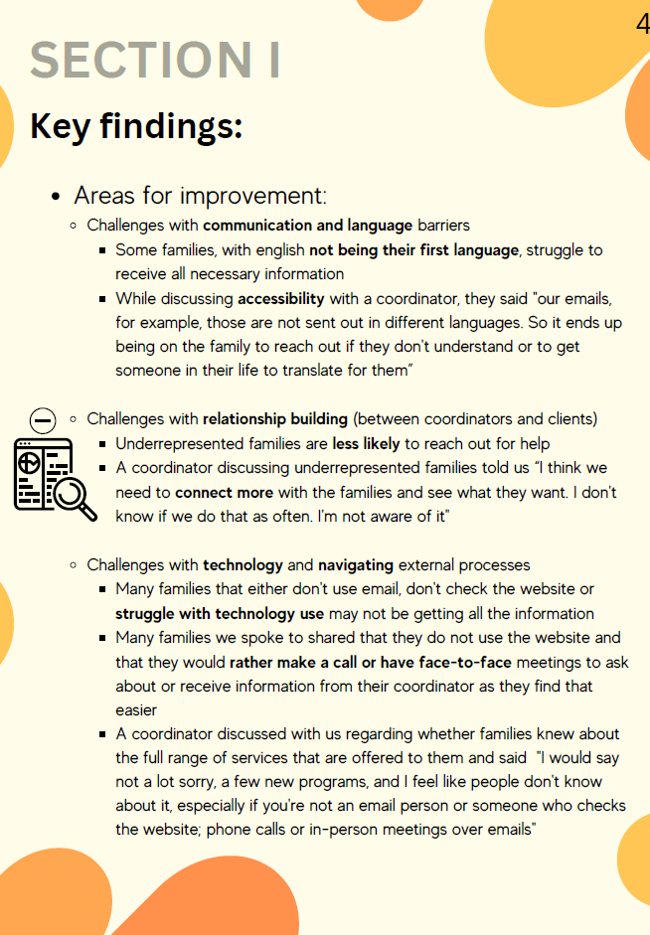
Student Pilot Study #2 – Key Learnings
Families feel connected to coordinators due to investments made in the relationship
Programs are affordable and team members work with families to help them maximize use
Lack of available supports in different languages (especially in email)
Families from marginalized groups are less likely to connect if they are struggling
Opportunities to provide better, more culturally relevant and appropriate support

Slide 27
Centre for Community Research Learning and Action (CCRLA) Large Study
Connected with Dr. Krist through CCRLA in May of 2023
Total project cost including translation and incentives - $18,750 (supported by MCCSS)
Replicated the survey from the first student pilot, with the addition of gender and sexual identify questions and open-ended opportunities to share ideas for making services more inclusive and accessible to different community members and service user satisfaction
Survey offered by email in English, Arabic, Tygrina and Spanish. Somali added at midway point
Survey included staff and board members

Slide 28
Centre for Community Research Learning and Action (CCRLA) Large Study
Connected with Dr. Krist through CCRLA in May of 2023
Total project cost including translation and incentives - $18,750 (supported by MCCSS)
Replicated the survey from the first student pilot, with the addition of gender and sexual identify questions and open-ended opportunities to share ideas for making services more inclusive and accessible to different community members and service user satisfaction
Survey offered by email in English, Arabic, Tigrinya and Spanish. Somali added at midway point
Survey included staff and board members

Slide 29
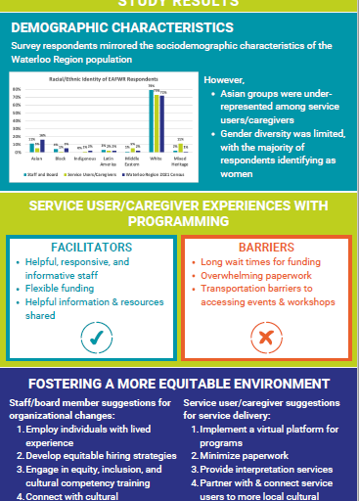
Centre for Community Research Learning and Action (CCRLA) Large Study – Key Findings
Incentives help with survey responses – a bit
87 responses (4% response rate) from families, 45% response rate from staff
Racial demographic data for service users was similar to the region (with the exception of Asian communities who were underrepresented)
EAFWR family service users were more likely to have university degrees and have an income slightly lower than the regional average
Gender and sexual orientation were not included in the 2016 census data set, which is the most recent data set that is publicly available

Slide 30
Centre for Community Research Learning and Action (CCRLA) Large Study – Key Findings
Service satisfaction levels were slightly lower for marginalized groups This seemed to be connected primarily to MCCSS wait times
Families and team members provided a number of valuable ideas and connection suggestions that will be integral in guiding work moving forward
Reducing administrative requirements is perceived as creating more equitable services
Forging strong relationships with community groups, offering interpretation support and virtual programs to reduce transit requirements were seen as key next steps

Slide 31
Successes
Data validated some of the anecdotal evidence
Talking about equitable services began to increase team members comfort with why this information is important to know, even if it’s awkward to ask
Provided a baseline to work from
Built relationships with student researchers and we are now regularly approached for project collaboration
Ideas from team members and people who use our services provided a fantastic jumping off point to continue the work

Slide 32
Opportunities
Context is key – help people understand why you’re asking the questions and anticipate some pushback from team members and people receiving support
Survey and interview fatigue is real, even with incentives
Share learnings publicly to support ongoing engagement, even if the results aren’t what you hoped for
Asking questions when people join us rather than playing catch up will be less time and cost intensive, but will need engagement throughout the organization
Different groups engage with service providers differently for a variety of reasons. We know the what, next we need to learn the why.
Putting your survey link or interview contact email on your social media channels, especially when there are incentives will find every spam bot on the whole internet

Slide 33
Next Steps
Data collection helped confirm importance of EDIB focus within upcoming strategic plan and survey results were shared as part of the strategic plan
Developed an internal case data form to capture additional voluntary demographic information
Developed a script for team members on collecting additional voluntary demographic information alongside our research partners
Developed a training for our team members to increase comfort with asking the questions

Slide 34
Next Steps
Invested in an EDIB role internally to support staff growth as well as better service user experience. This role will focus on increasing our “who” through identification of the “why” and “how” we can reduce barriers
Utilizing existing baseline data to create a baseline to monitor annually for improvement
Included our surveys and findings on a Community Partner Resource section of our website to share with others
Sharing data with team members and others in our sector to support creation of programs and services that reflect the wider community

Slide 35
Key Takeaways
Demographic and socioeconomic factors are inextricably linked to outcomes for the people we support
Support to intersectionality at individual, organizational and systemic levels supports people to reach their full potential in a way that is fair and appropriate from their perspective
Knowing who you’re supporting helps you identify who you may not be supporting
Identifying potential people to support may help attract new people to your services

Slide 36
Key Takeaways
Investing in good data collection will help create a workplan for moving forward
Take the time to bring people along on your journey and understand how knowing this information improves outcome for people you support
There may be resources in your community to support this work at low or no cost
You’ll have some starts and stops in the process and that’s okay

Slide 37
Resources
Toronto Health Equity Program -https://torontohealthequity.ca/
Wilfrid Laurier University Employers and Community Partners - https://www.wlu.ca/information-for/community-members/employers/index.html
Centre for Community Research, Learning and Action - https://researchcentres.wlu.ca/ccrla/index.html
EAFWR Community Partner Resources - https://www.eafwr.on.ca/community-partner-resources/

